Slide 1
Vocational vs Academic
An insight into vocational courses and academic study

Slide 2
Life after Secondary School
When you finish you GCSEs you stay in education, training or employment until you are at least 18.
You can choose an academic or vocational route depending on the subjects you like or career you would like to pursue.
Academic
Vocational

Slide 3
What does ‘Vocational Education’ mean?
Hands on education & training
Industry Specific
Minimum of 1 Year
When choosing a vocational course, you just choose 1!
You learn skills to straight into your chosen career or continue learning at a higher level.

Slide 4
Where can I study?
College can be very different to secondary school.
You might not be in all week, class sizes will be different and your treat like an adult.
You can study at college or sixth form between 3 – 5 days per week.
Different colleges have different courses depending on what you want to study.
At college, lecturers have often worked in the industry, and you train in industry standard facilities.

Slide 5
Course Levels
Foundation Level
Level 1
Level 2
Level 3
Develops Communication
Study Skills
Students who require extra help to progress
Fundamental basics
Builds confidence
Prepares you for the next step
Fundamental basics
GCSE grade 4-9
A Level standard
Advanced apprenticeships
You could then progress into…
University
Apprenticeships
Higher-Level Apprenticeship
Employment

Slide 6
Employed
Off the job
Intermediate – degree level
Paid a salary
Typically 1-6 years
Real responsibilities
600+ standards
Contract
Not the easy option
Notes:
But before we look at Higher and Degree apprenticeships specifically, it’s important to cover what an apprenticeship actually is.
An apprenticeship is a real job, with a real employer, where the apprentice will work full-time whilst also studying towards a qualification.
So you could be an apprentice working for Sky as a journalist, for example, whilst also studying and gaining a qualification in journalism.
PAID A SALARY
As it’s a real job, you will earn a wage – and it can be a really good salary too! The salary of an apprentice can vary from employer to employer. Legally, an employer must pay an apprentice the National Minimum Wage for apprentices, which is currently £4.81 per hour. This is lower than the normal National Minimum Wage, but it recognises that some people will be going into their first job with little or no experience.
The good news is that lots of employers pay a lot more than the National Minimum Wage for apprentices, with some local employers offering starting salaries of £xx,xxx and other national employers even offering starting salaries over £15,000-£20,000.
Presenter note: Please include local example you are aware of.
I have pulled together some local vacancy information which I will show you in a little while, so you can see some real examples of local and national apprenticeships available and see what types of salaries are being offered.
It’s important to remember that if you see an apprenticeship you’re interested in, don’t be put off by the pay if it’s low: there’s room for progression and working your way to the top of an organisation.
CONTRACT
You will also get a contract of employment, holiday pay, annual leave etc – exactly the same as any other member of staff.
STUDY AND WORK
The apprentice will spend the majority of their time ‘on-the-job’ (doing their role), and a minimum of at least 6 hours per week ‘off-the-job’, which means studying or working towards their qualification.
This study element (off-the-job) would take place with a training provider, who will help them to achieve the qualifications and make sure they complete their apprenticeship.
Training providers could be colleges, Universities or independent training provider organisations, who deliver the training/teaching element of the course.
The employer will also support the apprentice, helping an apprentice to gain qualifications and valuable new skills and experience. As well as their time, employers also pay the fees of the apprentice’s training, showing their investment in the apprentices development.
TYPICALLY 1 – 6 YEARS
An apprenticeship typically takes 1 to 4 years to complete (sometimes up to 6 for some areas like a Solicitor). As a minimum, all apprenticeships must last for a minimum of 12 months.
The total duration will depend on the delivery model that the employer selects (how the mixture of training and working is delivered), the level (which we will come onto explain) and the subject they are studying.
600+ STANDARDS and INTERMEDIATE – DEGREE LEVEL
There are more than 600 different apprenticeship standards covering many different levels of apprenticeships, from Level 2 (which is the equivalent of 5 GCSEs), all the way up to Level 7, which is the equivalent to masters level. So you can actually work your way towards gaining a degree or masters through an apprenticeship. We will discuss this more shortly.
REAL JOB = RESPONSIBILITIES and NOT THE EASY OPTION
As I said before, it’s a real job and so it’s important to remember that apprenticeships aren’t the ‘easy option’. Holding down a full time job and studying takes a certain skill and commitment, and it won’t be right for everyone.

Slide 7
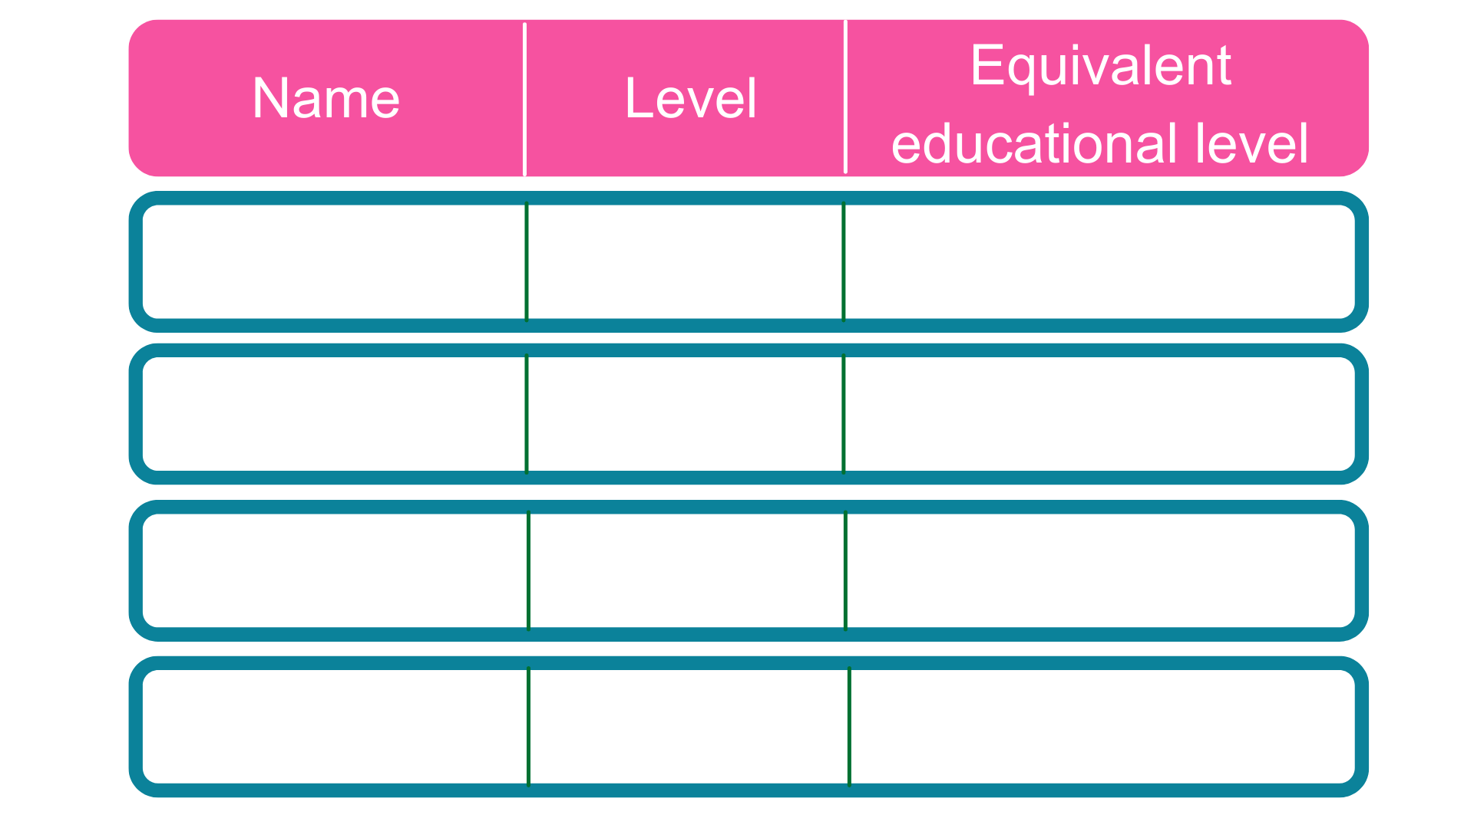
Intermediate
5 GCSE passes at grade A*-C or 4-9
2
2 A Levels / Level 3 diploma / international Baccalaureate
3
Advanced
Higher
Foundation degree and above
4,5,6 & 7
Degree
Bachelor’s or master’s degree
6 & 7
Notes:
Each apprenticeship has a level which will falls into one of the four categories above: Intermediate apprenticeships, Advanced apprenticeships, Higher apprenticeships and degree apprenticeships.
The equivalent educational level column helps to explain what level the qualification at the end of the apprenticeship will be in comparison to more familiar qualifications, like GCSEs and A Levels.
So you can see that if you do a level 3 (advanced) apprenticeship, once you have qualified you’ll have gained a qualification that is equivalent to 2 A Levels, a level 3 diploma or other equivalents, like IB’s or BTECs.
You can now start an intermediate apprenticeship and work all the way up to achieving a degree or masters through the apprenticeship route.
Higher apprenticeships cover all levels from 4 through to 7
Level 4, 5, 6 and 7 are equivalent to a Foundation Degree and above.
A degree apprenticeship contains a Level 6 or 7 Bachelors or Masters degree or equivalent level 6 or level 7 qualification.
The level of apprenticeship you start at will depend on the kind of job that you are applying for.
It’s really important not to be held back by only looking for a particular level e.g. degree apprenticeships. Apprenticeships work a bit differently to school which can be confusing, as lots of students think that they should progress onto the next level, so if you leave after GCSEs you should do a Level 3 and if you finish after A Levels you should go for a degree apprenticeship, but this isn’t always the case.
Depending on the sector and apprenticeship, it may be that you need to start at advanced or higher level and work your way up, or that brilliant apprenticeships are only offered at Level 2 or 3 – for example, Journalism is only offered at Level 3 because that is all the industry requires.
Equally, you may be entering a completely new sector or industry that you haven’t studied or worked in before, and so may need to do a Level 2 or 3 to enter the world of work and get that understanding. Doing a job is completely different to getting a GCSE or A Level and that’s why it can be a bit confusing.
It is very important to keep an open mind so that you can explore all of the opportunities available and have multiple options available when applying.
The duration of your apprenticeship will depend on a number of factors including the delivery model that your employer selects and which level of apprenticeship you are studying.
As a minimum, all apprenticeships must last for a minimum of 12 months.
Higher and Degree apprenticeships are more likely to last for 3 to 5 years. Some degree apprenticeships actually last for 6 years.

Slide 8
Business
Sport
Beauty
Audit
Manager
HR
Coaching
Safety
Trainer
Hairdressing
Barbering
Therapist
Law
Health
Media & Art
Paralegal
Solicitor
Prosecution operations
Nurse
Dental Technician
Veterinary Nurse
Graphic
Fashion
Interior
Notes:
Presenter notes: Please add in some local opportunities to the slide above (a mixture of traditional and non-traditional job titles) to also bring the range of the local offer and facilitate discussions below.
We’re now going to take a look at the different job roles available through an apprenticeship and when we talk about apprenticeships, people often start to think of Plumbing, Electrical and some of the other construction trades. There are many brilliant apprenticeships in these areas, but there are also hundreds of new apprenticeships in exciting areas that you might not know exist.
Suggested interactivity: Ask the audience ‘does anyone know of any apprenticeships that they might expect to see on this list?’
Once completed, click on for the image.
The range of apprenticeship job roles out there is amazing.
This slide gives you an idea of the huge range of apprenticeships available and this is just a taster – there are now over 600+ different apprenticeship standards available, resulting in over 1,500+ different job roles.
You could start an apprenticeship in hundreds of occupational areas. Some will amaze you!
Suggested interactivity: Depending on the time available…
Activity idea: Pick out a few of the job roles to discuss – will depend on the audience.
Activity idea: Can anyone spot an apprenticeship on the screen that has surprised them?
Activity idea: Does anyone know someone who is doing an interesting apprenticeship?

Slide 9
Notes:
Presenter notes: Please update this slide with local companies if you feel that the logos are not representative of your area. Please include small and large organisations.
Equally, the range of employers offering apprenticeships is incredible.
This slide shows you some really familiar logos of big companies in England who all recruit apprentices.
Some of these employers may not be recruiting currently, but you will be able to track their recruitment updates on their websites or social media.
Around 50% of apprenticeships started are with large companies like this, but 50% will be with smaller local companies.
It can be tempting to think that the ‘best’ apprenticeships are just with the big, well-known companies, but many of the smaller employers have absolutely brilliant schemes that enable fast-track career progression for their apprentices, so it’s really important to do your research and not to ignore smaller employers because they can be just as good.
Presenter notes: Please include an example of a local company in the town that you are delivering in. An example of a small local company is…X who employs apprentices in job roles like X and X etc.

Slide 10
Life after Secondary School
T- Levels
What are T- Levels?
Click on the link below to find out.
What are T Levels - YouTube
Vocational

Slide 11
What does Academic education mean?
A Levels only route for some careers like medicine, vet, lawyer or dentist.
3 or 4 subjects
Classroom based
Minimum of 2 years
Main destination: University and Higher-Level Apprenticeships

Slide 12
Where can I study?
Sixth Forms are sometimes attached to secondary schools.
Some sixth forms are attached to colleges or are independent.
Timetables can look very different.

Slide 13
Entry Requirements
5 GCSE’s grade 5 – 9
Specific grades for certain subjects
Varies between Sixth Forms
You could then progress into…
University
College
Degree Apprenticeship
Employment

Slide 14
Would you rather?
Stay at school
Start a new experience
Learn in a classroom
Learn in a workshop
Gain knowledge across a range of subjects
Gain practical, work-based experience
Be assessed through exams and coursework
Be assessed through practical work

Slide 15
Would you rather?
Mostly black?
Mostly green?
The academic route might be best for you!
You might be ready to explore vocational courses!

Slide 16
Key Differences
Academic
Vocational
School Sixth Form
Sixth form College
FE College
Apprenticeships
Sometimes bigger than school
More informal
Offer more options
New friends from different schools
Adult environment
Lots of courses and levels available
Enrichment activities
Minimum of 1 year
Work related qualifications
Paid money while you learn
Learning on the job skills
School Setting
Classroom based
A-Levels
Minimum 2 year
1 T-Level subject area
Classroom based
Hands on, practical learning
80% work experience
20% classroom based
3 or 4 A-Levels subjects
3 or 4 A-Level subjects
1 subject area
1 subject area
You could then go on to University, an Apprenticeship or Employment

Slide 17
Making you decision
TOP TIPS
Book a 1:1 advice and guidance session
Take an online personality quiz to identify your learning style
Talk to friends and family about their careers
What qualifications do you friends and family have?
Do you prefer hands-on or classroom learning?
Do you know what career you would like to go into to?
Look around colleges and their facilities.

Slide 18
Useful websites
Colleges
Gateshead college: Subjects | Gateshead College | Gateshead College
Newcastle college: www.ncl-coll.ac.uk
South Tyneside college: www.stc.ac.uk
Tyne Met college: www.tynemet.ac.uk
Sunderland college:Home - Sunderland College
Sixth forms
Harton Sixth Form:Harton Academy | Sixth Form (harton-tc.co.uk)
St Joseph’s RC VA Sixth form: Homepage - St. Joseph's Catholic Academy (stjosephs.uk.net)
Whitburn C of E Academy: Sixth Form | Whitburn Church of England Academy (whitburncofeacademy.org)
Newcastle Sixth Form College:Home | Newcastle Sixth Form College
Apprenticeships:
National apprenticeship service: https://www.gov.uk/further-education-skills/apprenticeships

