Slide 1
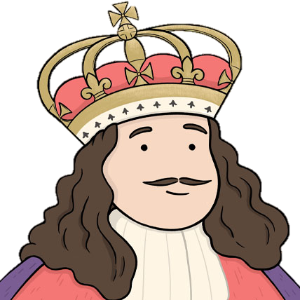
Key people
Andreas Vesalius (1514-64) | Promoted dissection and published an illustrated textbook called ‘The Fabric of the Human Body’ which helped students to learn. His knowledge was a basis for better treatments in the future.
Ambroise Pare (1510-90) | A surgeon in the French army. H used rose oil cream instead of hot oil on wounds, used ligatures rather than cauterising on amputations, discovered gunshot wounds were not poisonous, and created false limbs for wounded soldiers.
William Harvey (1578-1657) | An English doctor, became a doctor to King Charles I in 1632. He challenges Galen's theory about blood; Harvey stated the blood circulated while Galen stated new bloody was constantly made. He challenged ideas such as the four humours.
Thomas Sydenham (1624-1689) | English doctor famous for recognising symptoms of epidemic diseases such as scarlet fever. He dismissed the value of dissection and ignored Harvey’s discovery. Usually used bleeding methods in his work by often promoted letting nature run its course when ill. Hi book ‘Medical Observations’ became a standard textbook.
John Hunter (1728-1793) | Became an army surgeon in 1760, after three years he left and set up a surgical practice, he even trained other doctors including Edward Jenner. Hunter showed a great talent for dissection and anatomical research. He died in debt and poverty in 1793.
Edward Jenner (1749-1823) | An English doctor who initiated the concept of vaccines. In 1796 he cowpox pus and smeared it into a wound of an 8-year-old boy, next Jenner gave him pus from a smallpox victim and the boy did not become ill. May did not believe this was safe and church members opposed it. In 1852 it became compulsory for all newborn babies to receive a vaccine for smallpox.
Health and the People
The beginning of change
Who could treat ordinary people?
Barber surgeons- poorly trained people who could give you a hair cut, perform minor surgery e.g., bloodletting and tooth pulling.
Apothecaries- little or no medical training but sold medicines.
Wise women- treatments often relied on superstition, they did have knowledge of plants and herbs.
Quacks- travelling salesmen who sold medicines and ‘cure-alls’.
What treatments were available for ordinary people?
Bloodletting
Herbal remedies, usually passed down from generation to generation.
Opium from Turkey was used as an anaesthetic.
Lemons and limes used to treat scurvy.
Tobacco from North America was wrongly said to cure many conditions e.g., toothache.
‘Re-birth’ of old ideas. There was an increase and a hunger for learning!
Many became educated in art, music, science, and literature.
Education allowed people to question the church, they could now find their own answers.
The printing press (1451) allows ideas to spread across Europe. Old and new texts could be studied!
The Renaissance
New foods and medicines were brough from the ‘new world’.
New technology such as gunpowder meant soldiers had new types of wounds. Doctors had to find new ways to treat them!
Charles II and treatments
In 1685, Charles II health failed him and one of his doctors, Sir Charles Scarburgh, recorded that the king had collapsed with a ‘disturbance to the brain’.
The king received 58 drugs, and he was purged, bled, blistered and cauterised.
None of these treatments were helping the chronic kidney disease that killed him.
It is also said that the treatments he was given may have brought about kidney failure, for example the poisonous mercury treatments he was given for ‘curing’ syphilis.
The Great Plague (1665)
What caused it? | Many believed it was a punishment from God, miasma, or the alignment of planets. It was caused by fleas living on rats.
How did people try to treat/cure it? | Set fires in streets to keep away the bad air. Animals; chickens, frogs, snakes, and scorpions were used to draw out the poison. Wealthy people moved to the countryside to avoid it. King Charles II moved to Oxford. People realised that most deaths occurred in the poorest and dirtiest parts of the city by, some people were making a connection between dirt and disease. Women searches were paid to examine and record people with plague symptoms. Bodies were thrown into mass plague pits. Pigs, dogs, and cats were not allowed in the streets. Trade between towns with infections stopped and the border to Scotland was closed.
How did it end? | Many believed the Great Fire of London (1666) ended it. The fire destroyed large parts of city, by the poorest areas were outside the city walls. The plague actually declined because the rates developed further resistance to the disease, and so the fleas did not need to move to their human host! After 1666, quarantine laws prevented epidemic diseases coming into the country aboard ships.

Slide 2
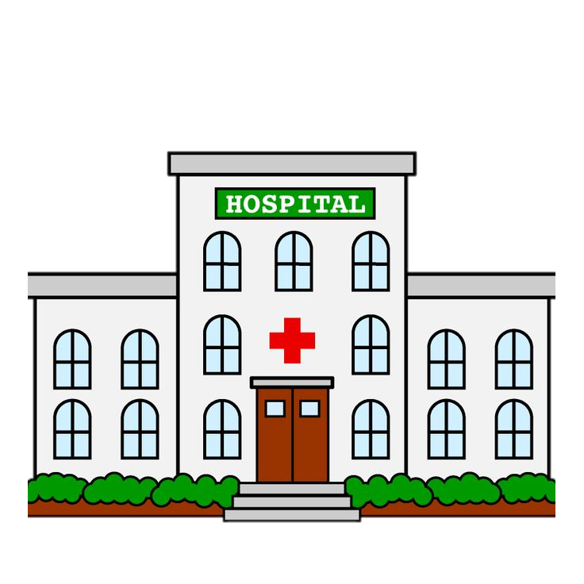
Key Terms
Renaissance ‘re-birth’ of old ideas.
Hypothesis - A suggested idea usually given on limited evidence as a starting point for further investigation.
Quack - Unqualified and often useless doctor.
Vein - Carries mainly oxygen-depleted blood towards the heart.
Artery - Carries oxygenated blood which is pumped from the heart around the body.
Emetic - Substance that makes a patient vomit.
Purgative - Something that makes you go to the toilet.
Enema - Fluid that is injected into the bowel to clean it.
Scurvy - Disease caused by a deficiency of vitamin C, characterised by swollen bleeding gums and the opening of previously healed wounds.
Influenza - The flu, fever, runny nose, sore throat etc.
Typhus - Bacterial disease that is passed on by rats.
Virus - An infection carried by molecules that are too small to be seen.
Vaccination - Giving the body a mild dose of an infection for it to build up an immunity to that particular disease/illness.
Variolation - First method to try and immunise. Rub /insert powdered smallpox scabs into scratches in the skin
18th century hospitals
What happened in hospitals? | Cared for the sick and doctors receiving training were often attached to hospitals. In their final year of training, doctors often gained experience on the wards shadowing a professor. Individual wards for different types of diseases. Doctors attended ordinary people for free, the fees paid by private patients gave the doctors a source of income. Treatments were still largely based on the four humours. Towards the end of the 18th century, hospitals added dispensaries where the poor could obtain medicine free of charge.
Types of hospitals | There were general and specialist types of hospitals. St Luke’s in London (1751) became the second largest hospital for the mentally ill. William Battle advocated that mental illness was no less curable than any other diseases. A new type of hospital was the maternity hospital e.g., Middlesex Hospital for pregnant women in 1747. later became known as the British Hospital for Mothers and Babies in 1749. High mortality rates were issued during this time; severe epidemics in 1720s and 1730s of influenza and typhus hit children particularly. Provisions were made for the poorest babies and children to aid them. The Founding Hospital was set up in 1741 to care for orphaned children. They were given a clean environment, clothing, and a simple education up to 15 years old. It became one of London’s most popular charities.
Hospital boom | Between 1720 and 1750, five new hospitals were built in London and nine more throughout the country. 1800- London’s hospitals were dealing with 20,000 patients a year. In 1400, 470 hospitals in England only had room for ten patients! Attitudes towards illness changed as more Christians thought it was better to help the sick. Fewer people thought illnesses was a punishment for God, instead though it could be dealt with by more scientific approaches.
Who built hospitals? | Hospitals were founded and supported by charitable gifts of private people. For example, Westminster Hospital was founded by a private bank in 1719 and Guy’s Hospital was founded by a merchant called Thomas Guy in 1724. Hospitals could also be built by ‘private subscription’ where local people would club together to pay for the construction and building of the hospital.
How did people deal with pain?
Pain relief was not new, for example, opium was used in the Medieval people to numb pain, however, getting the dosage right was often a problem. Alcohol was also used but this made the heartbeat faster which made it difficult for surgeons.
What were the developments?
Nitrous Oxide
1795 – Thomas Beddoes (physician) and his assistant Humphry Davey experimented inhaling nitrous oxide.
In 1800 Davy published an account describing how the nitrous oxide made him laugh, feel giddy and relaxed. He did not recognise the value in it and it later became a novelty where people would inhale it to have fun!
1844 – Horace Wells, an American dentist saw this anaesthetic as a way of removing teeth in more comfort, his demonstration failed to impress.
Ether
1842-William Clark (American dentist) used it for a tooth extraction.
1842-Crawford Young used it to remove a neck growth from a patient.
1846-William Morton gave a public demonstration of this anaesthetic.
This spread to Europe where Robert Liston, a British surgeon, used it in a leg amputation. It was effective but had its side-effects such as vomiting, difficult to inhale, and highly flammable.
Chloroform
Still a need for safe an effective anaesthetic. There was a breakthrough in 1847 with a Scottish doctor, James Simpson.
It is said that Simpson and his friends were testing a number of substances when someone knocked over the bottle of Chloroform. Simpson’s wife found them sleeping peacefully!
This was a safe and effective anaesthetic.
Overcoming opposition:
By 1850, opposition was lessening.
Queen Victoria had suffered many difficult labours and in 1853, Victoria gave birth to Prince Leopold using chloroform. She wrote ‘the effect was soothing, quieting and delightful beyond measure’.
For the patient, the conquest of pain was a major step forward but it did not revolutionise surgery. Infection was the next issue to be tackled.
Practice questions:
Explain the significance of Edward Jenner’s work with Vaccination. (8 marks)
Explain two ways in which treatments in the Middle Ages and treatments in the seventeenth and eighteenth centuries were similar. (8 marks)
Was the printing press the main feature of medicine during the Renaissance? (16 marks plus 4 SPaG marks)

