Slide 1
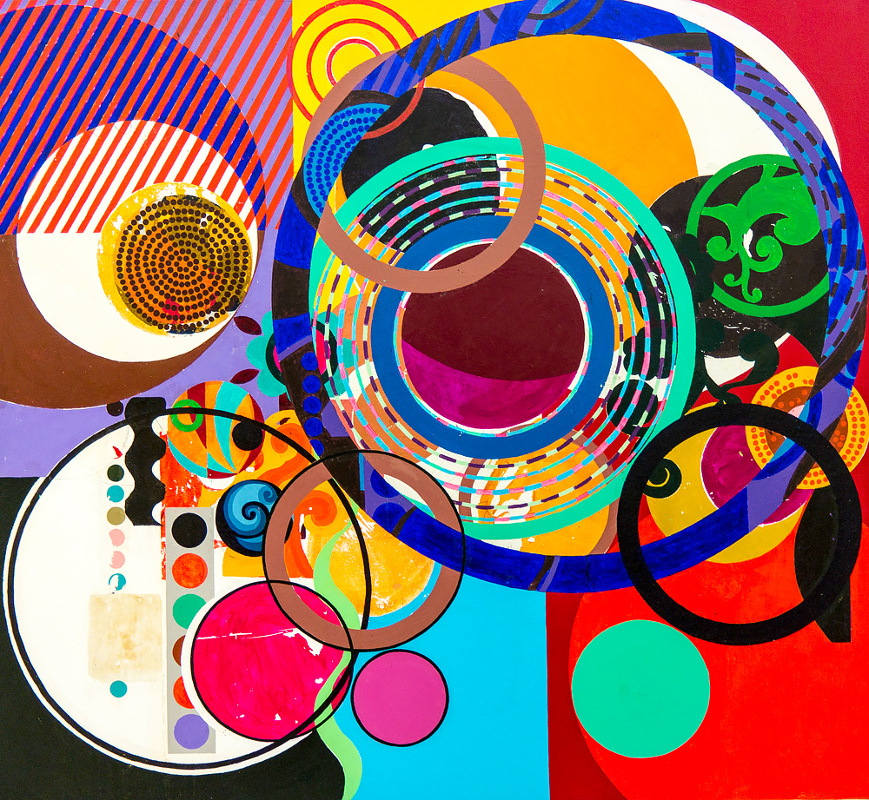
Y7 SOL – be brave with colour
Aim – pupils will study the artwork by Beatriz Milhazes. They will explore geometric and abstract influences found in her work to help generate ideas for own final piece. Pupils will explore mark making techniques, collage and complementary colours. Samples will be refined in to shapes to reflect the artists work and presented on an A4 canvas.
project context
Artists research – Pupils will watch a YouTube video about Beatriz Milhazes and be shown a PP. They will use their knowledge and understanding to answer questions in the booklet and create a research page.
Sewing skills – pupils will explore the basics of using a sewing machine. They will complete a machine practice challenge to test their understanding. Hand sewing is also taught, to create a Suffolk puff and add embellishments.
Material experiments – bubble wrap, Suffolk puffs, stencilling, powdered paints, collage, combing, masking tape, fabric pens and polyblock printing will all be explored to create a wide range of samples. These will be transformed in to geometric shapes and presented on an A4 canvas. They must refer to the artists work to help with the colours and layout.
Planning & designing – pupils will create a minimum of 3 ideas based on the research they have already gathered. They will select their favourite design and further develop, explore materials and processes to show the best outcome. This will then be made in to the final wall hanging.
Resources
paper, fabric, stencils, acrylic paints, mark making tools, canvas, fabric & paper scissors, pencils, felt tips, colouring pencils, powdered paint, ink, fabric oil pastels, fabric glue, self adhesive embellishments, sewing machine, needle, pins, thread, coloured cardboard, circle templates, sponge, paintbrushes, water pots, paper towels, rollers, bubble wrap, polyblock, printing ink.

Slide 2
Y7 SOL – be brave with colour
Curriculum links
Literacy – keywords enlarged, keywords explained in small sentences, pupils to read out and explain their understanding, spelling tests, following instructions on the IWB, write up about experiments completed.
Numeracy – use of symmetry, measuring out fabric, calculating marks to create an equal pattern.
Assessment - Pupils work is marked using ‘WIN’. Knowledge and understanding is assessed through Q & A, peer assessment, quizzes, 1-2-1 discussion, weekly reviews, written evaluations.
Homework - is set every other week. It will involve pupils further investigating the theme or chosen artists, designing a poster to reflect health and safety rules and finishing off any incomplete work from the lesson.
SMSC/British Values
Spiritual – look at the influences of Milhazes work - Brazil. Experiment with various techniques, exploring mixed media & independent thinking.
Moral – discussions about why art is important and how it enhances life. Respecting nature and the importance of reserving its natural habitat.
Social – respect each others ideas and opinions when talking about Milhazes artwork, including the work of others in the class.
Cultural – reflect on the ways in which cultures are represented in artwork. Understand that all cultures have expression, purpose and artistic worth.
British Values – take in to account the views of others, follow class rules – safe practice, understand the consequences if rules are not followed, make own choices, talk about artwork from different cultures, faiths & cultures from around the world, review each others work respectfully, help & advise others.
SEN/EAL
Sentence starters.
Keyword descriptors.
1-2-1
Visual examples.
Repartition of tasks/skills.
Pre cut materials.
respond to students diverse learning needs.
Keywords - primary, secondary, complimentary, collage, layering, botanical, layering, Brazil, mark making, bold colour, textural, contrast, Suffolk puff, mixed media, tonal, sewing, embellishments, experiment, stencils, acrylic.

