Slide 1
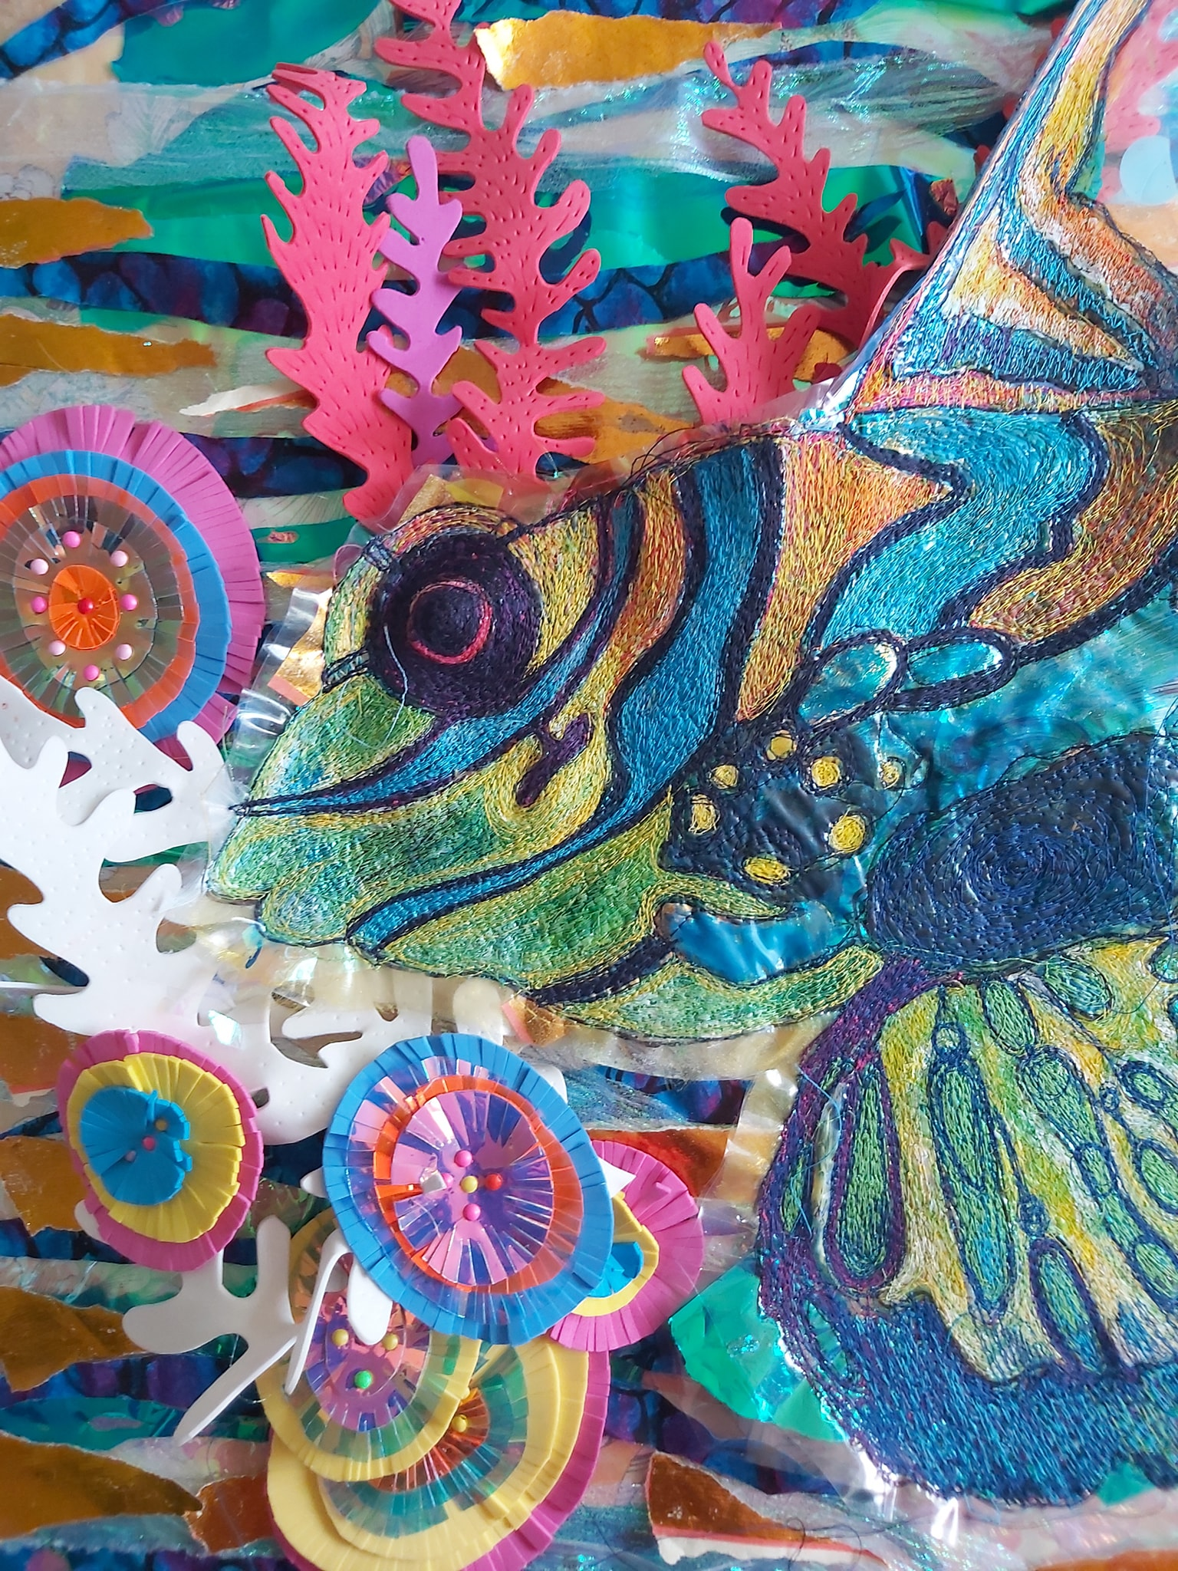
Y9 SOL – Recycled 3D Fish
Aim – pupils will explore recycling and look at the impact it has on our environment. They will look at the changing world of manufacturing clothing good & bad points. Pupil will use recycled products to make their 3D fabric fish – plastic bags, fruit netting, old clothes, etc. Other techniques that should be included on the final fish are tie dye, machine & hand sewing, heat press, collage and painting. The fish will be stuffed with wadding to create the 3D effect.
project context
Recycling – pupils will use their knowledge of recycling to inform the different types of materials that could be used as part of their 3D fish.
Tie Dye – pupils will use the tie dye technique to transform a piece of cotton. They will choose either bulls eye, fan or triangle folding methods. This will form the first side of their fish.
Collage – using different patterns, colours, textures of materials, pupils will layer their materials. They can be fused together using the heat press & stitch on using the sewing machine.
Sewing skills – pupils are encouraged to show both machine & hand stitching. Embellishments will had that sparkle that represents the reflects seen on fish in water. Sequins and beads would work best.
Painting – pupils will use stencils, bubble wrap to create different patterns & texture onto their fabric. 3D paints will be used as a finishing touch to outline.
Planning & designing – pupils will take inspiration from textile artists Kate Tume & Nikki Parmenter when designing their 3D fish. Pupils must take in to consideration the size of the fins/tails and colour combinations.
Resources
Cotton, fabric paint, glue, paintbrushes, plastic gloves, aprons, tie dye powder, double sided tape, elastic bands, scissors, water pots, fabric, iron, heat press, needle, sewing machine, pins, thread, coloured pencils, stencils, embellishments, fine liners, quick unpick, 3D paint.

Slide 2
Y9 SOL – Recycled 3D Fish
Curriculum links
Literacy – keywords displayed on the wall and in booklet. Pupils read out information & written descriptions – sharing of spellings.
Numeracy – measuring of fabric. Scaling up of fish design (A3). Measurements of tie dye –water to powder. Timing on heat press. Mark 1cm seam allowance.
Assessment - Pupils work is marked using ‘WIN’. Knowledge and understanding is assessed through Q & A, peer assessment, quizzes, 1-2-1 discussion, weekly reviews, written evaluations.
Homework - is set every other week. It will involve pupils further investigating the theme or chosen artists, completing work that hasn’t been finished in class, further development of embellishment techniques.
SMSC/British Values
Spiritual – explore work by Kate Tume & Nikki Parmenter, research meanings & feelings behind their textile pieces and links to recycling.
Moral – look, discuss & evaluate artwork that shows different aspects of fish designs & recycling. Discuss & share ideas about what message is being given.
Social – look at current environmental issues. What are we doing to ensure a sustainable future. Discuss plastic straws and the impact on marine life.
Cultural – work links with contextual themes that encompass cultures, civilization, beliefs & religions from around the world.
British Values - take in to account the views of others, follow class rules – safe practice, understand the consequences if rules are not followed, make own choices, talk about artwork from different faiths & cultures from around the world, review each others work respectfully, help & advise others.
SEN/EAL
Sentence starters.
Keyword descriptors.
1-2-1
Visual examples
Digital research sheets
Revisit, review, retrieve
New skills in small steps
Group work
Keywords – tie dye, contrast, graduate, bulls eye, cotton, iridescent, reflective, textural, colourful, Kate Tume, Nikki Parmenter, three dimensional, recycle, environment, collage, techniques, sewing machine, stitch, threads, embroidery, pinking shears, wadding.

