Slide 1
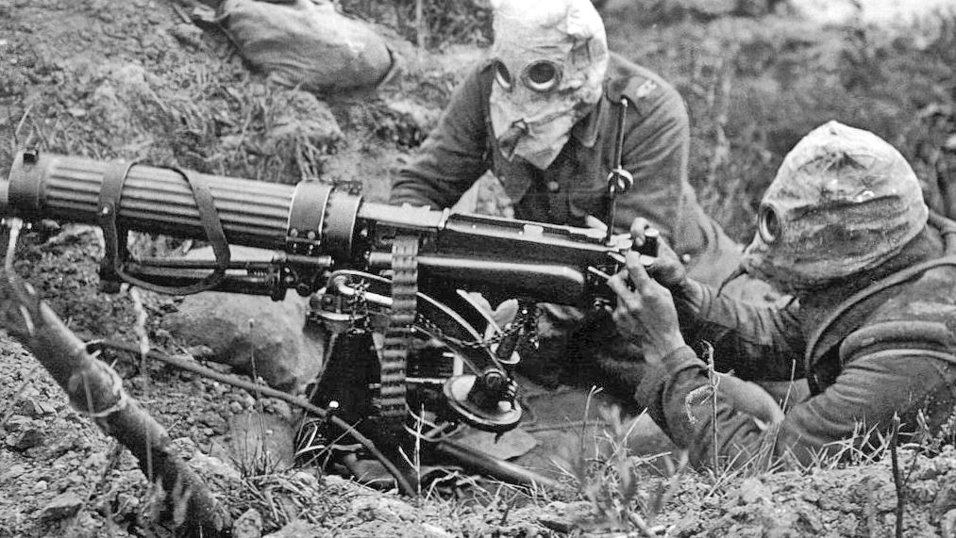
Year 9 Revision
Understanding the Modern world: Conflict and Cooperation

Slide 2
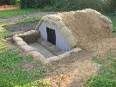
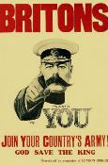
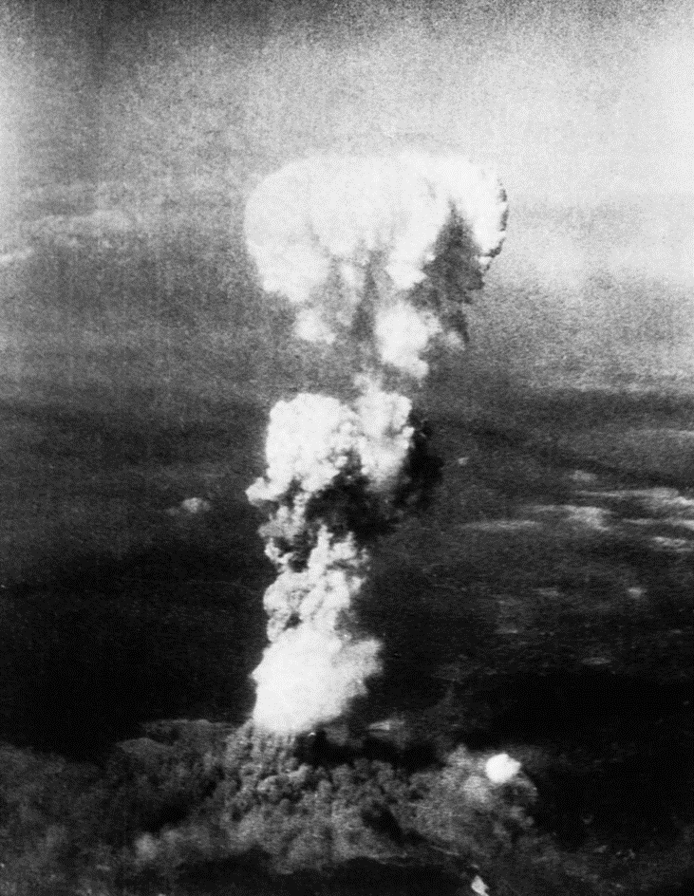
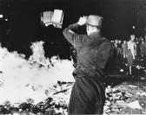
Year 9 - Understanding the Modern world: Conflict and Cooperation
How did life change for people during WW1?
Why did people turn to totalitarian governments and what was life like for the people living in them?
How was the Holocaust allowed to happen?
What were the causes of the second world war?
How did WW2 differ to WW2?
How far was the 20th Century, America’s Century/

Slide 3
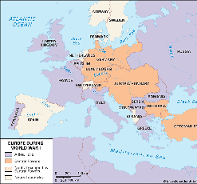
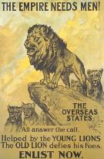
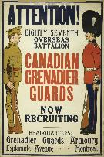
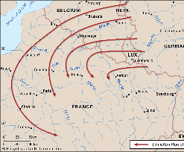
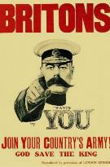
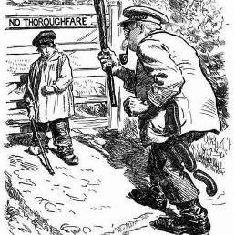
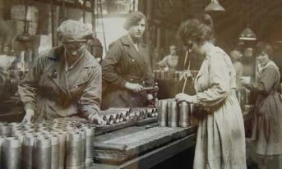
Britain and the First World War
Recruitment
BEF | British expeditionary force.
Pals battalions | Entire units made up of people from the same local areas
Volunteers | From August 1914 a large volunteer army was needed to boost Britain’s forces to around 2 million.
Conscription | In 1916 all men between 18 and 41 were called up to fight.
Conscientious objectors | These were people who disagreed with fighting due to moral religious or political grounds.
Canary girls | Nickname given to the women who worked in the munitions factories.
WLA | The women's land army
Causes of the First World War
Imperialism | A policy of extending a country's power and influence through colonization, use of military force, or other means.
Nationalism | Identification with one's own nation and support for its interests, especially to the exclusion or detriment of the interests of other nations.
Militarism | The belief that a country should maintain a strong military capability and be prepared to use it aggressively to defend or promote national interests.
Alliances | A union or association formed for mutual benefit, especially between countries or organizations.
Archduke Franz Ferdinand | Heir to the throne of Austria-Hungary who was assassinated in Sarajevo in June 194
Gavrilo Princip | Member of the Black Hand gang who assassinated Franz Ferdinand
Kaiser Wilhelm | German Emperor who gave the Austro-Hungarians a blank cheque to respond to the Serbians
Ultimatums | 10 demands that Serbia had to meet or they would be attacked by Austria-Hungary
Schlieffen Plan | German war plan designed to take France out of the war so they didn't have to fight on two fronts.

Slide 4
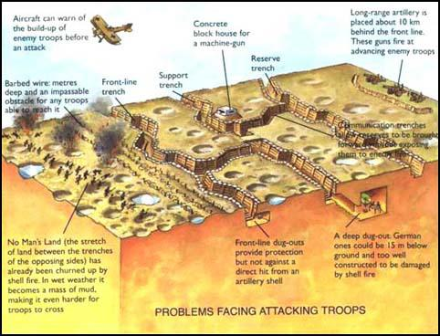
Trench Warfare
Trench Foot | Fungal infection of the feet which came about from having little chance to keep feet clean and dry.
Shell Shock | PTSD. Men during WW1 were labelled cowards and often shot for cowardice.
Blighty | Name for Britain. To give yourself a blighty was to purposely injure yourself to get sent home.
Bully beef | Corned beef. This was a staple of the meals on the front line.
Battle of the Somme
1. Lasted 5 months. First use of the tank in battle by the British.
2. The first day was known as the worst day in British military history with 56,000 casualties.
3. In total there were over 2 million casualties.
4. It was the first battle of Britain’s Volunteer army
5. Whether it was a success or failure is argued about to this day. Many blame General Haig for the large amount of deaths and this battle led to the myth of the army being ‘Lions led by donkeys’.
The Homefront
DORA | Defence of the realm act which controlled all aspects of peoples lives. | U-Boat | German Submarines. They sank ships of the coast and in the Atlantic in order to starve Britain into submission
Rationing | Voluntary in 1917, compulsory in 1918. Only a few products were included. | Censorship | The newspapers and books were censored to only report on positive features of the war.
Zeppelin Airship | Giant balloon that flew across from Germany and dropped bombs on Britain. | Propaganda | This was used to keep peoples spirit high during this ‘Total war.

Slide 5
Weimar Germany 1919-1933
The New Democratic Government was established after the Kaiser fled to the Netherlands. It’s first job was to ask for an armistice and then sign the treaty of Versailles. Germany was in so much turmoil it had to meet in the town of Weimar in Bavaria. Not the best of starts.
How did the Nazis become more popular in the late 20’s and early 30’s?
Weimar Republic timeline
1919 | Left wing Spartacists take over Berlin and are defeated for the Weimar government be the Army supported by ex-service men known as the Free Corps. The Weimar government are forced into signing the Treaty of Versailles. This leads to many people believing that the Weimar government has betrayed the German people. Hitler Joined the German Workers party, later the National Socialist German Workers Party (NSDAP).
1920 | The Kapp Putsch sees right wing nationalists trying to take Berlin. The Workers support the new government by going on strike. Hitler becomes leader of the Nazi Party’s propaganda and speeches. They had 2000 members.
1923 | Hyperinflation means money becomes worthless and people have to barter to buy goods. Many people starve as a result of the government’s policies. Nazi’s have 20000 members and feel in a position to launch an attempt to overthrow the government with the Munich Putsch. It is put down by the army who support the government.
1924 | Hyperinflation is brought under control with a new currency and loans from the USA. Hitler spends 9 months in prison and writes his book Mein Kampf. He realises that he will need to get into power through legal methods (elected) 3% of votes are for the Nazis in 1924 elections and they win 32 seats
1926 | Germany joins the league of nations and is therefore accepted by other countries to be a player on the world stage again.
1928 | Weimar art and culture are flourishing; a night out in Berlin was meant to be one of the greatest experiences in the world. The Nazis lose popularity and gain only 12 seats in the Elections.
Organisation of the Party
Nazis would take control legally.
Effective Speaker
Hitler could command an audience when he made a speech
Effects of the Great Depression
6 Million unemployed
Fear of Communism
Middle-class feared losing their wealth
Disillusionment with Weimar government
Democracy didn’t appear to be working.

Slide 6
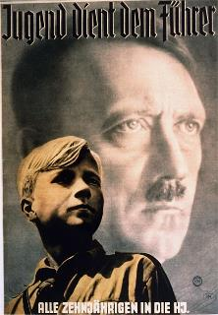
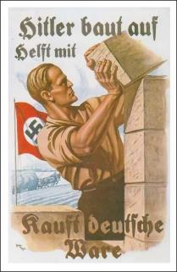
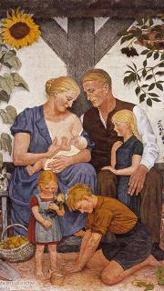
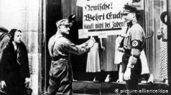
Life in Nazi Germany 1939-1939
Keyword | Definitions
Propaganda | Information, ideas, or rumours deliberately spread widely to help or harm a person, group, movement, institution, nation, etc.
Censorship | Restricting what is seen in books, plays, news reports, motion pictures, radio and television programs, letters, cablegrams, etc., for the purpose of keeping information out of the publics view on moral, political, military, or other grounds.
SA | A paramilitary organization whose methods of violent intimidation played a key role in Adolf Hitler's rise to power. Known as Brown Shirts.
SS | Originally established as Adolf Hitler's personal bodyguard unit. It would later become the elite guard of the Nazi Reich. Known as Black Shirts.
Gestapo | The official secret police of Nazi Germany
Indoctrination | The process of teaching a person or group to accept a set of beliefs without question.
Goebbels | The process of teaching a person or group to accept a set of beliefs uncritically.
The Young | Workers | Women
School Boys were taught to become good Nazis Lessons focused on military skills Girls were taught how to run a home and how to produce perfect Nazi children with Aryan husbands. Nazi Ideology was in everything, and anti-Jewish info ran throughout the curriculum. Hitler Youth organisations meant boys and girls continued their indoctrination after school. | Hitler offered the 6 million unemployed ‘Bread and Work’. National Labour Service was set up to get young men to work. Mass building programmes. ‘Strength Through Joy’ provided cheap holidays and other benefits for workers. | Raising a family was key. Women were encouraged to stay at home and were awarded medals for how many children they had. Loans were given out for marriages and didn’t need to be paid back if you had children. Work and higher education were frowned upon and limited.

Slide 7
Peace Making after WW1​
World War I started in 1914 and fighting ended with the armistice on November 11th, 1918.​
The winners, Britain, France and the USA – known as the Allies, then agreed to a peace treaty with the losers.
Knowledge Organiser: Causes of World War II
Hitler was to blame
Hitler vowed to overturn Versailles and take Lebensraum (living space). This was the basis of his foreign policy and meant he would have to invade countries. This could start a war. He also vowed to make Germany strong again. and destroy Communism.
Terms of the Treaty of Versailles
Economic:
Reparations for damage caused during war (£6.6 billion).
War Guilt Clause (Article 231) - accept blame.
Loss of overseas territories (ports for trading).
Military:
Army restricted to 100,000 men.
No modern weapons i.e. tanks, aircraft, U-boats.
Limit of 6 battleships
Territory:
Alsace-Lorraine returned to France permanently.
Demilitarisation of the Rhineland
Saar, which was rich in coal, iron and steel was given to France for 15 years.
The Treaty of Versailles
Peace treaty created by the Big Three.
Signed on 28th June 1919 at the Paris Peace Conference at Versailles Palace.
Only dealt with Germany, who was not invited to the peace negotiations.
The failure of the League of Nations
Its structure and organisation made the League weak. Its lack of army meant it could not force nations to comply. Membership - countries could leave, the USA never joined and USSR and Germany were not allowed to join at first.
Aims of the Big Three:
David Lloyd George, Prime Minister of Great Britain wanted to ‘make Germany pay’ because he knew that was what the British people wanted to hear. He wanted justice but not revenge.
Georges Clemenceau, the Prime Minister of France wanted revenge and to punish the Germans for what they had done.
Woodrow Wilson, the president of America wanted to make the world safe. He wanted to end war and establish lasting peace.
League of Nations
The idea of American President Woodrow Wilson to bring the world together in peace. It would be a group of countries that would work together to solve world problems.
Aims
To stop war from breaking out again
To encourage disarmament
To improve working conditions
To tackle deadly diseases
The Great Depression
The Wall Street Crash caused a decline in international cooperation. Desperate people turned to extremist parties and Leaders including Hitler and Mussolini. The League also could not afford to put effective economic sanctions on aggressors.
Keyword | Definition
Armistice | An agreement to stop fighting
Allies | A group of individuals/countries which work together
Self-determination | A country's right to make own decisions
Reparations | Compensation for war damage paid by Germany
Appeasement
The policy of appeasement aimed to prevent another war. Chamberlain believed this could be achieved through negotiation with Hitler and agreeing to his demands if they were reasonable. It failed to prevent war.

Slide 8
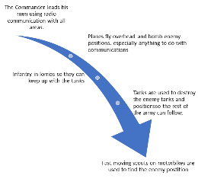
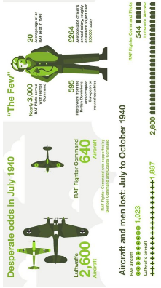
WW2 – Main Events
Blitzkrieg
Dunkirk
Timeline of WW2
1st Sept 1939 | Germany Invades Poland
3rd Sept 1939 | Britain declares war on Germany
10th May 1940 | The Germans launched an attack on France through Holland and Belgium.
April 1940 | Germany launches attacks on Denmark and Norway eventually occupying both.
26th May - 4th June 1940 | Evacuation of Dunkirk. British soldiers leave France returning to the UK having been trapped at the coast near Dunkirk.
22 June 1940 | The fall of France. France surrenders to the Nazis.
Success | Failure
340,000 allied troops rescued from the beaches They had hoped to rescue 50,000 Navy worked hard 27,000 were rescued by civilian boats | 68,000 British were killed or wounded All the equipment were left in France. The Fall of France happened 3 weeks after the evacuation of Dunkirk.
D-Day 6th June 1944
Battle of Britain
Planning
Photograph the coast.
Pretend army.
Spies give Nazi’s the wrong details of the landing.
Floating harbours.
Attack: Gold, Juno, Sword Beaches.
150,000 soldiers landed, some 4,400 died.
1942 | Battle of El Alamein begins the push to get rid of German forces in North Africa. Intense allied bombing of civilians in Germany begins.
1943 | Battle of Atlantic is effectively won when codebreakers work out how to find German submarines. Invasion of Italy Germany begins its retreat from Russia
1944 | D-Day, the allies land in France which is liberated by the end of the year. Soviet union push Germany back into Poland.
1945 | Huge bombing of Germany. 100,000 die in bombing raids in Dresden. April: Hitler commits suicide. May 8: Germany Surrenders.
Why did the British win the Battle of Britain?
The Atom Bomb
Hiroshima 6 August 76,000 casualties Nagasaki 9th August 50,000 casualties
Why drop the Bomb?
Save allies from dying
Justify spending so much
Revenge on Japan
Show USSR who was boss.
But should they have dropped it?
Spitfire and Hurricane
Radar
The many

Slide 9
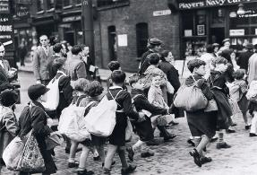
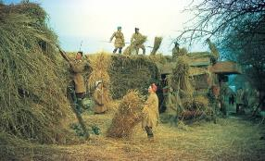
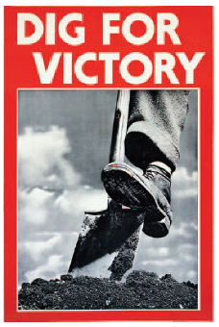
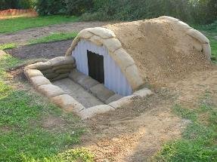
WW2 - Homefront
Blitz
After the battle of Britain the Germans turned to bombing industrial areas to destroy morale. 1940-41 was known as the Blitz. 44,000 died in London.
Morrison and Anderson shelters were built and people used the underground.
Black out and air raid sirens were essential.
The government encouraged the idea of the blitz spirit, people just getting on with everyday life.
In 1944 the Germans launched V1 and V2 rockets towards Britain from mainland Europe.
Shortages
Rationing
Make do and Mend
Pig Clubs
Fuel Shortages
Black market
Conscription was introduced for all men except those in reserved occupations like ship building and coal mining.
Women were conscripted into the labour service in 1941. Hours were long but millions more worked than did in the first world war
Women's land army employed 2 million
The Empire provided many men to fight. 16,000 joined from the British Caribbean
The Indian Army proved very useful to British forces wherever it served. Recruitment was entirely voluntary and 2.5 million served in the in the Second World War.
Recruitment
In September 1939, around 1.5 million people, mainly school children, were moved from areas at high risk of bombing: big cities, industrial areas, ports and villages and towns near to airfields.
Evacuees were usually separated from their families. Some evacuee children were badly treated or exploited.
Evacuation saved many lives, but it had other important effects. It freed up many mothers to take on vital war work.
Many comfortable people outside the cities learnt how bad conditions in the cities were. After the war, they voted for politicians who wanted to stamp out poverty.
Evacuation

Slide 10
America’s Century
Timeline of Events 1945-2001 | Timeline of Events 1945-2001
1945 | ‘A’-Bomb dropped on Hiroshima + Nagasaki.
1948 | Start of the Berlin Blockade – ended in 1949
1949 | USSR exploded her first ‘A’-bomb; China becomes communist
1950-53 | Korean War
1956 | Hungary revolts against USSR and communism; they are crushed
1957 | Sputnik launched by the USSR. This is the first man made satellite.
1961 | Berlin Wall built cutting of the capitalist west Berlin from west Germany
1962 | Cuban Missile Crisis begins when the USSR starts placing missiles on Cuba.
1965 -73 | USA openly involved in Vietnam to stop the spread of communism.
1968 | USSR invades Czechoslovakia who have begun reforming their Communist government.
1969 | Apollo 11 takes first men to the Moon
1979 | USSR invaded Afghanistan the USA supplies weapons and aid to the Afghans.
1989 | Fall of the Berlin wall
1991 | Collapse of the Soviet Union
2001 | The terrorist attack on the World Trade Centre
Key Term | Definition
Communism | A theory or system of social organization in which all property is owned by the community and each person contributes and receives according to their ability and needs.
Capitalism | an economic and political system in which a country's trade and industry are controlled by private owners for profit, rather than by the state.
Cold War | a state of political hostility between countries characterized by threats, propaganda, and other measures short of open warfare.
Stalin | Leader of the Soviet Union at the outbreak of the Cold War (1922-53)
Truman | Leader of the USA at the outbreak of the Cold War (1945-52)
Domino theory | The idea that if one country falls to Communism that this will continue like falling dominoes until eventually the USA will fall.
Space Race | The competition between the USSR and USA to show who had technological superiority by getting humans into space and ultimately the moon.
Vietcong | Guerrilla fighters of the North Vietnamese.
Guerrilla Tactics | Fighters who blend in and don’t follow traditional army methods. They don’t wear uniform and use improvised devices.
Terrorism | The unlawful use of violence and intimidation, especially against civilians, in the pursuit of political aims.

