Slide 1
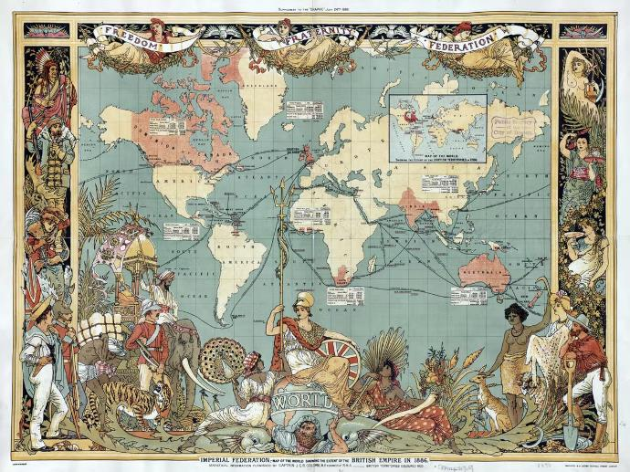
Year 8 Revision
Britain’ s place in the World - How did Britain help shape the world we live in and how did the world shape Britain?

Slide 2
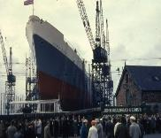
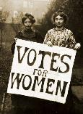
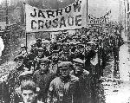
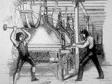
Year 8 - Britain’ s place in the World. How did Britain help shape the world we live in and how did the world shape Britain?
Was the British Empire a force for good?
How far have the experiences of Black British people changed over time?
How did life change for people during the industrial revolution?
How far was the 19th Century an age of reform?
How ‘modern’ is Modern Britain?
How did the Economy of the North east change during the post war years?

Slide 3
Why did the British Build and Empire?
Why build an Empire?
Money
Other parts of the world had natural resources tha the British desired. Tea, Gold, Cotton, Tobacco, Sugar to name but a few. If we controlled the area it came from we could make lot of money
Exploration
In the 16th and 17th century lots of the world were un known to the Europeans. This encouraged people like Walter Raleigh and Francis Drake to go exploring. They could make their name and fortune from this.
War
Other countries also wanted to build empires and therefore wars happened. If Britain won the war it allowed more land to be taken into their empire. E.g. Canada and India off the French.
Settlers
Many people wanted to leave Britain and settle elsewhere. In the 1600’s puritans went to America to avoid religious persecution.
Other
Areas on the African coast became part of the empire due to their role in the transportation of Slaves. Australia became a prison colony. Religious organisations wanted to convert people
The Empire Builder | What was their role?
Elizabeth I | Encouraged exploration and developed England's sea power.
Walter Raleigh | Set up the first colony of Roanoke in North America.
Francis Drake | First Englishman to sail around the world.
The East India Company | Set up trading bases in India and spread to control most of the country by 1857
James Cook | Explorer if the 1700’s who sailed the pacific ocean and landed in Australian the 1770’s
Clive of India | Soldier who was instrumental in wars against local Indian leaders
David Livingstone | Missionary who travelled into the interior of Africa to spread Christianity.
Queen Victoria | Empress of India from 1857 and Queen of Canada, Australia, New Zealand to name but a few.
Cecil Rhodes | Set up the colony of Rhodesia. Nugh in the mining industry of South Africa. He wanted to be able to build a train line through British territory from South Africa to Egypt.

Slide 4
The British Empire: India, Australia and the Scramble For Africa
India
Date | Event
Pre 1612 | By 1500 India was a mainly Hindu country ran by a Muslim minority called the Mughals. It was rich in many resources and spices to trade. The Mughals buildings were huge and impressive (Taj Mahal).
1612- 1757 | East India Company and the Battle of Plassey The East India company were one of many European companies that set up trading bases on the coast of India. Its first entry into India was Surat in 1612. Many Local Indians helped the East India company by serving in their army. In 1757 the French helped a Local Indian prince attack the East India company. The British led by Robert Clive (Clive of India) beat the larger forces. This led to the French being pushed out and Britain expanding further into India.
1857-8 | First Indian War of Independence (known in Britain ad the Indian mutiny). This event saw the Sepoys (locals in the British Army) rebel. It was eventually defeated by the British and India became governed from Britain.
1947 | Partition of India After years of campaign to be independent from the likes of Ghandi, India is given its independence. It is split along religious lines into India and Pakistan. This leads to violence and the murder of many Hindus, Muslims and Sikhs. Tension continues to this day.
Australia
Date | Event
40,000 BC | The first Aborigines arrive from south-east Asia By 20,000 BC they have spread throughout the mainland and Tasmania.
1770 | Arrival of Cook at Botany Bay Captain James cook arrives on HMS Endeavour. He claims it for Britain and names it New South Wales.
1785 | Orders in council Australia was to be colonized. What is now Sydney was settled in 1788 and people began to arrive. Those who arrived were mainly convicts sent for petty crimes.
1850 | Discovery of gold This event saw more people heading to Australia in order to make their fortune.
1901 | Australia becomes a Dominion Australia is given semi independent status from Britain
1967 | Australian Referendum This eventually agreed to count aboriginal people in Census’s and to allow the government pass laws to better their plight.
Africa
Date | Event
Pre 1500 | Great African Empires Africa is huge and many different areas flourished at different time. The north had the Egyptians, Romans and Muslim Caliphates. There were great Empires in Mali, Benin and Zimbabwe. Great centres of Literature and art were everywhere.
1500 - 1850 | European slave trade Europeans traded metal goods for people and took them to the Americas as slaves. This led to European trading ports on the coast e.g. Britain on the gold coast.
1884 | The Berlin Conference Triggered by the settlement of the Congo by Belgium the conference set the rules for how Europe could safely carve up Africa without going to war.
1945-80 | Independence After the second world war the countries of Africa began to gain their Independence from European powers. Some through violent rebellion.

Slide 5
The British Empire: Was its legacy positive or negative?
Infrastructure Better roads and railways.
Language
The English language spread, allowing people to communicate.
Culture
People brought culture with them making Britain's more diverse
Culture
Original colonies cultures were banned or forgotten.
Economy
Local economies collapsed as profits went back to Britain.
War
Empire resulted in wars of conquest. Local troops were used by Britain to fight for them.
Positive
Negative
Democracy
Britain took it with them and helped build their own
Religion
Christianity was sent and stopped the practice of other religions
The Commonwealth Old colonies working together
Law and Order Improved legal systems of colonies
Infrastructure Improved children's education with schools
Disease
British diseases were unfamiliar to the colonies and many people died.
Theft
Britain stole resources and land from their colonies and left them poor and on the brink of extinction.
Slavery
African slaves were taken to be sold in the colonies.

Slide 6
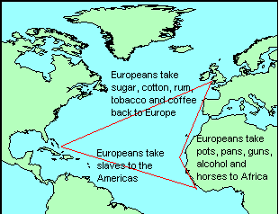
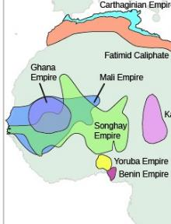
Black and British
Key Word | Definition
Enslavement | The action of making someone a slave; subjugation.
Slave trade triangle | See picture. The journey taken by slave traders
Middle passage | The second leg on the slave trade triangle that saw the transportation of people from Africa to the Americas
Slave Auction | The Process of selling slaves in the Caribbean
Plantation | Large farm that grew sugar tobacco and cotton
Overseer | Worker on the plantation whose job it was to ensure that slaves worked.
Abolition | The movement to ban slavery across the world
William Wilberforce | MP who brought the abolition of the slave trade to parliament which was passed in 1807
Thomas Clarkson | Campaigner and one of the founders of the abolition society
Olaudah Equiano | Ex-slave who bought his freedom, travelled to Britain and campaigned against slavery
Toussaint L’Overture | Ex slave who led a rebellion and became leader of the first free black country outside of Africa.
Empire Windrush | Ship which transported black immigrants from Jamaica in the 1940’s.
Event | Date
Mansa Musa Emperor of Mali | 1280-1337
John Blanke plays trumpet at Henry VIII tournament | 1511
Abolition of the slave trade | 1807
Abolition of Slavery | 1833
The Arrival of the Empire Windrush | 1948
Key Word | Definition
Oba | Emperor of the Benin Empire
Timbuktu | Major centre of religion and learning in the Mali Empire
Mansa Musa | Emperor of the Malian Kingdom who was the richest man the world has ever known
Gold, Salt, Slaves | Some of the things that made African Nations wealthy
West African Empires Pre 1500

Slide 7
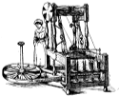
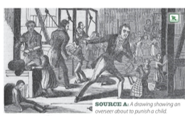
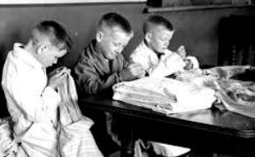
Knowledge Organiser: Industrial Revolution
Causes of Industrial Revolution
New machines such as 'spinning frames' were much faster than working by hand.
Steam powered factories replaced working from home and could run 24/7.
Canals and Steam engines allowed easier transport of products across the country.
Mines and Factories
Children began work as young as 5.
Shifts were 16+ hours long with few breaks.
Pay was low, as the new machines meant there was no need for skilled workers.
The conditions and air were dirty, causing health problems for workers.
Overseers in factories beat those that didn't work hard enough.
Workers could be killed by machines in the factories or collapses and explosions in the mines.
Workers reforms
The 1833 Factory act said no children under 9 could work in factories
The 1842 Mine Act said no women, or children under 10, should work down a mine.
The 1847 10 Hour Act said no women or children should work more than 10 hours a day.
The 1871 trade Union Act allowed workers to join together to negotiate for better pay and conditions. If they were unhappy, they could go on strike (refuse to go to work).
Were Industrial Schools bad?
Yes | No
Children had to do hard labour as well as lessons. | Children were given somewhere to stay and food to eat.
They would be punished harshly for misbehaving. | There was a reduction in crime and begging on the streets.
They were treated like criminals, just for being poor. | They learned basics such as reading and writing.

Slide 8
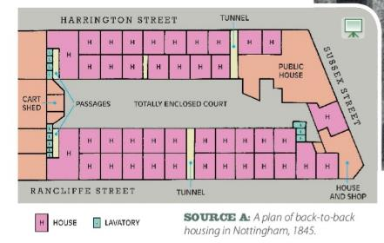
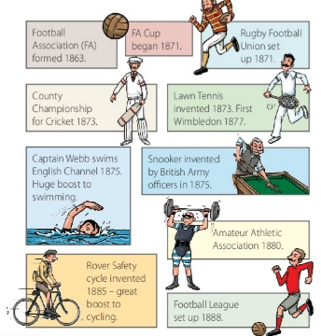
Knowledge Organiser: Industrial Revolution
Industrial Towns
The population rose from 7 million in 1750, to 37 million in 1900.
The new factories pulled people in from the countryside to towns and cities.
Houses were crammed together, entire families shared one room.
Water from the pumps and river was polluted by waste.
The streets weren't regularly cleaned; there was waste and rats.
The air was heavily polluted from burning coal, causing illness.
Public Health Reforms
In 1842 Edwin Chadwick reported that poor conditions in towns were making people ill.
In 1854 John Snow proved that dirty water was spreading cholera.
In 1858 Joseph Bazalgette built the first underground sewers.
In 1861 Louis Pasteur proved that bacteria causes disease.
In 1875 the Public Health Act made it compulsory for towns to provide clean water, sewers and clean streets.
Leisure Time
By 1850 workers had more free time on evenings and weekends.
In 1851 the first 'Music Halls' opened to provide cheap entertainment.
The Rover Safety Bicycle was invented in 1885 and made cycling popular.
In the 1840s a man called Thomas Cook began organising railway trips to seaside towns.
The first professional football club, Notts County, was set up in 1862.
'Blood Sports' (betting on animal fights) were popular until they became illegal in 1849.
Crime
In 1829 Sir Robert Peel set up Britain's first police force in London.
In their first year they doubled the number of convictions for serious crimes.
Their most famous unsolved crime is the murder of 5 women by 'Jack the Ripper' in 1888.
The murders happened in poor parts of London to women who worked as prostitutes, so they weren't given as much attention as they should have been.
The narrow streets and smokey air made it difficult for witnesses to describe what they saw.

Slide 9
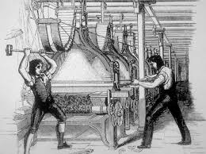
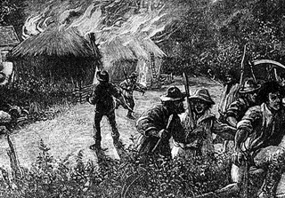
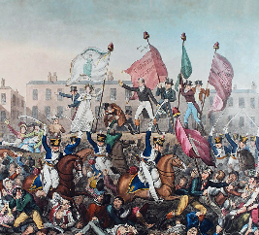
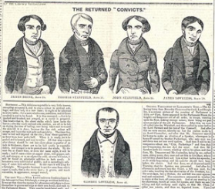
Knowledge Organiser: Was the 19th century an age of reform?
Group | Aims | Actions | Outcome
Luddites (1811) | Stop new machinery from taking jobs away from factory workers, better pay. | Smashed up machines. Sent threatening letters. | 60 men were arrested. 30 were found guilty and either executed, imprisoned or transported to Australia.
Swing Rioters (1830) | Stop new machinery from taking jobs away from farm workers, get better pay and stop paying a tithe to the church. | Smashed up machines. Vandalised tithe barns. Sent threatening letters. | 19 were hanged, 644 were imprisoned, and 481 were transported to Australia.
Peterloo Massacre (1819) | To get the vote for working class men. To get an MP for Manchester. | A peaceful meeting near Manchester to listen to Henry Hunt's speech. | Hunt was arrested, 18 people died and 650 were injured when the cavalry were sent in.
Tolpuddle Martyrs (1834) | To convince their employer to pay them fairly. | Joined together to form a 'Trade Union' and told their employer they would all leave if they weren't paid more. | Originally arrested and transported to Australia, but after protests and petitions across the country they were freed.

Slide 10
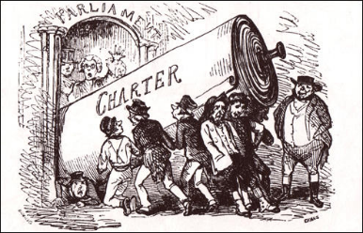
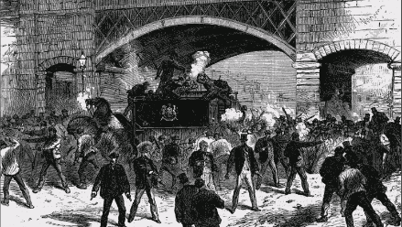
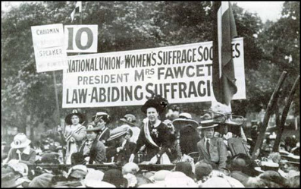
Knowledge Organiser: Was the 19th century an age of reform?
Group | Aims | Actions | Outcome
Chartists (1839-1848) | The vote for all men, and MPs to represent equal sized constituencies across the country. | Peaceful marches and three petitions presented to parliament. | Ignored by parliament, lost support, voting reforms eventually made, but not until years after the chartist movement.
Irish Nationalists (1840s-1860s) | Independence for Ireland, their own parliament back. Reversal of the 1801 Act of Union. | Repeated attempts at violent protests, often thwarted by informers warning the police. | Arrests, executions and transportation to Australia. A compromise, 'Home Rule' was proposed but unpopular with people on both sides. No solution was found in the 19th Century.
NUWSS (1897) | Votes for women. Women allowed in parliament. | Peaceful marches, meetings, petitions, pamphlets, letters to MPs. | Mostly ignored in the 19th century. Women eventually given equal voting rights to men in 1928.
LGBT+ activists (1897) | Fair treatment and equality for LGBT people. Homosexuality to be accepted and made legal. | Books encouraging acceptance of homosexuality. 'Order of Chaeronea' held meetings to discuss gay rights. | Books were banned. Meetings had to be held in secret to avoid arrest. Homosexuality wasn't made legal until 1967.

Slide 11
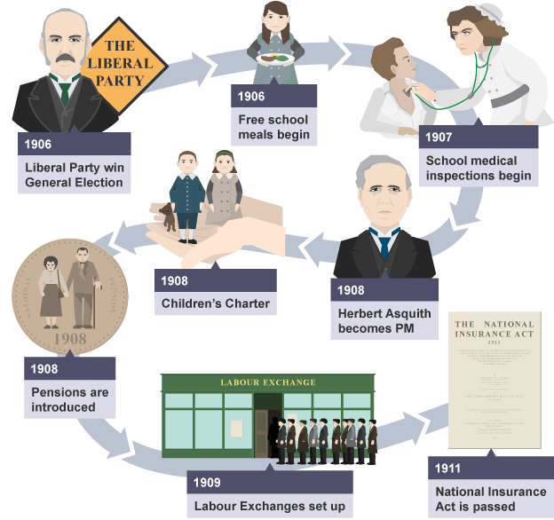
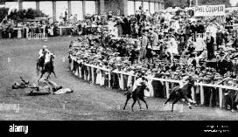
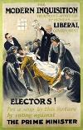
Modern Britain Post 1945
Liberal Reforms
Women's Suffrage
Suffragists | Suffragette | The War
Founder: Milicent Fawcett in 1897 Petitions Marches Peaceful Mostly middle class | Founder: Emiline Pankhurst in 1903 Deed not words More militant Vandalism Emily Davison and the Derby 1913 Often arrested Hunger strikes and the cat and mouse act. | Munitionettes/Canary girls Women's Land Army Order of the white feather Auxiliary armed forces Nursing Football
All women over 30 with property got the vote in 1918.
All women over the age of 18 were given the vote in 1928.

Slide 12
Modern Britain Post 1945
5 Evil Giants
Want - a desire for something essential for life
Ignorance - lack of knowledge or information.
Idleness - a state of inaction; inactivity.
Disease - Illness
Squalor - the state of being extremely dirty and unpleasant, especially as a result of poverty or neglect.
Swinging Sixties
Music | The Beatles, Rolling Stones, The Who, The Kinks
Fashion | Mary Quant, Twiggy, The mini skirt, Carnaby Street and the Kings Road
Film | Alfie, James Bond, The Italian Job
Sport | England beat West Germany 4-2, Geoff Hurst hat-trick, Celtic win the European Cup
Technology | Colour T.V. Refrigerators, Vacuums, Dishwashers, Cars, Flights all more common.
Poverty | 3 million live in slums, toilets outside and many with no bath, 2 million children living in poverty.
Key People
Aneurin Bevan – Founder of the NHS 1948
William Beveridge –Author of the 1943 Beveridge report
Harold Wilson – Prime minister at the height of the swinging 60’s
Enoch Powell – Conservative MP who made the controversial rivers of blood speech on immigration in 1968
Margaret Thatcher – A conservative and Britain’s first female Prime minister.
Key developments in rights
1967 Sexual relations act | 1970 Disabled Persons act | 1972 Equal Pay act and first Pride parade | 1975 Sex discrimination act | 1976 Race Relations act | 1995 Disability discrimination act | 2014 Gay people are allowed to marry.
Exam Skills – How useful is a source
Use the knowledge | Use the Provenance (source origin)
Work out what the source is suggesting about the situation then test it against your own knowledge. | Who made the source and what reasons do they have for saying what they do. Do they stand to benefit from the what they produce? Are they trying to justify something? Are they wanting to attck someone? Why?

Slide 13
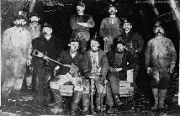
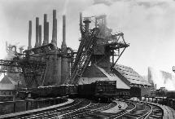
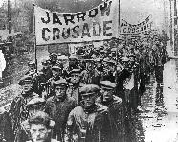
Knowledge Organiser: Local Depth Study
What is deindustrialisation?
Deindustrialisation is the reduction of the amount of industry in an area or a country. Factories and other manufacturing businesses, for example, will close down.
The effects of deindustrialisation:
Increase in unemployment
Poverty
Dependence on benefits
How did people in the North-East respond to economic changes in the twentieth century?
Skilled workers in Britain began organising themselves into trade unions in the 17th century.
A trade union is an organised association of workers in a trade, group of trades, or profession, formed to protect and further their rights and interests.
In what ways did trade unions influence workers?
Between the 1850s/60s, trade union membership rose from 100,000 to 1 million.
Trade unions grew in numbers: Independent Labour Party was formed in 1893.
The Labour Representation Committee (LRC), an organisation created to unite trade unionists, was formed.
In 1900 and 1906, the number of Labour MPs in Parliament rose from 2 to 29.
In 1926 trade unions were powerful enough to mount a General Strike, which lasted ten days.
The Jarrow March took place 5-31st October 1936 and involved 200 mean marching from Jarrow to Parliament.
How did the North-East economy recover?
The Special Assistance Area, the Team Valley Corporation, was formed to help depressed areas.
The government provided grants of £2million to Special Assistance Areas.
New council houses and roads were built by Newcastle City Council.
The council also funded a publics works programme to tackle unemployment.
The outbreak of WW2 boosted production in industries following the introduction of the re-armaments programme in 1938.
What were the major industries of the time?
Coal industry
Steel industry
Shipbuilding industry
What were the key events in the late 20th century?
1947 – Nationalisation of the coal mining industry.
1960s-80s – Decline in shipbuilding. Redundancies reached 2,580 in the North-East.
1976 – Creation of Eldon Square: A modern shopping complex offering a metro rail scheme.
1984 – Creation of Metrocentre: A shopping centre and leisure centre which was a main source of employment and business.
1985 – Formation of the Team Valley Business Centre

