Slide 1
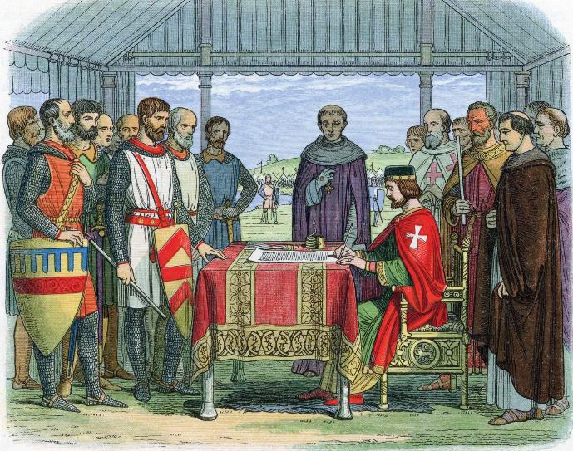
Year 7 Revision Booklet
From Monarch to Democracy - The changing nature of political power in Britain.

Slide 2
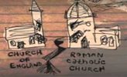
Year 7 - From Monarch to Democracy -The changing nature of political power in Britain.
What is History? Local study on Newcastle Keep
Was Anglo-Saxon England a Golden age?
Why did the Normans win the Battle of Hastings?
How far did the power of the Monarchy change during the Medieval period?
How far was the renaissance period a ‘rebirth’?
How did the church and monarchy change during the Tudor and Stuart period?
How did the Enlightenment change the world?

Slide 3
What is History?
Key Term | Definition
Chronology | The order in which past events happen.
Period | A rather large interval of time that is meaningful in the life of a person, in history, etc., because of its characteristics: Bronze age, iron age.
BCE | Before the common Era – Common era is taken as the birth of Christ. This is often referred to as B.C.
A.D. | Anno Domini (in the year of our lord). After the birth of christ
Source | A thing that we can get our information from e.g. Books, letters, buildings, coins, pictures etc.
Interpretation | This is someone view on something
Reliability | How honest/truthful something is
Cause and Consequence | Why something happened and what are the effects of that event.
Continuity and change | The extent to which things stay the same or become different over time.
Significance | The importance of something and it’s consequences.
Archaeologist | A specialist who dig up artefacts from the past
History is the study of the past. It is not the past itself.
History changes all the time as new research is discovered and interpreted in different ways.
How history is seen depends on a lot of factors
These include:
The time people are writing in.
Where they are from.
Experiences.
What they are wanting to do with the history.
What they have read or seen about events.
An historian must work through all this information and consider all the above things when trying to find out about the past.
Therefore history is great in the fact that they are no right or wrong answers just well-argued answers.

Slide 4
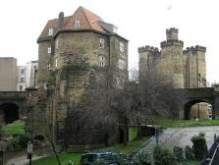
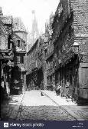
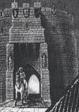
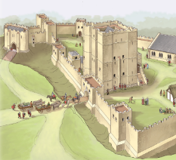
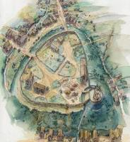
Newcastle Keep and Garth
1600’s
Newcastle is no longer needed as a castle except when it was garrisoned during the Civil war 1642-49. Houses are built in the Garth area and it becomes an area of slums with Scottish and Irish immigrants living and working there.
1800-now
The Industrial revolution sees most of the slums removed for the railway line. A battle between progress and preservation of history begins.
The Castle is now a museum.
1292
King Edward I hosts Scottish King John Balliol who swears an oath of allegiance. This is broken and Newcastle becomes a central base for launching attacks against the Scots during many Anglo-Scottish wars between 1300 and 1500.
1068-78
Henry II orders the building of the castle in stone. Newcaslte has been under the control of the Scottish and he wants to reaffirm control
1250’s
The Black Gate was added to the castle by King Henry III
1207-16
The Great hall was added by King John
C. 122AD
The Romans built Newcastle as a fort on Hadrian’s wall. It could watch over the river Tyne and was the first place you could cross the river. Its Roman name was Pons Aelius or Hadrian’s Bridge.
1080
The Normans built a castle on the site to try and impose their rule on the English.

Slide 5
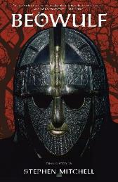
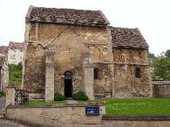
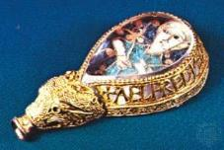
Anglo Saxon England: A golden age?
Was it a Golden Age for Women?
Positive
Women had legal rights to own land
Women could leave their husbands who committed adultery and there were fines for sexual harassment.
Negative
Only 5% of land was controlled by women
Poor women worked hard in the fields and at home most writing about women is about the wealthy.
Edward the Confessor left most things to his advisers and focussed on the church.
Made up the Witan with bishops who advised the king and even had a say in who was king.
6 Earldoms from 3 families. Rivalries were fierce.
King
Ceorl
Thrall
Earl
Thegn
5000 of them. To be one you had to own 250 hectares of land.
Vast majority of the people who were free and worked the land. Most paid rent to the Thegn. They made up the fyrd in times of war and had a role in decisions during trials. They were becoming more tied to the Thegn by 1066.
The Church was very wealthy and a great centre of learning. However it was very corrupt with people buying their positions
They told stories and wrote down their history. Beowulf is a tale about a hero slaying a beast and the Anglo-Saxon Chronicle told their history.
Slaves who made up 10% of the population.
They were well skilled and many of their jewels were traded around Europe
England was one of the wealthiest and best governed countries in the country.
Kings had strong central control over the realm. It was divided into shires which were easy to run.
Most shires had a royal burh (walled town) which would hold a market and was a safe place. They became centres of trade.
England made its wealth from the wool trade. The king set up a number of mints (machinery that produces money) which produced trusted and quality coins. This made trade and taxation easier.
Pre 1066 settlers
C.500BC – Celts
43 – 410 – Romans
410 – 1066 – Anglo-Saxons
860 onwards - Vikings

Slide 6
Knowledge Organiser: Norman Conquest of England
Key events
25th December 1066 | William was crowned King of England in Westminster Abbey in London.
1069 | The most famous rebellion against William was led by Earls Edwin and Morcar, who wanted to put Edward the Confessor’s 18 year old nephew – Edgar Aetheling - on the throne. Their army was supported by the Scots and Vikings, but was brutally put down by William.
Harrying of the North | As a punishment for supporting Edgar Aetheling’s rebellion, William ordered villages and crops in the north of England to be burnt, people and animals killed and the land poisoned so people could not farm there afterwards. It is estimated that 75% of the population of the north was wiped out.
1085 | William ordered a huge survey of England. The Domesday book was begun. However, William did not live to see it completed.
Key words / terms
Motte | William built castles as part of his conquest of England. The first ones were made of wood, and were built on a motte. A motte is a mound of earth.
Bailey | This was the area around a castle, which was enclosed by a wooden fence and a ditch to protect it.
Domesday Book | William ordered a survey of England which became known as the Domesday Book. It was full of information about how many people there were in each area, and how much property they owned. This was so William knew how many people he could call up to his army if he needed them, and how much he could tax people.
Feudal system | A system developed by King William where each group of people owed loyalty to the group above, starting with villeins, knights, barons and ending with the king.
Baron | In return for their loyalty, William gave his supporters big chunks of land in England to rule. These powerful landowners were known as barons.
Knight | Smaller landowners who would get land from the barons. They ranked below the barons in the feudal system, but were much higher ranking than the peasants.
Villein | Peasants who farmed the land. They were part of the property of the baron or knight who owned the land they lived and worked on.
Murdrum fines | If a Norman was killed, the English people living in the area where the crime happened would be taxed heavily.
Key concepts
Conquest | Taking control of an area by military force. William’s invasion and takeover of England in 1066 is known as the Norman Conquest.
Rebellion | An act of resistance against an established government or leader. There were many rebellions against William in the early years of his rule of England.
Tax | A compulsory fee charged by a government. Taxes contribute to the running of the country. In the Medieval period, a tax could be paid in the form of money or goods.
© Oxford University Press 2019
www.oxfordsecondary.co.uk/acknowledgements
Invasion, Plague and Murder: Britain 1066–1558

Slide 7
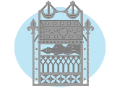
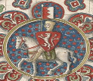
Knowledge Organiser: Medieval Realms
The power of the Church over society in the Middle Ages
In the Middle Ages, the Catholic Church dominated the lives of people.
People believed that if they did not support the Church or believe in God, they would go to hell.
Everyone paid 10% of what they earned to the Church. This tax was called a tithe.
If a cleric was accused of a crime, he was not tried in the king's court. Instead, he was tried in a Church court where the punishments were not so strict.
King John and the Magna Carta
John was King of England from 1199 until his death in 1216.
King John was unpopular because he collected taxes and did not treat the people fairly.
The barons rebelled against King John and set out to limit his power.
The Magna Carta was created in 1215 which contained 63 promises about what the king could and could not do.
A council of 25 barons was set up to make sure King John kept his word.
Henry II and Thomas Beckett
Henry II became the King of England in 1154 after Stephen I’s death.
Henry II made Thomas Becket the Archbishop of Canterbury to help him control the Church. After Becket became the Archbishop, he started to live a very religious life.
Becket and the Henry argued because the king said he should obey him and not the pope.
In rage, Henry shouted “will no one rid me of this turbulent priest?”
Four knights heard this and rode to Canterbury and murdered Thomas Becket in December 1170.
The Peasant's Revolt
Started in 1381
Parliament passed Statute of Labourers which reduced wages.
King Richard II introduced new Poll Tax
Peasants attacked tax collectors
Wat Tyler led the revolt
The power of the Church over the Monarch
The king was not the Head of the Church, the Pope was.
The Pope claimed authority over all kings and bishops. The bishops were powerful landowners who acted as the king's advisers.
The king could make decisions, such as selecting an Archbishop, but the Pope had to approve.
Henry III and the First Parliament
Henry III was crowned king in 1216.
Magna Carta was re-issued, but Henry ordered higher taxes.
Simon de Montfort led the baron's in a rebellion against the king.
The Provisions of Oxford was created in 1258. This created a privy council of 15 members who were chosen by the barons.
This became known as Parliament which met 3 times a year.
Henry II vs. The Church
In 1173, the Pope made Beckett a saint.
The Pope excommunicated the knights who killed him. They had to go Crusade for 14 years.
In 1174, Henry walked barefoot to Canterbury Cathedral and allowed the monks to whip him as punishment for his sins.
Henry had to give up on the Constitutions of Clarendon (a set of rules which attempted to restrict the power of the Church courts and papal authority in England).
He had failed to reduce the power of the Church.

Slide 8
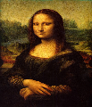
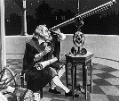
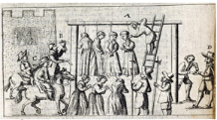
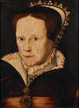
Knowledge Organiser: The Renaissance
What were the key features of the Renaissance?
Art
Science
Architecture
Medicine
Who were the key figures of the Renaissance?
Leonardo Da Vinci: Painter, scientist, and inventor. Famous paintings include the Last Supper and the Mona Lisa.
Galileo: Famous scientist who invented the first telescope.
William Shakespeare: An influential playwright.
Martin Luther: Leader of the Protestant Reformation.
Why was there a witch craze?
Very few people knew about science meaning scientific breakthroughs were restricted to doctors and scientists.
Many people were poorly educated.
People looked for a way to explain and solve problems e.g. natural disasters and diseases.
People feared standing up to witch hunters in case they themselves were accused of witchcraft.
Why did Henry break with Rome?
To increase his royal authority
To restrict the power of the Pope
To divorce his first wife, Catherine of Aragon so that he could remarry.
Why Mary nicknamed 'Bloody Mary'?
Mary I, who became Queen in 1553, was blamed for the death of 300 Protestants who were burned to death for not accepting Catholicism in England.
Some believe she executed traitors more ruthlessly than both her father and sister.
The bishop of Winchester had urged Mary to burn the heretics but it was her who insisted on continuing.
Key term | Definition
Renaissance | This means 'rebirth' in English.
Humanism | The belief that people can live a good life without following religion or believing in God.
Age of Faith | Name given to the Middle Ages because of the importance of the Catholic Church.
Indulgences | These were payments to the Catholic Church for forgiveness for sins.

Slide 10
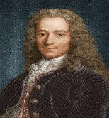
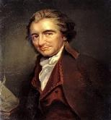
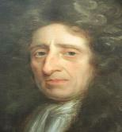
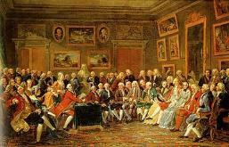
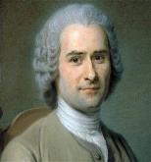
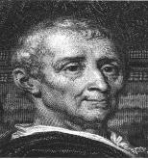
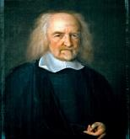
Knowledge Organiser: The Age of Enlightenment
What was the Age of Enlightenment?
The Enlightenment, also known as the Age of Reason, was an intellectual and philosophical movement that dominated the world of ideas in Europe during the 17th to 19th centuries.
Who were the key thinkers of the Enlightenment?
John Locke: An English philosopher known as the Father of Liberalism.
Thomas Paine
A writer and radical republican. He is most famous for writing a pamphlet called Common Sense, which said that England should not be allowed to control the colonies in America.
Voltaire
A philosopher, write and playwright. He argued with the Catholic Church and the French government.
Jean-Jacques Rousseau
A Swiss-born French philosopher, writer, and teacher. He was a figure of the Counter-Enlightenment - a movement which existed between the 18th and 20th centuries which aimed to reverse the political, social and religious changes brought by the Enlightenment.
Baron de Montesquieu
A political thinker. He is famous his writings about the separation of powers.
Thomas Hobbes
He supported absolute monarchy
The Glorious Revolution
The Glorious Revolution took place from 1688 to 1689 in England. It involved the overthrow of the Catholic king James II, who was replaced by his Protestant daughter Mary and her Dutch husband, William of Orange. The event changed how England was governed, giving Parliament more power over the monarchy and planting seeds for the beginnings of a political democracy.
Key idea | Description
Reason | People were encouraged to think for themselves and not to automatically believe what an authority, such as the Church.
Equality | The idea that society is best when everyone works together. Even people with very little power or money should have the same rights as the rich and powerful to help create the society they live in. The nobility should not have special rights or privileges anymore.
Democracy | A government that is ruled by the citizens of the society.
The First Jacobite Rebellion 1715 | The Second Jacobite Rebellion 1745 | The Battle of Culloden 1747
The American Revolution
The American Revolution was the time period where America tried to gain its independence from England.
Federalists: Rich businessmen who protected their own interests.
Republicans: Supporters of farmers who were against the federal government taking rights away.
The French Revolution
The Enlightenment inspired people and the French Revolution encouraged people all over the world to fight for freedom and equality.

