Slide 1
Relationships
Bullying

Slide 2
Learning Objective
To understand what bullying is, how it can impact people and how it can be dealt with and prevented.
Success Criteria
To understand what bullying is and identify some different types of bullying.
To understand the impact that bullying can have on someone’s emotional and physical wellbeing.
To recognise our responsibilities in helping to deal with and prevent bullying.
To know how and where to get help.
Why?
Many people experience bullying every day and this can have a negative impact on their physical and mental wellbeing. Even if we are not the person doing the bullying or the target of bullying ourselves, we all have a role to play in preventing it.

Slide 3
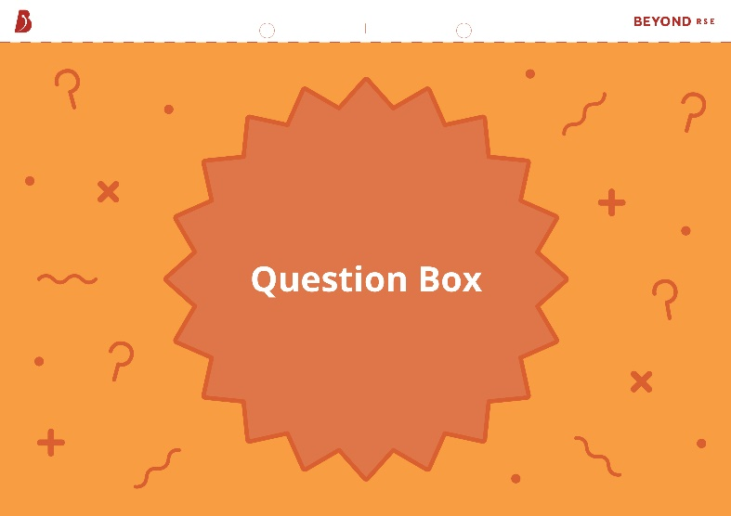
Question Box
If you have a question during this lesson that you don’t want to ask in front of everyone, write it down on one of the cards provided and put it in the question box. You can also use this box to add any concerns or anything you want to tell us about regarding bullying in our school.

Slide 4
Starter
Write down any examples of bullying that you can think of.
You have 2 minutes.
0:00
1:00
2:00
Start Timer

Slide 5
What Is Bullying?
Bullying is repeated behaviour which is intended to hurt someone either emotionally or physically. It can take many different forms.
name-calling
pushing
spreading rumours
teasing
intimidating
trolling
inappropriate touching
social exclusion
hitting
sharing private photos of someone
making nasty comments
threatening

Slide 6
What Is Bullying?
Bullying is more than just a disagreement or a ‘falling out’. Everyone may say or do things that are hurtful to others sometimes, but when this behaviour becomes repetitive and intentional, it can be extremely harmful to the person on the receiving end.
You can usually tell if bullying is taking place if:
the actions are intended to cause harm;
the behaviour is repeated over a period of time;
the person being targeted is physically or emotionally impacted;
there is an imbalance of power (e.g. one person is physically stronger or has some kind of advantage over the other person).
All types of bullying, name calling, “teasing” and spreading rumours, whatever the method or motivation, is unacceptable and should not be tolerated. There is no justifiable excuse for bullying and it needs to be stopped and addressed.

Slide 7
Why Do People Bully?
There are many reasons that someone might bully others:
Low self-esteem – someone might bully to focus attention onto someone else in order to mask how they feel about themselves. If the person doing the bullying is jealous of someone, they may take out their frustrations on them.
Stress or trauma – people that have had traumatic life experiences are more likely to bully as a way to cope with the situation.
Difficult home life – someone who is a victim of verbal or physical abuse at home may bully others as a way of asserting dominance elsewhere in life. Some people also use negative behaviour as a way of getting the attention of adults, particularly if they are struggling to get attention from parents or guardians at home.
Being bullied themselves – people who have been victims of bullying are twice as likely to bully others, as a way of asserting dominance elsewhere in life or protecting themselves from being bullied again.
Peer pressure – people may give in to pressure from their peers to behave in certain ways, including bullying others.

Slide 8
Types of Bullying
Bullying behaviour can be split into several different groups. These include:
Physical bullying – physical action intended to hurt or intimidate
another person.
Verbal bullying – using cruel or abusive language (written or spoken)
to hurt another person.
Relational (social) bullying – using relationships or reputation to exclude
or isolate another person.
Sexual bullying – targeting someone with sexual actions or comments.
Cyberbullying – using electronic communication to hurt another person.
!
Some bullying actions might fall into more than one of these groups, while others may not obviously fit into any of them.

Slide 9
Physical Bullying
Physical bullying involves physical action intended to hurt or intimidate another person.
Examples include:
punching, hitting or slapping;
pushing or tripping;
kicking;
spitting;
unwanted or inappropriate touching;
stealing or damaging of possessions, including clothing, books or money.

Slide 10
Verbal Bullying
Verbal bullying involves using cruel or abusive language (written or spoken) to hurt another person.
Examples include:
name-calling, including racist, homophobic and ableist language;
making threats;
mocking someone’s voice or way of speaking;
laughing at someone;
spreading rumours or lying about someone;
making disrespectful comments about someone’s appearance or other characteristics.

Slide 11
Relational Bullying
Relational (social) bullying involves using relationships or reputation to exclude or isolate another person. This might include actions that link to physical, verbal or cyberbullying.
Examples include:
deliberately ignoring someone when they are talking to you;
not inviting someone to take part in a game or social activity;
making fun of or humiliating someone, either to their face or behind their back;
spreading rumours or lying about someone;
sharing someone’s secret that they have told you in confidence;
posting pictures or comments online to damage someone’s reputation.

Slide 12
Sexual Bullying
Sexual bullying involves targeting someone with sexual actions and/or comments.
Examples include:
uninvited inappropriate touching of someone’s body;
making comments about someone’s gender or sexuality;
catcalling, including wolf-whistling or making uninvited sexual comments about someone’s body, clothing or appearance;
using inappropriate sexual language towards someone;
sharing intimate photos of someone without their consent;
upskirting – taking a photo or video under someone’s clothing without their consent.

Slide 13
Cyberbulling
Cyberbullying involves using electronic communication to hurt another person.
Examples include:
sending threatening messages via email or instant messaging apps;
leaving derogatory comments on someone’s social media posts;
targeting someone unfairly in an online game;
sending or posting photos or videos of someone without their consent;
trolling – making a deliberately offensive or abusive online post, often anonymously, with the aim of upsetting someone;
cyberstalking – using electronic communication to pursue and find out information about someone.

Slide 14
The Impact of Bullying
A quarter of people aged 12-18 have experienced some form of bullying in the last year.¹ This might be from people at school, work, online or even those in their own home.
Write down how you think bullying makes people feel.
You have 2 minutes.
0:00
1:00
2:00
Start Timer
¹ The Annual Bullying Survey 2020 (Ditch the Label)

Slide 15
The Impact of Bullying
Bullying can make people feel all kinds of negative emotions.
lonely
angry
invisible
hopeless
isolated
scared
worthless
upset
weak
humiliated
hurt
threatened

Slide 16
The Impact of Bullying
People that are bullied are more likely to:
experience mental health issues, such as depression or anxiety;
become isolated and lonely;
have low self-esteem;
skip school, leading to lower grades and fewer opportunities in later life;
find it difficult to trust people, making it harder to form healthy relationships in the future;
develop anti-social behaviour as a defence mechanism;
self-harm or have suicidal thoughts.
If you or someone you know is being bullied, don’t put up with it. We all have the right to be safe from bullying and the responsibility to protect others from bullying.
!

Slide 17
Bullying Scenarios
For each scenario, consider the following questions:
How do you think the person being bullied feels?
What should the person being bullied do in this situation?
What could you do as a witness in this situation?

Slide 18
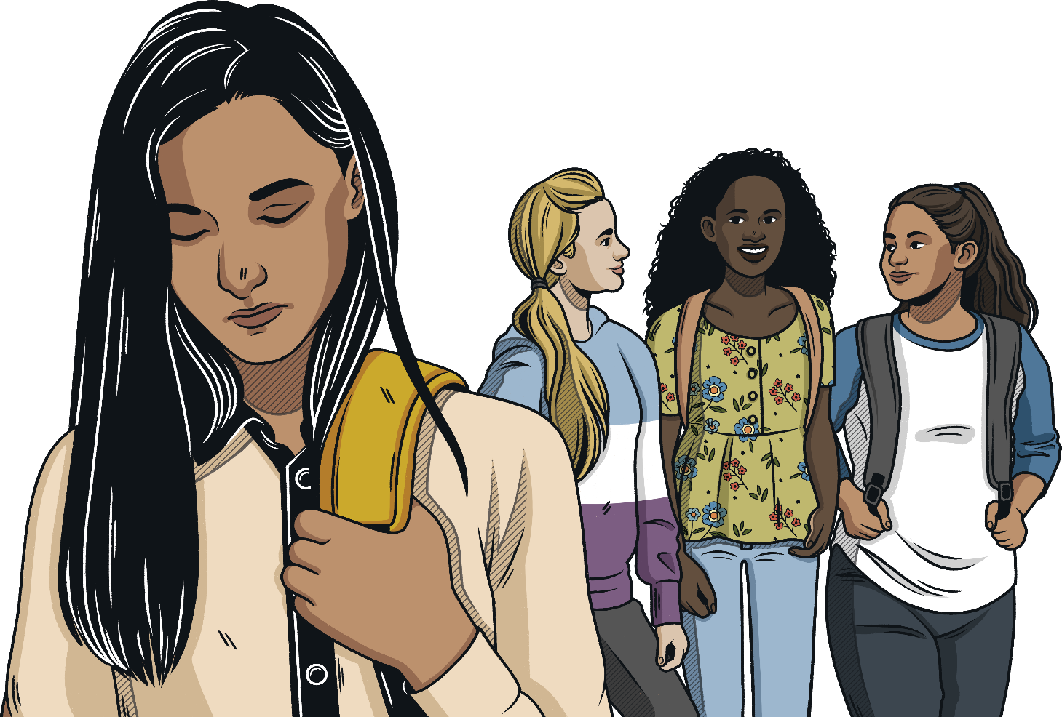
Bullying Scenarios
Your friend Aleesha is planning a sleepover, but she doesn’t want to invite Abigail, who is also in your friendship group. Abigail overhears you all talking about the sleepover and asks when it is happening. Aleesha ignores her and changes the conversation.

Slide 19
Bullying Scenarios
Your friend Aleesha is planning a sleepover, but she doesn’t want to invite Abigail, who is also in your friendship group. Abigail overhears you all talking about the sleepover and asks when it is happening. Aleesha ignores her and changes the conversation.
This behaviour is likely to make Abigail feel hurt and isolated. This is likely to be friendship conflict rather than bullying.
However, if Aleesha continues to be excluded from a game or social activity, this may be considered relationship bullying
Abigail should try to talk to Aleesha about why she is excluding her from the group. If Aleesha still won’t speak to her, she could try talking to a trusted adult about the situation.
Abigail might also like to arrange a fun activity with some other friends, to help lift her spirits and make her feel more supported.
As a witness, you could speak to Abigail to make sure she is OK and try to explain to Aleesha that what she is doing is unkind and hurtful.

Slide 20
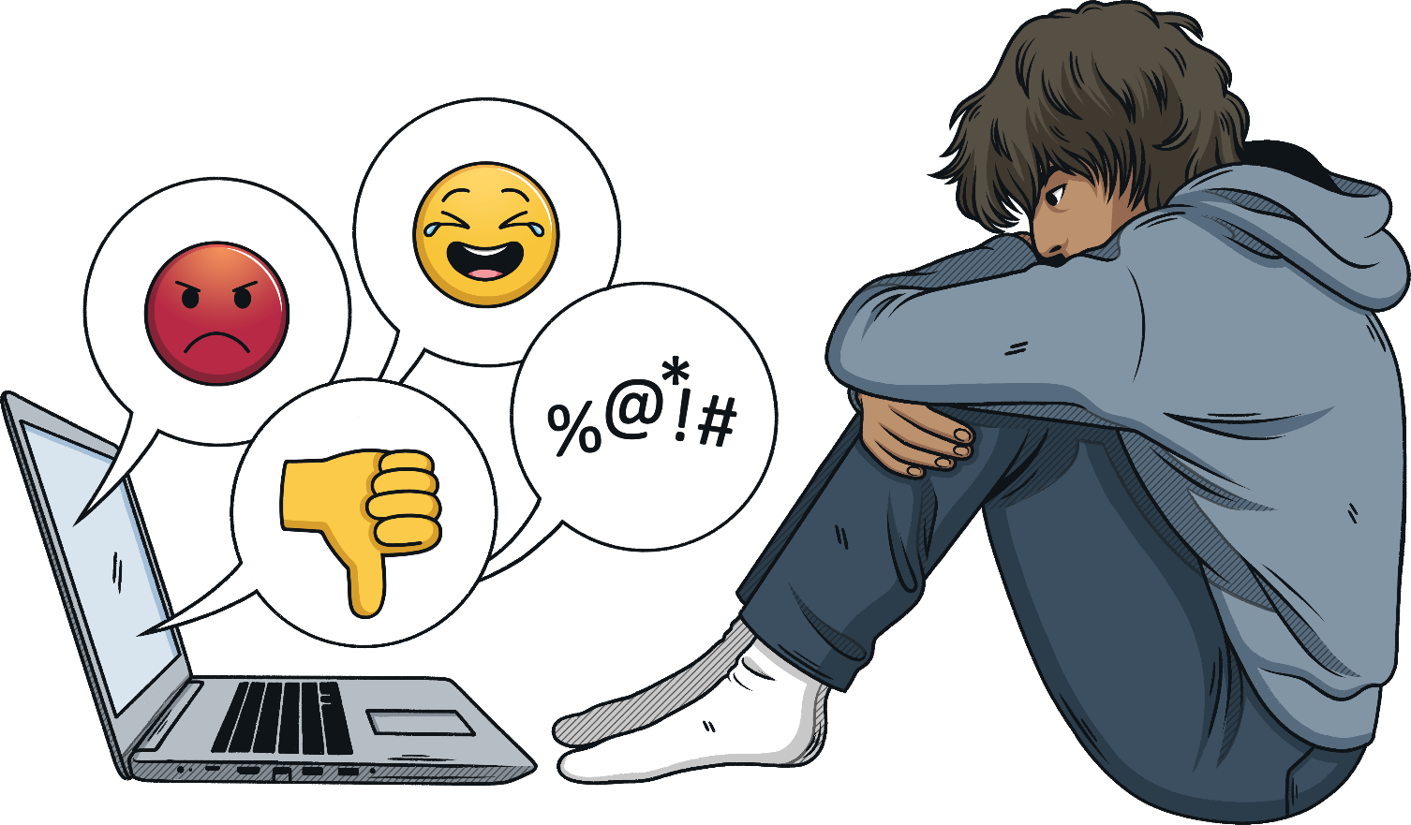
Bullying Scenarios
You are looking at the social media profile of someone called Jamie from school. You wouldn’t really call them a friend but you have some lessons together. You notice that someone has commented on most of Jamie’s pictures, calling them names and telling them to hurt themself. You don’t know the person who has commented but you can see from their profile that they are an older student from school.

Slide 21
Bullying Scenarios
You are looking at the social media profile of someone called Jamie from school. You wouldn’t really call them a friend but you have some lessons together. You notice that someone has commented on most of Jamie’s pictures, calling them names and telling them to hurt themself. You don’t know the person who has commented but you can see from their profile that they are an older student from school.
These comments could make Jamie feel threatened and worthless. Jamie may even consider doing what the comments are telling them to do. This is cyberbullying
Jamie should report the comments to the social media platform and speak to a trusted adult at school if they know the name of the person making the comments. They should take screenshots of the comments as evidence. Jamie can also block this person so they aren’t able to comment on their profile anymore. If Jamie is worried that they might act on the comments, they should seek support from a trusted adult.
As a witness, you could report the comments and tell a trusted adult at school what the older student has been saying. You could also reach out to Jamie in the lessons that you have together to check they are OK and let them know that they are not alone.

Slide 22
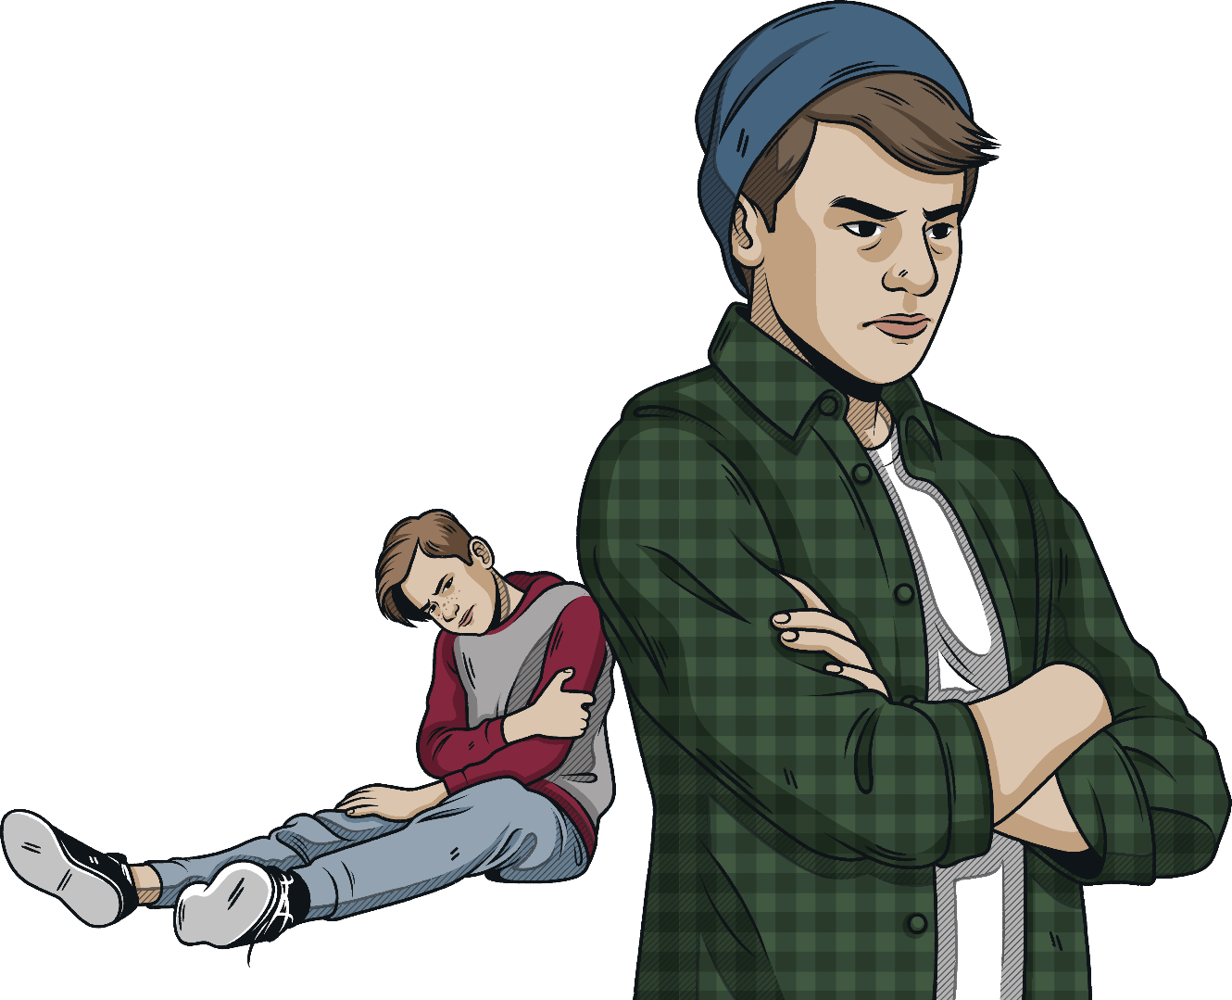
Bullying Scenarios
You are hanging out at the park with your friend, Sam. Sam’s little brother, Theo, who is two years below you at school, comes over and asks if he can hang out too. Sam shoves him to the ground and tells him to get lost.

Slide 23
Bullying Scenarios
You are hanging out at the park with your friend, Sam. Sam’s little brother, Theo, who is two years below you at school, comes over and asks if he can hang out too. Sam shoves him to the ground and tells him to get lost.
Theo feel angry and upset. He might also be physically hurt from being shoved to the ground. If this is not persistent, then it is likely to be a conflict rather than bullying
Theo should tell a trusted adult, such as a parent or carer, what has happened. If the same sort of thing happens within school, he could also tell a teacher or his head of year.
As a witness, you could check that Theo is OK and take him to get medical help if he needs it. You could also try and speak to Sam about why he is behaving like this – maybe something has happened to make him act in this way.

Slide 24
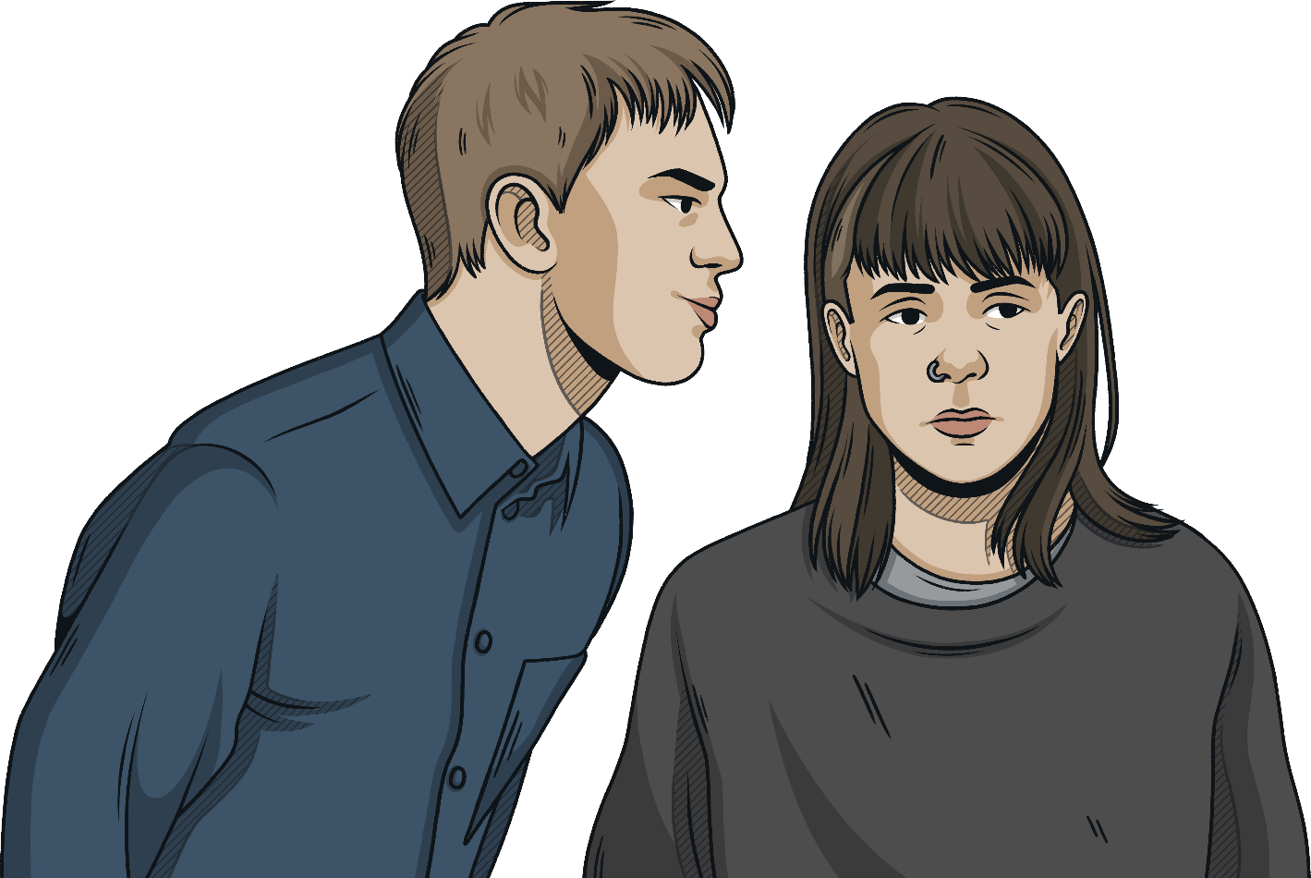
Bullying Scenarios
Your mate Brad has been making jokes about your new classmate Raven, who identifies as non-binary. While you are all hanging out after school, Brad pulls Raven’s shirt up to “get a look at what’s underneath” and tries to persuade Raven to show everyone their genitalia.

Slide 25
Bullying Scenarios
Your mate Brad has been making jokes about your new classmate Raven, who identifies as non-binary. While you are all hanging out after school, Brad pulls Raven’s shirt up to “get a look at what’s underneath“ and tries to persuade Raven to show everyone their genitalia.
If this is not a repeated incident, it may not be classed as bullying at this time. However, it is a serious case of sexual assault and any incident like this will be investigated and severely dealt with by our school.
Raven would probably feel extremely uncomfortable and threatened by this behaviour
Raven should report this to a trusted adult at school and possibly even consider going to the police as it could be classed as sexual assault and/or a hate crime.
As a witness, you could tell Brad to stop what he is doing and help Raven to remove themself from the situation to somewhere that they feel safe. You could also report the incident to a trusted adult, or support Raven to report it themself.

Slide 26
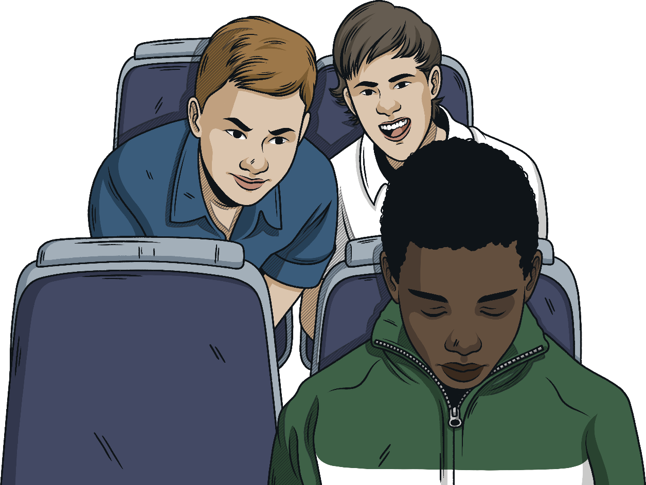
Bullying Scenarios
You are on the top deck of the bus and a group of people start picking on a new kid called Wes and using racist language towards him. Someone grabs his school bag and the group start throwing it back and forth. The other people that are watching this happen are laughing and not doing anything to stop it. This isn’t the first time this has happened.

Slide 27
Bullying Scenarios
You are on the top deck of the bus and a group of people start picking on a new kid called Wes and using racist language towards him. Someone grabs his school bag and the group start throwing it back and forth. The other people that are watching this happen are laughing and not doing anything to stop it. This isn’t the first time this has happened.
This is bullying as it is not the first time that it has happened
Wes would probably feel upset and helpless in this situation. It might make him scared to get the bus again, or even stop him from going to school.
Wes should try to remove himself from the situation and make sure that he reports the incident as soon as possible, either to his parents or carers, or to a trusted adult at school.
As a witness, you could try to stand up to the people doing the bullying and tell them to stop what they are doing. If this feels too dangerous, you could try to alert the bus driver to what is happening. You could also check that Wes is OK afterwards and help him to report the situation to the school.

Slide 28
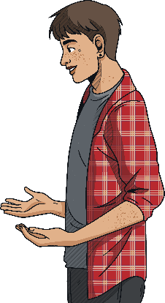
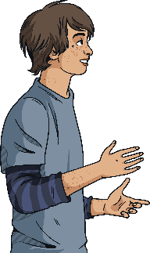
Dealing with Bullying
If you are being bullied, or see someone else being bullied, there are some things you can do to help deal with it.
Walk Away – if you are experiencing physical or verbal bullying, remove yourself from the situation if you can do so safely. Try not to retaliate as this can make things worse and you could get into trouble yourself.
Talk It Out – if you feel safe to do so, try to talk to the person who is bullying you and explain that their behaviour is harmful or upsetting. They may not realise the impact that their actions are having.
Report It – tell a trusted adult, such as a teacher or family member, about what is happening. If you don’t feel comfortable talking to someone you know, there are also helplines that you can contact for advice.
Collect Evidence – keep a note of what happened, who was involved and when it happened. If the bullying is online, take screenshots of messages or comments so you can report it.

Slide 29
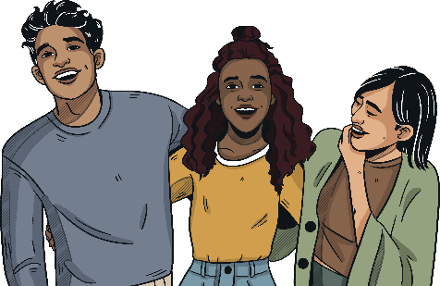
Dealing with Bullying
Surround Yourself with Friends – hang out with people who you trust and who make you feel good. If people in your friendship group are bullying you, they aren’t real friends.
Don’t Blame Yourself – if you are being bullied, remember it isn’t your fault. You shouldn’t have to change anything about yourself to appease someone who is bullying you, and you don’t have to go through it alone.
Be Confident – hold your head up high and do things that make you feel good about yourself. This could be joining a new club or sports team, or doing something you enjoy, like drawing, writing or making music.
Be an Ally – if you see someone else having a hard time, stand up for them and make it clear you are on their side. If you think this will make the situation worse, report the bullying to a trusted adult.

Slide 30
Responsibilities of Bystanders
A bystander is someone who witnesses bullying, either in person or online, but does not take part. Friends, peers, trusted adults and even strangers can be bystanders. Bystanders have the power to help prevent bullying. However, even if they believe that bullying is wrong, they may not intervene for fear of making the situation worse or becoming a target themselves.
If you witness someone else being bullied, don’t ignore it. We all have a responsibility to protect others from bullying.
Depending on the situation, you could:
stand up to the person doing the bullying and explain why their behaviour is unacceptable;
approach the person being bullied afterwards to make sure that they are OK and let them know they are not alone;
invite the person being bullied into your friendship group or walk with them between lessons to reduce the likelihood of them being targeted;
report the bullying to a trusted adult.

Slide 31
Dealing with Bullying
Stop
Support
Report
Stop the bullying by standing up to the person doing it and telling them why their behaviour is unacceptable.
Support the person being bullied by making sure they are OK and letting them know they are not alone.
Report the bullying that you have witnessed to a trusted adult.
Bystanders
Stop reacting to the person bullying you by ignoring them and removing yourself from the situation.
Seek support from friends and people you trust.
Report the bullying that you have experienced to a trusted adult.
Targets
Stop yourself from bullying others by considering how your actions might make others feel.
Get support for your behaviour or any underlying issues that are causing you to take out your frustrations on others.
Report what you have done to a trusted adult so you can get help to stop bullying others.
Person bullying

Slide 32
Dealing with Cyberbullying
Cyberbullying is a bit different to other forms of bullying as it is easier for the perpetrators to remain anonymous if they choose to. This means you might not always know who is responsible for the bullying.
Here are some ways of dealing with cyberbullying:
Ignore
People who cyberbully are often trying to get a reaction out of the person that they are targeting. It is therefore advisable not to respond to any comments and avoid getting into arguments online.
Block
On social media, there is always the option of blocking the person doing the cyberbullying so they can no longer access your profile or leave comments. If you are receiving unwanted text messages, you can block the number that is sending them.
Report
If the cyberbullying is taking place over social media, most platforms will give you the option to report or flag harmful content. In some cases, for example if the person cyberbullying is encouraging someone to harm themselves, this can be reported to the police. Remember to take screenshots of any harmful comments as evidence.
Increase Privacy
Make sure your social media accounts are set to the highest possible privacy settings, and only allow people you know in real life to add or follow you. You should also think carefully about what you post as your content could always be shared with people you don’t know without your knowledge or consent.

Slide 33
What Will You Do?
Write down one thing that you are going to do to tackle bullying.
This could be:
sending a message of support to someone who is being bullied to show them they are not alone
speaking out to stop someone bullying another person
encouraging others to be kind to one another

Slide 34
Further Help If you or a friend are being bullied, report it at speakout@hebburn.net

Slide 35
Questions?

