Slide 1
Relationships
Bullying

Slide 2
Learning Objective
To understand what bullying is, how it can impact people and how it can be dealt with and prevented.
Success Criteria
To understand what bullying is and identify some different types of bullying.
To understand the impact that bullying can have on someone’s emotional and physical wellbeing.
To recognise our responsibilities in helping to deal with and prevent bullying.
To know how and where to get help.
Why?
Many people experience bullying every day and this can have a negative impact on their physical and mental wellbeing. Even if we are not the person doing the bullying or the target of bullying ourselves, we all have a role to play in preventing it.

Slide 3
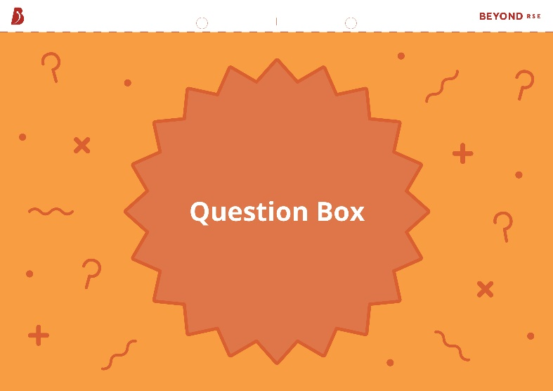
Question Box/Bag
If you have a question during this lesson that you don’t want to ask in front of everyone, write it down on one of the cards provided and put it in the question box. You can also use this box to add any concerns or anything you want to tell us about regarding bullying in our school.

Slide 4
Starter
Write down any examples of bullying that you can think of.
You have 2 minutes.
0:00
1:00
2:00
Start Timer

Slide 5
What Is Bullying?
Bullying is repeated behaviour which is intended to hurt someone either emotionally or physically. It can take many different forms.
name-calling
pushing
spreading rumours
teasing
intimidating
trolling
inappropriate touching
social exclusion
hitting
sharing private photos of someone
making nasty comments
threatening

Slide 6
What Is Bullying?
Bullying is more than just a disagreement or a ‘falling out’. Everyone may say or do things that are hurtful to others sometimes, but when this behaviour becomes repetitive and intentional, it can be extremely harmful to the person on the receiving end.
You can usually tell if bullying is taking place if:
the actions are intended to cause harm;
the behaviour is repeated over a period of time;
the person being targeted is physically or emotionally impacted;
there is an imbalance of power (e.g. one person is physically stronger or has some kind of advantage over the other person).
All types of bullying, name calling, “teasing” and spreading rumours, whatever the method or motivation, is unacceptable and should not be tolerated. There is no justifiable excuse for bullying and it needs to be stopped and addressed.

Slide 7
Why Do People Bully?
There are many reasons that someone might bully others:
Low self-esteem – someone might bully to focus attention onto someone else in order to mask how they feel about themselves. If the person doing the bullying is jealous of someone, they may take out their frustrations on them.
Stress or trauma – people that have had traumatic life experiences are more likely to bully as a way to cope with the situation.
Difficult home life – someone who is a victim of verbal or physical abuse at home may bully others as a way of asserting dominance elsewhere in life. Some people also use negative behaviour as a way of getting the attention of adults, particularly if they are struggling to get attention from parents or guardians at home.
Being bullied themselves – people who have been victims of bullying are twice as likely to bully others, as a way of asserting dominance elsewhere in life or protecting themselves from being bullied again.
Peer pressure – people may give in to pressure from their peers to behave in certain ways, including bullying others.

Slide 8
Types of Bullying
Bullying behaviour can be split into several different groups. These include:
Physical bullying – physical action intended to hurt or intimidate
another person.
Verbal bullying – using cruel or abusive language (written or spoken)
to hurt another person.
Relational (social) bullying – using relationships or reputation to exclude
or isolate another person.
Sexual bullying – targeting someone with sexual actions or comments.
Cyberbullying – using electronic communication to hurt another person.
!
Some bullying actions might fall into more than one of these groups, while others may not obviously fit into any of them.

Slide 9
Physical Bullying
Physical bullying involves physical action intended to hurt or intimidate another person.
Examples include:
punching, hitting or slapping;
pushing or tripping;
kicking;
spitting;
unwanted or inappropriate touching;
stealing or damaging of possessions, including clothing, books or money.

Slide 10
Verbal Bullying
Verbal bullying involves using cruel or abusive language (written or spoken) to hurt another person.
Examples include:
name-calling, including racist, homophobic and ableist language;
making threats;
mocking someone’s voice or way of speaking;
laughing at someone;
spreading rumours or lying about someone;
making disrespectful comments about someone’s appearance or other characteristics.

Slide 11
Relational Bullying
Relational (social) bullying involves using relationships or reputation to exclude or isolate another person. This might include actions that link to physical, verbal or cyberbullying.
Examples include:
deliberately ignoring someone when they are talking to you;
not inviting someone to take part in a game or social activity;
making fun of or humiliating someone, either to their face or behind their back;
spreading rumours or lying about someone;
sharing someone’s secret that they have told you in confidence;
posting pictures or comments online to damage someone’s reputation.

Slide 12
Sexual Bullying
Sexual bullying involves targeting someone with sexual actions and/or comments.
Examples include:
uninvited inappropriate touching of someone’s body;
making comments about someone’s gender or sexuality;
catcalling, including wolf-whistling or making uninvited sexual comments about someone’s body, clothing or appearance;
using inappropriate sexual language towards someone;
sharing intimate photos of someone without their consent;
upskirting – taking a photo or video under someone’s clothing without their consent.

Slide 13
Cyberbulling
Cyberbullying involves using electronic communication to hurt another person.
Examples include:
sending threatening messages via email or instant messaging apps;
leaving derogatory comments on someone’s social media posts;
targeting someone unfairly in an online game;
sending or posting photos or videos of someone without their consent;
trolling – making a deliberately offensive or abusive online post, often anonymously, with the aim of upsetting someone;
cyberstalking – using electronic communication to pursue and find out information about someone.

Slide 14
Is It Bullying?
Look at the scenarios described on the cards and decide whether you think they are examples of bullying. For each situation that you think counts as bullying, explain what type of bullying you think it is.
Simon gets his pants pulled down by an older student in the corridor between lessons.
A group of people refuse to let Aled eat lunch with them in the canteen.
Ian receives an anonymous text asking him if he is gay.
Eli posts a video of her new dance routine online and someone leaves a comment calling her fat.
Jamil’s friends repeatedly ‘kill’ him in an online video game.
Kelly accidentally trips Henry up when he is getting off the bus.
Someone prints out photos of Janine pulling a funny face and puts them around school.
Angus forces Keisha to give him her lunch money every day.
Eliza tells Samantha that she thinks the new girl at school has an eating disorder.

Slide 15
Is It Bullying?
Simon gets his pants pulled down by an older student in the corridor between lessons.
If this is not a repeated incident, it may not be classed as bullying at this time. However, any incident like this will be investigated and severely dealt with by our school.
Simon is still likely to be emotionally impacted by the action. Furthermore, as other students are likely to have seen the incident, this could lead to him being teased or embarrassed further which would be considered bullying. If it were bullying, it would be an example of physical bullying, as well as possibly sexual bullying as a private part of Simon’s body has been exposed without his permission. There is also an imbalance of power because the student who carried out the action is older and potentially holds more influence over younger students.

Slide 16
Is It Bullying?
Ian receives an anonymous text asking him if he is gay.
This might not be considered bullying if it is a one-off occurrence. The text may be from someone who is genuinely interested in Ian’s sexuality but doesn’t feel comfortable asking him face-to-face. If this is the case, their actions are probably not intended to cause harm, but the person who sent the text should consider how this might make Ian feel, whether he is gay or not.
However, if the text contains homophobic language, or if the action is repeated and it has a negative impact on Ian, it could be considered cyberbullying or harassment. Any incident, if the school is made aware of it, will be investigated by our school.

Slide 17
Is It Bullying?
A group of people refuse to let Aled eat lunch with them in the canteen.
If Aled is being deliberately and repeatedly excluded from the group, this would be considered relational bullying. Even though Aled isn’t being hurt physically, this behaviour is likely to make him feel lonely and upset, particularly if it is something that keeps happening.
Any incident, if the school is made aware of it, will be investigated by our school.

Slide 18
Is It Bullying?
Jamil’s friends repeatedly ‘kill’ him in an online video game.
If Jamil is being caused emotional distress about this and has already asked the group to stop but it continues, this could be considered to be relational (or social) bullying because Jamil is being stopped from participating in the game with his friends. If it continues, then it is an example of cyberbullying, because an online platform is being used to cause emotional distress.
Even though Jamil isn’t being hurt physically, being excluded from a group and having others gang up on him is likely to make him feel lonely and upset, particularly if it is something that keeps happening.
Jamil can also report this incident to the online gaming platform who may proceed with further action.

Slide 19
Is It Bullying?
Eli posts a video of her new dance routine online and someone leaves a comment calling her fat.
If this is a repeated incident, it would be considered an example of cyberbullying as the comment has been made on an online platform, is intended to cause harm and is likely to have an emotional impact on Eli.
Eli can also report this incident to the online platform who may proceed with further action.
Any incident, if the school is made aware of it and it escalates during school time, will be investigated by the pastoral team.

Slide 20
Is It Bullying?
Kelly accidentally trips Henry up when he is getting off the bus.
If this action is unintentional, it probably isn’t bullying. However, if it was happening repeatedly and Kelly was intending to cause harm, it would be physical bullying.

Slide 21
Is It Bullying?
Someone prints out photos of Janine pulling a funny face and puts them around school.
This could be considered relational bullying as other people are likely to see the photos and Janine could end up feeling embarrassed or upset by this. However, it could be a friend who has printed out the photos as a joke and they may not have intended to hurt Janine. If Janine is emotionally impacted by the action and it is not a one-off incident, then it would be considered bullying.
This may result in the school investigating and discussing with the pupils concerned

Slide 22
Is It Bullying?
Angus forces Keisha to give him her lunch money every day.
This is an example of bullying because Keisha is repeatedly having her possessions (money) taken from her without her consent. This could be physical bullying (for example, if Angus is pushing or restraining Keisha and taking the money from her) or verbal bullying (if he is threatening her or intimidating her into giving him the money).
Any incident like this will be investigated and severely dealt with by our school.

Slide 23
Is It Bullying?
Eliza tells Samantha that she thinks the new girl at school has an eating disorder.
This action could be incredibly damaging, whether it is true or not. It may result in the new girl being excluded from social situations or feeling like everyone is talking about her. It could be considered an example of relational bullying, particularly if it is happening more than once, because a rumour is being spread about someone.
All types of bullying, name calling, “teasing” or spreading rumours, whatever the method or motivation, is unacceptable and should not be tolerated. There is no justifiable excuse for bullying and it needs to be stopped and addressed.

Slide 24
The Impact of Bullying
A quarter of people aged 12-18 have experienced some form of bullying in the last year.¹ This might be from people at school, work, online or even those in their own home.
Write down how you think bullying makes people feel.
You have 2 minutes.
0:00
1:00
2:00
Start Timer

Slide 25
The Impact of Bullying
Bullying can make people feel all kinds of negative emotions.
lonely
angry
invisible
hopeless
isolated
scared
worthless
upset
weak
humiliated
hurt
threatened

Slide 26
The Impact of Bullying
People that are bullied are more likely to:
experience mental health issues, such as depression or anxiety;
become isolated and lonely;
have low self-esteem;
skip school, leading to lower grades and fewer opportunities in later life;
find it difficult to trust people, making it harder to form healthy relationships in the future;
develop anti-social behaviour as a defence mechanism;
self-harm or have suicidal thoughts.
If you or someone you know is being bullied, don’t put up with it. We all have the right to be safe from bullying and the responsibility to protect others from bullying.
!

Slide 27
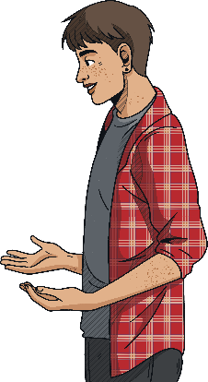
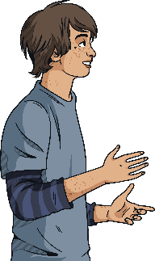
Dealing with Bullying
If you are being bullied, or see someone else being bullied, there are some things you can do to help deal with it.
Walk Away – if you are experiencing physical or verbal bullying, remove yourself from the situation if you can do so safely. Try not to retaliate as this can make things worse and you could get into trouble yourself.
Talk It Out – if you feel safe to do so, try to talk to the person who is bullying you and explain that their behaviour is harmful or upsetting. They may not realise the impact that their actions are having.
Report It – tell a trusted adult, such as a teacher or family member, about what is happening. If you don’t feel comfortable talking to someone you know, there are also helplines that you can contact for advice.
Collect Evidence – keep a note of what happened, who was involved and when it happened. If the bullying is online, take screenshots of messages or comments so you can report it.

Slide 28
Dealing with Bullying
Surround Yourself with Friends – hang out with people who you trust and who make you feel good. If people in your friendship group are bullying you, they aren’t real friends.
Don’t Blame Yourself – if you are being bullied, remember it isn’t your fault. You shouldn’t have to change anything about yourself to appease someone who is bullying you, and you don’t have to go through it alone.
Be Confident – hold your head up high and do things that make you feel good about yourself. This could be joining a new club or sports team, or doing something you enjoy, like drawing, writing or making music.
Be an Ally – if you see someone else having a hard time, stand up for them and make it clear you are on their side. If you think this will make the situation worse, report the bullying to a trusted adult.

Slide 29
Responsibilities of Bystanders
A bystander is someone who witnesses bullying, either in person or online, but does not take part. Friends, peers, trusted adults and even strangers can be bystanders. Bystanders have the power to help prevent bullying. However, even if they believe that bullying is wrong, they may not intervene for fear of making the situation worse or becoming a target themselves.
If you witness someone else being bullied, don’t ignore it. We all have a responsibility to protect others from bullying.
Depending on the situation, you could:
stand up to the person doing the bullying and explain why their behaviour is unacceptable;
approach the person being bullied afterwards to make sure that they are OK and let them know they are not alone;
invite the person being bullied into your friendship group or walk with them between lessons to reduce the likelihood of them being targeted;
report the bullying to a trusted adult.

Slide 30
Dealing with Bullying
Stop
Support
Report
Stop the bullying by standing up to the person doing it and telling them why their behaviour is unacceptable.
Support the person being bullied by making sure they are OK and letting them know they are not alone.
Report the bullying that you have witnessed to a trusted adult.
Bystanders
Stop reacting to the person bullying you by ignoring them and removing yourself from the situation.
Seek support from friends and people you trust.
Report the bullying that you have experienced to a trusted adult.
Targets
Stop yourself from bullying others by considering how your actions might make others feel.
Get support for your behaviour or any underlying issues that are causing you to take out your frustrations on others.
Report what you have done to a trusted adult so you can get help to stop bullying others.
Person bullying

Slide 31
Dealing with Cyberbullying
Cyberbullying is a bit different to other forms of bullying as it is easier for the perpetrators to remain anonymous if they choose to. This means you might not always know who is responsible for the bullying.
Here are some ways of dealing with cyberbullying:
Ignore
People who cyberbully are often trying to get a reaction out of the person that they are targeting. It is therefore advisable not to respond to any comments and avoid getting into arguments online.
Block
On social media, there is always the option of blocking the person doing the cyberbullying so they can no longer access your profile or leave comments. If you are receiving unwanted text messages, you can block the number that is sending them.
Report
If the cyberbullying is taking place over social media, most platforms will give you the option to report or flag harmful content. In some cases, for example if the person cyberbullying is encouraging someone to harm themselves, this can be reported to the police. Remember to take screenshots of any harmful comments as evidence.
Increase Privacy
Make sure your social media accounts are set to the highest possible privacy settings, and only allow people you know in real life to add or follow you. You should also think carefully about what you post as your content could always be shared with people you don’t know without your knowledge or consent.

Slide 32
What Will You Do?
Write down one thing that you are going to do to tackle bullying.
This could be:
sending a message of support to someone who is being bullied to show them they are not alone
speaking out to stop someone bullying another person
encouraging others to be kind to one another

Slide 33
Questions?

Slide 34
Further Help If you or a friend are being bullied, report it at speakout@hebburn.net

