Slide 1






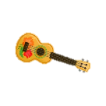


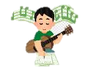

GCSE AQA Music Learning Journey
The Journey Starts
Pupils Perform
Pupils are recorded each assessment cycle performing solo(s) and ensemble pieces in instrumental, Djing or vocals.
All pupils introduced to the four AoS and additional elements of music, bridging the gap between KS3 and KS4.
Year 10
Composition
Pupils compose a piece of music under controlled assessment, which is finalised in the year of examination.
Listening
Pupils Perform
Pupils learn to differentiate between the 12 elements of music and learn the features of each of the four AoS.
Pupils are recorded each assessment cycle performing solo(s) and ensemble pieces in instrumental, Djing or vocals.
Composition
Pupils compose to a brief under controlled assessment. Pupils are given a choice of four briefs set by the exam board.
End of Year 11
Listening
Pupils learn to differentiate between the 12 elements of music and learn the features of each of the four AoS. Pupils also study set works.

