Slide 1
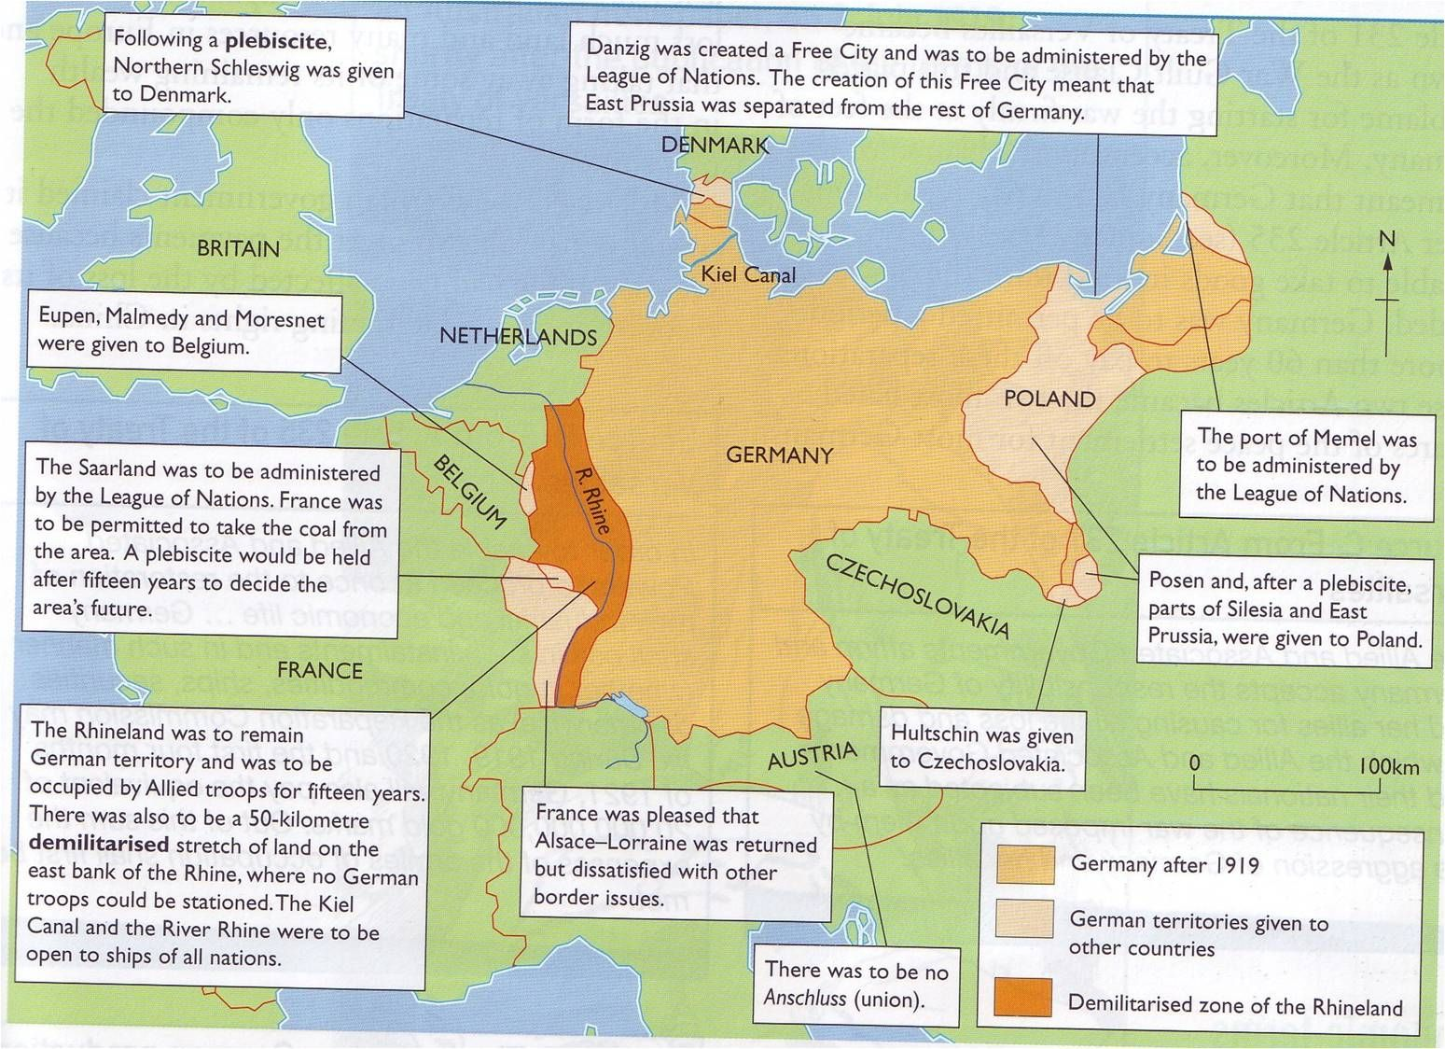
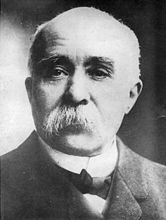
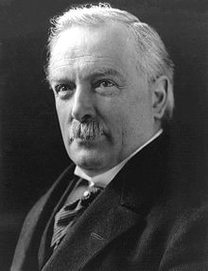
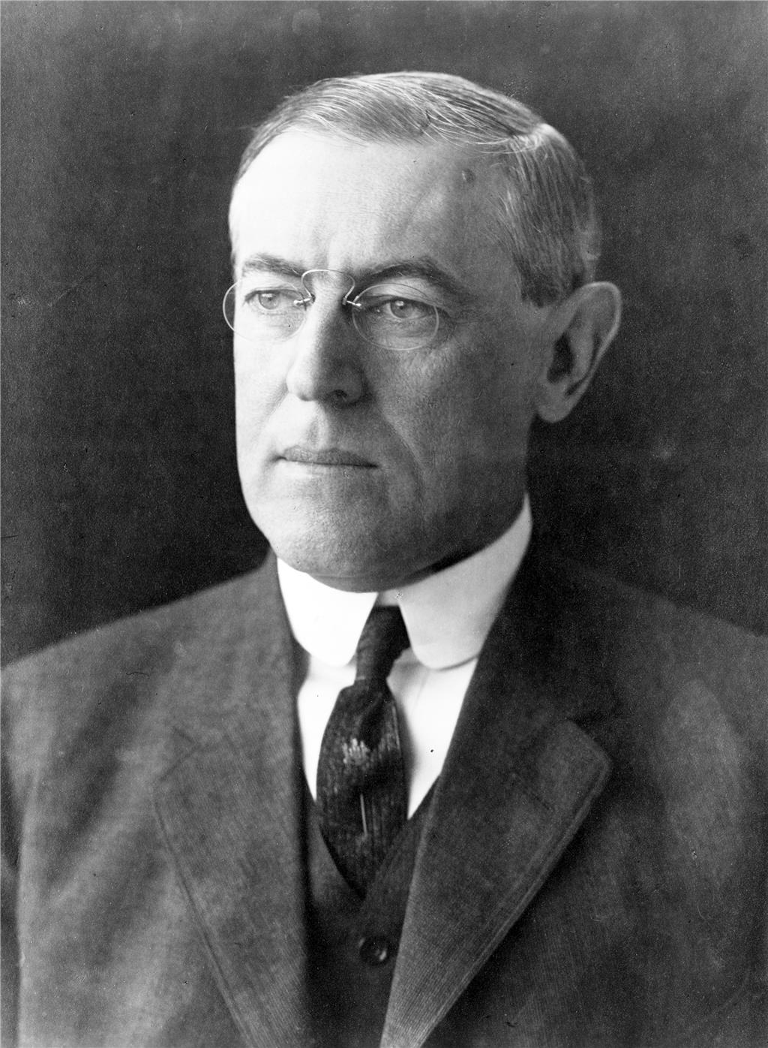
Peacemaking - The Treaty of Versailles
The Paris Peace conference dealt with Germany and was held in the Hall of Mirrors at the Palace of Versailles. The Big three were Georges Clemenceau of France, David Lloyd-George of Britain and Woodrow Wilson of the USA. They got on badly as they all wanted different things. Evwentually the Germans were forced to sign the Treaty of Versailles
Territorial Changes
Overseas colonies were lost, given to the League to run as mandates. The map shows other areas affect by the treaty.
 | Aims | Ideas | Disagreements/Compromise
 | Opportunity to cripple Germany so that it could not attack France again. It had been attacked twice in the last 40 years. | French President wanted Germany broken into smaller states. Clemenceau was REALIST and knew he would have to compromise. He needed the French public on side so wanted to weaken Germany as much as possible. | He and Wilson had issues over what to do with Germany and Frances border. Got his way when agreed to Wilsons self determination in the east. Disagreed with Lloyd George as Britain seemed treat Germany fairly in Europe but not in the overseas empire.
 | Wanted to punish Germany but not too harshly. Seen as the middle ground between France and the USA. Not too harsh as Germany had been Britains 2nd biggest trading partner before the war. | At home he promised to make Germany pay but he was more cautious than how he appeared to the public. | Wanted Germany to hand over it’s Navy and colonies but seemed lenient on Germany where the French were concerned. Britain was concerned about Self determination due to consequences for their empire.
 | Seen as an idealist who wanted to build a better and more peaceful world. | Germany punished but not too harshly so that it wanted revenge. 14 points for peace. Nations cooperate for peace. League of Nations. National self determination (Different people should govern themselves) | Self determination was almost impossible as groups were scattered across Europe. Wilson knew little of central and eastern Europe.
Terms of the Treaty
Military restrictions
Army = 100,000 men
Navy = 6 Battleships
No armoured vehicles, subs or aircraft
Rhineland was demilitarized (no troops)
Reparations and War Guilt
The war guilt clause meant Germany accepted the blame for the war.
They had to pay £6.6 billion for war damage.

Slide 2
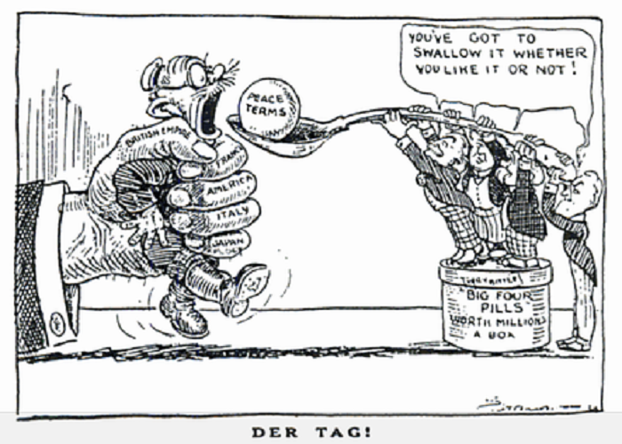
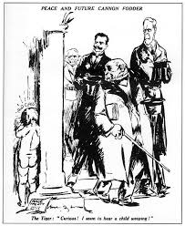
Peacemaking - The Treaty of Versailles
Other Treaties and Settlements
Treaty | Who it dealt with
St Germain | Austria
Neuilly | Bulgaria
Trianon | Hungary
Sevres | Turkey
Lausanne | Turkey after they threatened war over the terms of Sevres
The Allies
Georges Clemenceau | French saw it as not harsh enough. Reparations didn’t cover the cost of the war, the Rhineland demilitarization wasn’t enough. Their thirst for revenge not satisfied. Clemenceau was not reelected.
Woodrow Wilson | It had to be ratified buy the senate. They wanted to be more isolated from world affairs and felt the 14 points weren’t met so didn’t sign it or join the league of nations. Wilson lost the next election.
David Lloyd GEorge | Felt the treaty was too harsh and that reparations would destroy yht European economy. Lloyd George predicted another war in 25 years.
Negative Consequences
6 Million Germans living outside of Germany
People said it was too harsh and would lead to another war.
Treaty was a Diktat. It was forced on Germany who had to accept it.
Germany felt very vulnerable with their reduced army and stronger neighbours.
The causes of WW1 were vast and complicated but not just the fault of Germany
Reparations crippled Germany
Turkeys reaction to Sevres give the impression that others could get the allies to rewrite 'unfair' treaties.
Eastern Europe was now filled with smaller states many had Germans in them. Poland had no natural barriers or defence against Germany.
German Reactions
Diktat | Germany was force to sign they were not invited to Versailles and told if they didn’t sign war would re start. Germany would lose so signed.
War Guilt and Reparations | Germans didn’t see that they were to blame which meant they shouldn’t pay for the war. Reparations would damage Germany further as they tried to rebuild.
Disarmament | The Army had been a symbols of German pride. Despite allied calls for disarmament they didn’t seem to keen to do so themselves.
German Territories | It appeared that as Germany got smaller and lost land France and Britain were gaining from this.
14 Points | They felt that if the 14 points had been stuck to things would have been fair. However it didn’t really reflect these points.
Many complaints had fallen on deaf ears. Germany forced a harsh treaty of Brest Litovsk on the Russians and had planned to pay for the war when they won by extracting money from the defeated allies.

