Slide 1
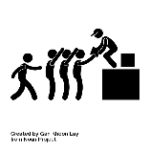
America’s experience of the Great Depression and the New Deal
Key People
Fred Astaire and Ginger Rogers | Glamorous dancers/movie stars of the big screen. Made films through the Depression to keep spirits high.
Herbert Hoover | US president 1928 – 1932. Followed Rugged Individualism and said that ‘prosperity is just around the corner.’ Heavily criticised for his work during the Depression.
Franklin Delano Roosevelt | Democratic President elected in 1932. Took office in 1933. He was the man behind the New Deal that brought the Alphabet Agencies into existence.
Rosie the Riveter | Important symbol of women taking over traditional roles of men during the Second World War.
Senator Huey Long | Critic of New Deal. Wanted to limit personal wealth to a max of $3 million with aim to share wealth between all Americans
John Steinbeck | American author who wrote about the poverty, racism, and social problems he witnessed.
Key Terms
Alphabet Agencies | Name given to the various measures introduced under the New Deal e.g. CCC Civilian Conservation Corps
‘Brains Trust’ | Name given to the group of advisers who helped Roosevelt develop the New Deal
Economic Depression | Long period of financial problems in the economy involving lowering living standards
Dustbowl | The area of the Tennessee Valley where the soil was eroding and turning the land into a desert
Hooverville | Shanty town of ramshackle huts where unemployed workers lived whilst they searched for work.
Hobo | Unemployed workers which travelled the country looking for work
Malnutrition | lack of proper nutrition/food to keep a person healthy
Munitions | The equipment and ammunition of an army and navy
Supreme Court | Highest court in US, with 9 judges
Overproduction | Goods being made faster than they could be sold. This forced the price of goods down and eventually led to people losing their jobs.
Tariff | A tax placed on imported goods
Bonus Army | Veterans of the First World War who marched on Washington demanding their bonus early to help them deal with the impact of the Wall Street Crash and Depression
Breadlines | Many were reduced to begging. The breadlines were queues that formed at soup kitchens run by charities. In 1932 the YMCA was giving away 12,000 meals a day in one small district of New York
Rugged Individualism | The belief that an individual is totally self-reliant and independent from outside, usually state or government, assistance.
Lend Lease | American policy of ‘lending ‘ Britain $7000 million worth of weapons.
Hawley-Smoot Tariff
President
Roosevelt
The New Deal
More New Deal
WW2 starts
USA enters
the war
What was the Great Depression?
The Wall Street Crash caused an economic bust throughout the whole country.
13 million had lost their jobs by 1932, nearly 25% of the workforce
1929-1932 factory production dropped by 45%
12,000 people a day losing jobs by 1932 as 20,000 companies went out of business
250,000 Americans stopped paying their mortgages and were evicted from their homes. Many lived on the streets. One family moved into a cave in New York’s Central Park.
Wall Street Crash
Emergency Relief Act
14 million
unemployed
Prohibiti-on ended
Roosevelt re-elected
Lend Lease
Timeline
1929
1930
1932
Nov 1932
1933
1933
1933
1935
1936
1939
1941
Dec 1941

Slide 2
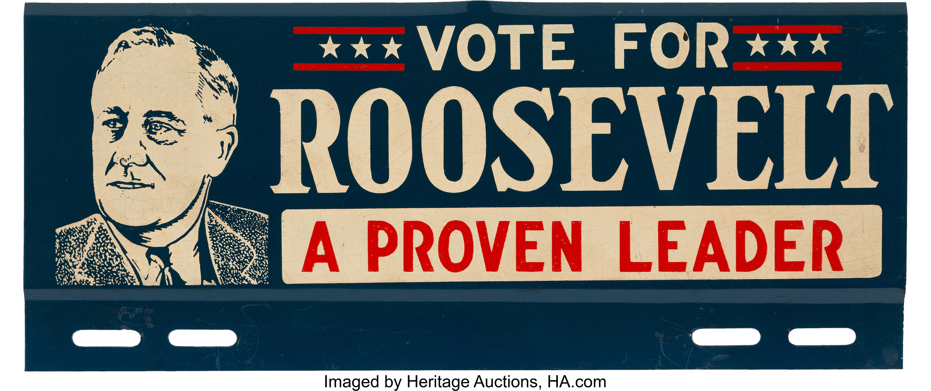
Hoover (Republican)
Roosevelt (Democrat)
What was the New Deal?
Unemployed workers travelled the country looking for work,
known as hobos. Other homeless people were forced to live in Hoovervilles.
Hoover was convinced that America would recover soon and believed I rugged individualism.
Hoover eventually began to take some steps to improve things. The Reconstruction Finance Corporation was set up. This lent money to businesses in trouble
1930 cut taxes by $130 million
1930 Hawley-Smoot tariff = high tax on imported good to encourage Americans to buy American. Europe responded with similar tariffs making it harder for American businesses to sell abroad.
1932 Emergency Relief Act made $300 million available to states to help the unemployed. Some states felt this was not the Federal Governments responsibility so only $30 million was actually given out.
Promised to end prohibition
Promised Americans a New Deal
Promised America the 3 ‘Rs’: Relief (for old, sick and unemployed), Recovery (government schemes to provide jobs), and Reform (ensure another Depression could not happen)
Won the 1932 election- 42 out of 48 states voted for him! His first action was the New Deal
This was a series of programs, projects, and reforms to get people back to work
Change No.1- Emergency Banking Act - Closed down banks and only reopened the reliable ones. This restored faith in the baking system.
Change No.2- Cut the pay of government workers and the armed forces by 15%. This saved $1 billion straight away.
Change No.3- The Beer act - Removed the prohibition laws making it legal to sell alcohol. This meant a tax could be put on sales, raising money for the Government.
Introduced the Alphabet Agencies targeting all sorts of areas. The idea was to provide work and income for those hit by the depression. For examples:
CCC (Civilians Conservation Corps) | FCA (Farm Credit Administration) | FERA (Federal Emergency Relief Agency)
18-25 employed in the countryside. | Lent money to farmers. | $500 million given to states to help homeless and starving people.
How successful was the New Deal?
Group | Success | Failure
Workers | NRA and Second New Deal measures strengthened the position of labour unions against large American Industrial Giants. | Unions were treated with suspicion and many strike were broke up with brutal violence. Companies such as Ford employed their own thugs.
Unemployed | The New Deal created millions of jobs. Projects such as TVA brought work and improved the standard of living. | There were six million unemployed by 1941.
African Americans | Around 200,000 African Americans gained benefits from the CCC and other New Deal agencies. | Roosevelt failed to pass laws against lynching, he feared Democrat senators in Southern States would not support him.
Native Americans | The Indian Reorganisation Act 1934 provided money to help native Americans to buy and improve land. | Remained poor and excluded from sections of society
Women | Some women achieved prominent positions. Eleanor Roosevelt became an important campaigner on social issues. | Most New Deal programmes were aimed to help male manual workers rather than women. Only about 800 women were involved in the CCC.
Opposition to the New Deal
It doesn’t do enough! | It does too much!
Hue Long- Politician from Louisiana believed the New Deal became too complicated and suggested an alternative called ‘Share Our Wealth’. For example, maximum income would be $1 million a year. Dr Francis Townsend- Campaigned for a pension o £200 per month for people over 60. Father Coughlin- A Catholic priest who set up the National Union for Social Justice which promised jobs and fair wages to everyone. The movement eventually faded. | Republicans- Many still supported ‘rugged individualism’ and believed FDR was behaving like a dictator. Businesspeople- Many wealthy businesspeople did like the way the government was interfering and gave rights to workers. For examples, the NRA which allowed trade unions, minimum wage, and improved conditions. Both believed the New Deal was complicated and there were too many codes and regulations.
America at war
As soon as war broke out in September 1939, America declared support for Britain and France. They did not send soldiers, instead they sold them high-quality American made weapons.
The Cash and Carry Plan- In November 1939, Britain and France began buying US weapons, warships, and planes which provided valuable production jobs.
Land Lease- In March 1941, FDR agreed to lend Britain $7000 million worth of weapons.
Attack on Pearl Harbour- On 7th December 1941, 183 Japanese bomber planes attacked Pearl Harbour (a US Navy base in Hawaii), 2000 men were killed. The next day, American entered the war declaring war on Japan (Germany’s ally). Three days later, Germany declared war on America.
Change in attitudes
African Americans | Women
Around 1 million fought in the war, despite facing discrimination. For example, the air force would not train black pilots. However, barriers began to break down and they were able to train as pilots, but this was only in black only regiments. The Fair Employment Practice Committee (FEPC) was set up to prevent discrimination. Some companies did improve their policies; however, companies could not be forced to change. | Before war broke out, women had worked in traditional ‘female’ jobs such as nursing or teaching. The war provide job opportunities. For example, in 1942, 200,000 women worked in shipbuilding and 350,000 joined the women’s section of the armed forces.
Popular Culture
Jazz remained popular. Bing Crosby and Judy Garland aimed popularity at this time Radio remained the main way that people listened to music, but Gramophones became more popular 60 million people a week were still going to the cinema to escape their troubles Comic books became popular. 1938 saw the debut of superman. Young people became big fans. Steinbeck was inspired to write ‘Of Mice and Men’ in this period.

