Slide 1
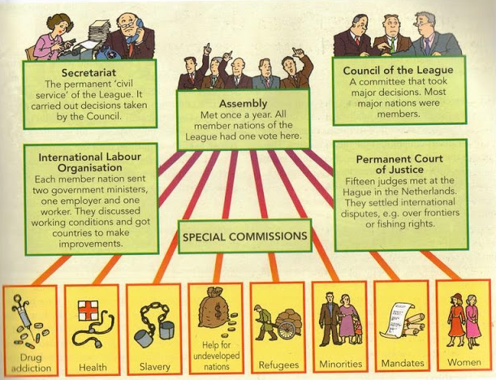
Conflict and Tension 1919-39 – The League of Nations
The League in the 1920’s
Dispute | Result
Vilna, 1920 | 2 new countries argued as Poland took the Capital of Lithuania. In the end the league did nothing, and the Poles kept Vilna.
Upper Silesia, 1921 | Voted to see if it would be part of Germany of Poland. Urban areas voted German and rural Polish. The league helped split this area and keep it running both sides accepted the decision.
Aaland Isles, 1921 | Sweden and Finland argued over who should run these lands. The league decided on Finland and Sweden accepted it.
Corfu, 1923 | Italy invaded Corfu as response to an Italians death. The league said that Corfu should pay compensation and Italy should leave. Italy officially accepted the situation.
Bulgaria, 1925 | Greece invaded Bulgaria when one of their troops was killed. The league order Greece to leave which they did; however they pointed out how it seemed like there were rules for big powers and different ones for the small ones.
Aims
To stop wars To encourage cooperation in business and trade To encourage disarmament To improve living and working conditions in all parts of the world.
Structure of the League of Nations
A Better World?
Refugees | 400,000 PoW’s returned home and many displaced people rehomed.
Working Conditions | Banned lead in paint, Tried to introduce the 8-hour day and 48 hour week.
Health | World Health Organisation (WHO) set up. Worked on Malaria, Leprosy and Cholera.
Transport | Worked on the international shipping lanes.
Social issues | Worked on freeing slaves, against the illegal drug trade and forced labour.
International agreements outside the league
Disarmament | Locarno Treaties | Kellogg-Briand Pact 1928
Washington conference limits size of navies for GB, USA and Japan. Disarmament conferences were refused in 1923 and 1926. Unwillingness of other powers to disarm. | Oct 1925 France, Britain, Germany, Italy , Belgium, Poland and Czechoslovakia met. Germany accepted borders with France and Belgium and that the Rhineland would remain demilitarized. This would pave the way for Germany to join the league. | High point of international relations. All countries need armies for defence. War was rejected and peaceful solutions were said to be the way forward.

Slide 2
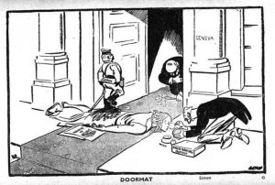
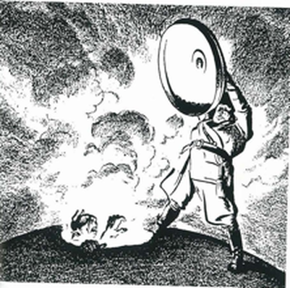
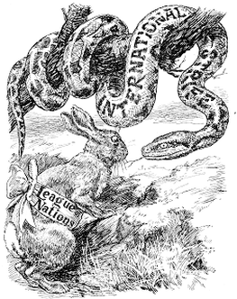
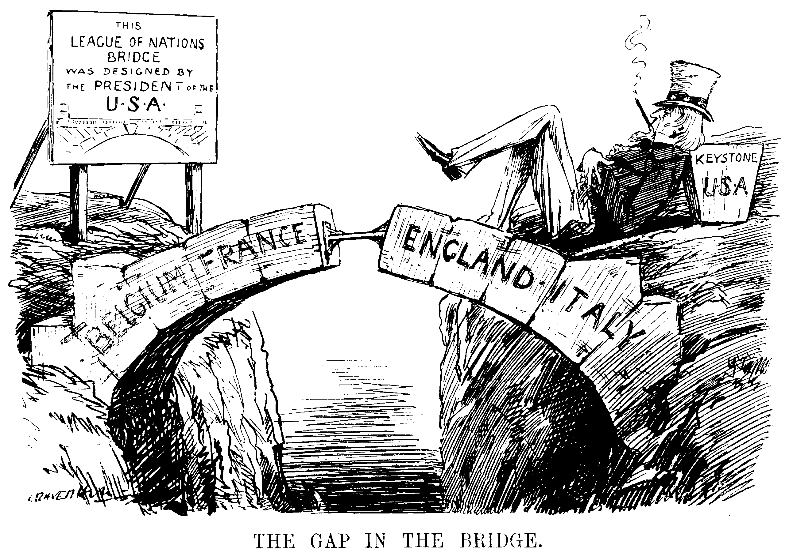
Conflict and Tension 1919-39 – The Collapse of the League of Nations
Strengths
Powers included:
Mora Condemnation (telling off)
Economic Sanctions
Armed action
It could force though judgement through the Court of international justice
58 Members by the 1930’s
Set up by the Treaty of Versailles which most powers had signed including Britain, France, Italy.
Economic Depression | In October 1929 the Wall St crash in the USA led to a global depression as every traded or had loans from the USA. Britain and France were more concerned with their own unemployment issues than international disputes. Germany, Italy and Japan decided to deal with problems by building armies and expanding their territory. Hitler came to power promising to overturn the treaty of Versailles. The USA would not support sanctions against other countries when its economy was in such a mess.
Manchurian Crisis 1931-33 | Mukden incident led to Japan Invading the Manchuria area in China League sent Lord Lytton to report on it. League said Japan was the aggressor and should withdraw. Japan was a permanent member of the council and decided to leave the league rather than do what the league said.
Abyssinian Crisis 1935-37 | Italy wanted to build an empire like Rome and after an incident at the Wal-Wal oasis, had his excuse An 8-month investigation by the league led to Italy being offered some of Abyssinia. Italy rejected it. When Italy invaded sanctions were put on Italy, but not on Oil. They also did not shut the Suez Canal. The Hoare-Laval agreement was secret by Britain and France who offered Italy 2/3 of Abyssinia. This showed Britain and France going against the League they were working with. Italy took Abyssinia and left the league, again Italy was a permanent member of the council and decided to leave the league rather than do what the league said.
Weaknesses
Most people thought the Treaty of Versailles was harsh and needed to be changed. The League was bound to protect these treaties
The USA was absent. At any one time important countries were also absent but the USA absence meant sanctions did little.
They had no army. Instead they relied on the main countries to provide soldiers which many didn’t want to do.
Decisions were slow and needed to be unanimous (all agree).
The organisation was to cumbersome.

