Slide 1
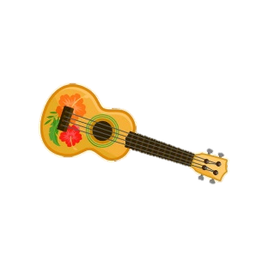
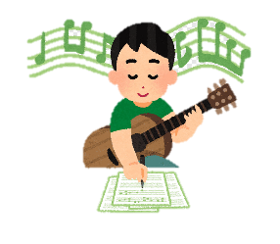
Year 7 Music Learning Journey
The Journey Starts
Pupils Perform
Pupils learn to appraise music and practice vocal performance skills through singing, rapping and beatboxing, in preparation for their assessment: Three Little Birds by Bob Marley
Composition
All pupils introduced to the Elements of Music, bridging the gap between KS2 and KS3
Pupils are introduced to the skill of composition as they create a Graphic Score
Year 7
The Bridging Unit
Listening
Composition
Pupils Perform
Pupils learn to differentiate between pitches; higher, lower or the same?
Pupils explore vocals through rhythmic speech, rap and beatboxing as they investigate further the Elements of Music in preparation for their assessment: singing ‘DoubleTalk’ in two parts
Pupils strengthen their compositional skills as they compose a piece of rap using a variety rhythm and pitch
Speech, Rap and Beatboxing
Listening
Pupils learn to recognise a broad range of rhythms by ear.
Children will leave with a love of music, the confidence to perform in front of their peers, the ability to appraise music using the elements of music and the skill of reading appropriate notation.
Ukulele
Pupils Perform
Pupils learn how to play a variety of chords on the ukulele whilst accompanying their playing with singing. This is In preparation for their assessment performance of ‘I’m Yours’.
Composition
Listening
Pupils further their compositional skills as they compose a chord sequence for the ukulele, incorporating major and minor chords, cadences and strumming patterns.
End of Year 7
Pupils will be introduced to major and minor intervals of a 2nd and 3rd and will be able to identify them individually by ear.

Slide 2
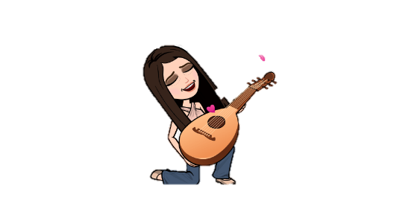
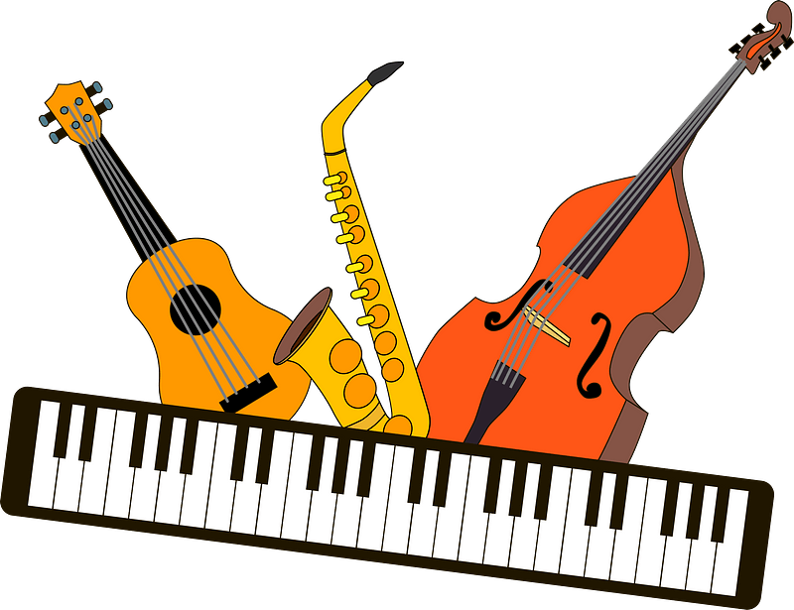
Year 8 Music Learning Journey
Pupils Perform
The Journey Starts
Pupils continue to appraise music, alongside reading TAB to play a variety of chords on the ukulele whilst accompanying their playing with singing. This is in preparation for their assessment performance: a ‘mashup’ in 2-part contrapuntal vocals.
All pupils are reminded of the Elements of Music
Composition
Year 8
Ukulele
Pupils compose a piece of music for the ukulele, including chords and a melody whilst incorporating clear cadence points, strumming patterns, articulation, primary triads, minor and major chords.
Pupils Perform
Pupils explore 2-part vocals and world percussion. This is in preparation for their assessment performance of ‘Samba Lele’ where pupils perform a melodic sequence whilst singing intervals and dotted rhythms with accuracy
Listening
Composition
Pupils will be introduced to intervals of a 4th, 5th and 8th and are able to identify them individually by ear.
Pupils strengthen their compositional skills and implement their knowledge of rhythm as they compose for a Samba drumming ensemble
Samba
Listening
Pupils consolidate their knowledge of rhythms as they
Continue recognise a broad range of rhythms by ear.
Pupils will leave with a love of music, knowledge of world music, the confidence to perform in front of their peers, the ability to appraise music using the elements of music, the skill of recognising rhythm, intervals and the ability to read and write Western staff notation.
Jazz
Pupils Perform
Pupils investigate Jazz music as they practice their performance skills through singing, speech and scat singing. This is In preparation for their assessment performance: ‘Swing Time’ in 2-parts.
Composition
Pupils further their compositional skills as they use Western staff notation to compose a chord sequence and chord chart, incorporating major, minor and dominant 7th chords, accidentals, primary triads and cadences.
Listening
Pupils will be introduced harmony as they learn to recognise major, minor and dominant 7th chords by ear.
End of Year 8

Slide 3
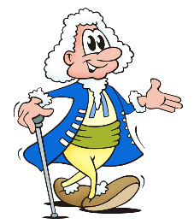
Year 9 Music Learning Journey
The Journey Starts
Pupils Perform
All pupils are reminded of the Elements of Music
Pupils continue to appraise popular music, practicing vocals in 3 parts. This is in preparation for their assessment performance of ‘Stand By Me’ in 3 parts.
Year 9
Popular Song
Composition
Pupils compose a piece of music, namely, a canon, in three parts using Western staff notation.
Composition
Pupils Perform
Listening
Pupils explore 3-part vocals and the world of Electronic Dance Music. This is in preparation for their assessed electronic dance music composition requiring 3-part vocals.
Pupils are introduced to major and minor intervals of a 6th and 7th and can identify them by ear.
Pupils strengthen their compositional skills and implement their knowledge of rhythm and sequences as they compose a layered Electronic Dance Music track.
Electronic Dance Music
Listening
Pupils consolidate their knowledge of instrumentation as they analyse the synths of drum, bass, chord and melody loops.
Pupils will leave KS3 with a love music, knowledge of world music, the confidence to perform in front of their peers, the ability to appraise music, recognise the elements of music, read and write Western staff notation, and play a range of instruments. They are fully equipped to choose and succeed in GCSE Music and engage in musical opportunities, clubs and events.
Twentieth Century Music
Pupils Perform
Pupils investigate genres of Western Classical Music, common in the twentieth century, and perform vocals in Serialism. This is in preparation for their assessed compositions in three genres.
Composition
Listening
Pupils further their compositional skills as they use Western staff notation to compose three individual pieces of music, using common place musical features of each genre: Minimalism, Serialism and Expressionism.
Pupils will consolidate their knowledge of Western staff notation as they are able to recognise pitches on both treble clef and bass clef.
End of Year 9

