Slide 1
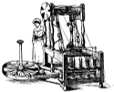
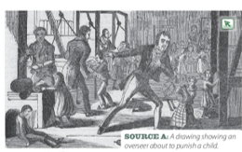
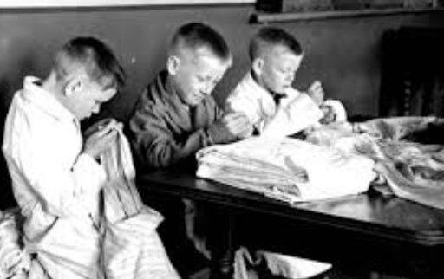
Knowledge Organiser: Industrial Revolution
Causes of Industrial Revolution
New machines such as 'spinning frames' were much faster than working by hand.
Steam powered factories replaced working from home and could run 24/7.
Canals and Steam engines allowed easier transport of products across the country.
Mines and Factories
Children began work as young as 5.
Shifts were 16+ hours long with few breaks.
Pay was low, as the new machines meant there was no need for skilled workers.
The conditions and air were dirty, causing health problems for workers.
Overseers in factories beat those that didn't work hard enough.
Workers could be killed by machines in the factories or collapses and explosions in the mines.
Workers reforms
The 1833 Factory act said no children under 9 could work in factories
The 1842 Mine Act said no women, or children under 10, should work down a mine.
The 1847 10 Hour Act said no women or children should work more than 10 hours a day.
The 1871 trade Union Act allowed workers to join together to negotiate for better pay and conditions. If they were unhappy, they could go on strike (refuse to go to work).
Were Industrial Schools bad?
Yes | No
Children had to do hard labour as well as lessons. | Children were given somewhere to stay and food to eat.
They would be punished harshly for misbehaving. | There was a reduction in crime and begging on the streets.
They were treated like criminals, just for being poor. | They learned basics such as reading and writing.

Slide 2
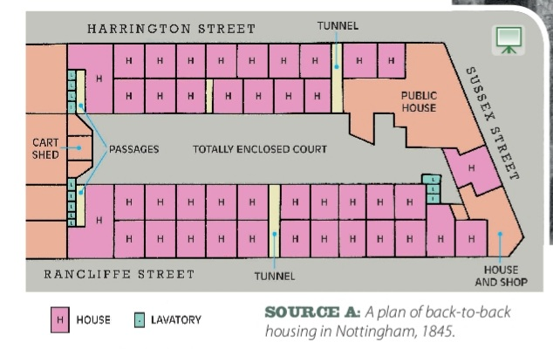
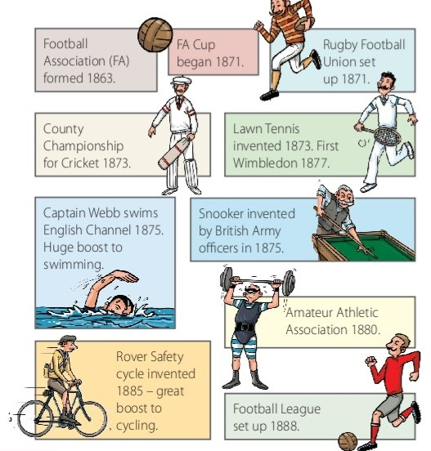
Knowledge Organiser: Industrial Revolution
Industrial Towns
The population rose from 7 million in 1750, to 37 million in 1900.
The new factories pulled people in from the countryside to towns and cities.
Houses were crammed together, entire families shared one room.
Water from the pumps and river was polluted by waste.
The streets weren't regularly cleaned; there was waste and rats.
The air was heavily polluted from burning coal, causing illness.
Public Health Reforms
In 1842 Edwin Chadwick reported that poor conditions in towns were making people ill.
In 1854 John Snow proved that dirty water was spreading cholera.
In 1858 Joseph Bazalgette built the first underground sewers.
In 1861 Louis Pasteur proved that bacteria causes disease.
In 1875 the Public Health Act made it compulsory for towns to provide clean water, sewers and clean streets.
Leisure Time
By 1850 workers had more free time on evenings and weekends.
In 1851 the first 'Music Halls' opened to provide cheap entertainment.
The Rover Safety Bicycle was invented in 1885 and made cycling popular.
In the 1840s a man called Thomas Cook began organising railway trips to seaside towns.
The first professional football club, Notts County, was set up in 1862.
'Blood Sports' (betting on animal fights) were popular until they became illegal in 1849.
Crime
In 1829 Sir Robert Peel set up Britain's first police force in London.
In their first year they doubled the number of convictions for serious crimes.
Their most famous unsolved crime is the murder of 5 women by 'Jack the Ripper' in 1888.
The murders happened in poor parts of London to women who worked as prostitutes, so they weren't given as much attention as they should have been.
The narrow streets and smokey air made it difficult for witnesses to describe what they saw.

