Slide 1
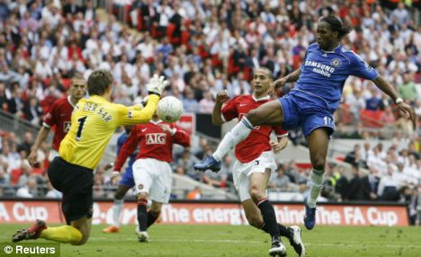
What's this got to do with Geography?

Slide 2
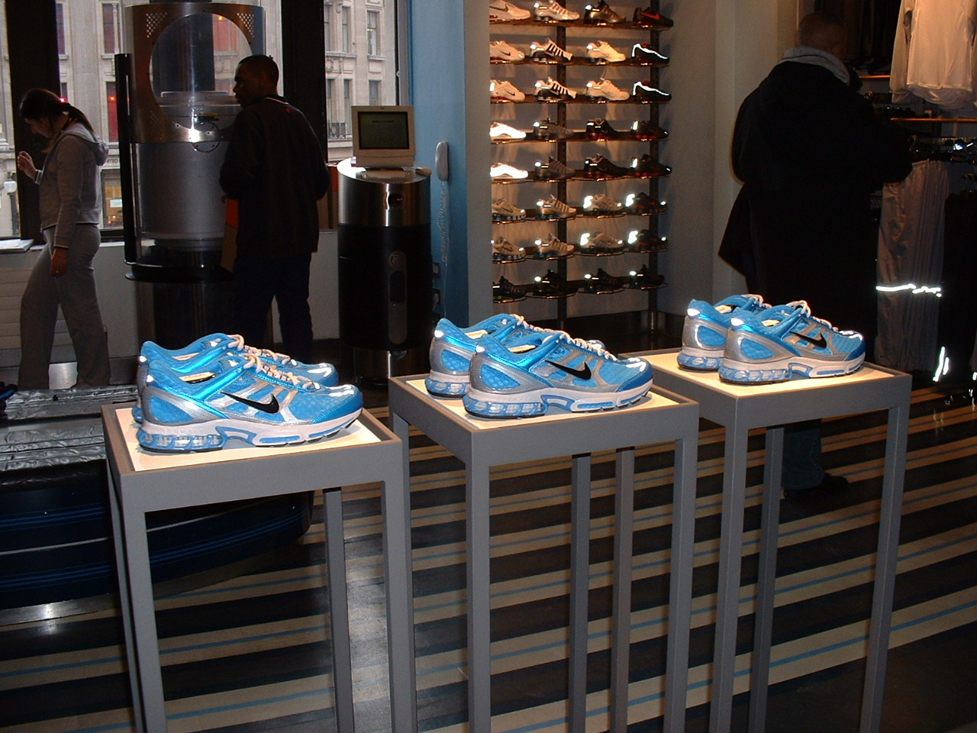
What's this got to do with Geography?

Slide 3
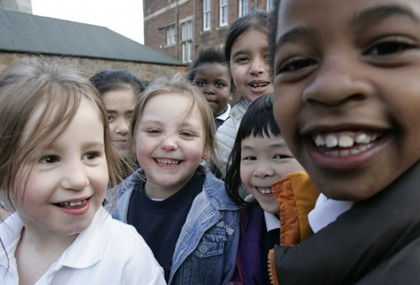
What's this got to do with Geography?

Slide 4
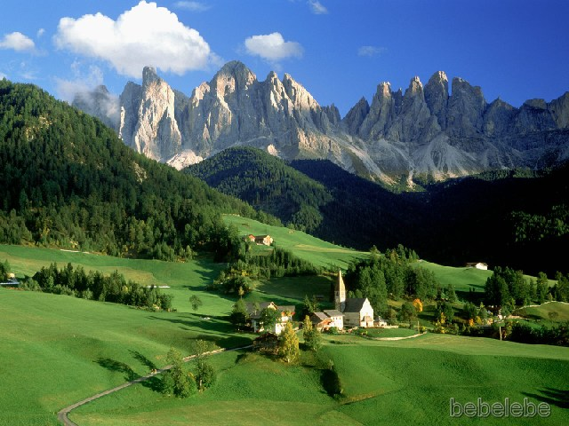
What's this got to do with Geography?

Slide 5
What's this got to do with Geography?

Slide 6
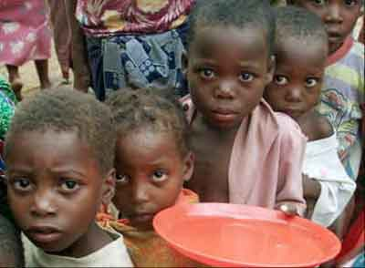
What's this got to do with Geography?

