Slide 1

Name the country
An example – what do you see?
L
&

Slide 2
Pick a Number
1
4
2
3
5
6
7
8
9
10
11
12

Slide 3
Question 1 – A European country
S
Back

Slide 4

Question 2 – An Asian country
L &
Back

Slide 5
Question 3 – A European country
S
L &
Back

Slide 6
Question 4 – A European country
Back

Slide 7

Question 5 – An Asian country
Back

Slide 8

Question 6 – A European country
Back

Slide 9
Question 7 – A South American country
Back

Slide 10

Question 8 – An African country
Back

Slide 11

Question 9 – Both a European and an Asian country
Back

Slide 12


Question 10 – An Asian country
A
Back

Slide 13

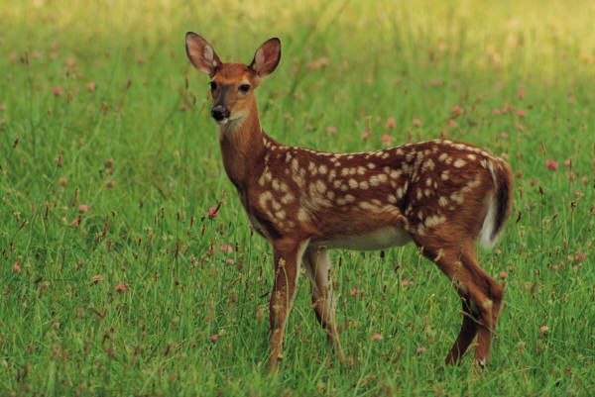
Question 11 – An Asian country
© 2010 Elliott Brown (ell brown)
http://www.flickr.com/photos/ell-r-brown/4558198317/
Back

Slide 14
Question 12 – A European country
Back

