Slide 1
CAN YOU CRACK THE CODE?
3
There is still a need for traditional code makers and code breakers. Highly sensitive data needs to be encrypted to prevent it from falling into the wrong hands – whilst our spies need to be able to crack the codes of other countries. Indeed, GCHQ (the British Intelligence Agency responsible for digital communications) last year recruited new employees by posting a code online. Crack the code and you secured yourself an interview.
Therefore codes and coding theory represents a varied and interesting career path for good mathematicians. Get cracking!

Slide 2
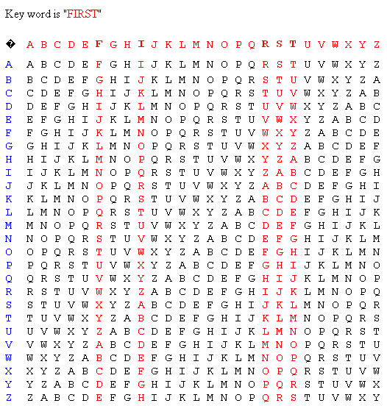
VIGENERE ENCRYPTION
The Vigenere encryption was the creation of the French diplomat, Blaise de Vigenere in the 1500s.
It combines multiple Caesar shifts making it so much more difficult to crack.
First, you need to choose a keyword.
This example uses the keyword ‘FIRST’.
It uses 5 different Caesar shifts, for F, I, R, S and T.
VOCABULARY
Encryption allows information to be hidden so that it cannot be read without special knowledge (such as a password). This is done with a secret code or cypher. The hidden information is said to be encrypted.

Slide 3
EXAMPLE
Codeword: BPFAG AMELX IKRDV ZTLK
Since the keyword was FIRST we look down the F column to find the first letter in the codeword, B.
Read across to the left and B becomes W.
Next we decode P by looking down the I column until we find P.
Read across to the lest and P becomes H.
Continue like this:
F becomes O
A becomes I
G becomes N.
Continuing like this we get:
WHO INVENTED CALCULUS?
Two mathematicians invented calculus separately; Isaac Newton and Gottfried Wilhelm Leibniz

Slide 4
YOUR TURN
Using the keyword ‘FIRST’ decode the following (remember, you may need to change the spacing between the letters):
BPRLB XBYWM MQIVV ZJVFN RJVJ
BPPVH UTRFM XPRLX RIKZL
NBXAO JAKZX RAHMT WMIGH YA
KEYWORD: MATHS
Now using MATHS as the keyword:
TOPTS ZYLLU ANWZA ZAWHQ
OHHVK QYHBJ AWGRW KWHYV FOLLF PMXHE QSLHY Q
BLXHK QTXSD YEMOW WERDG DDBUQ AUKLE MIE
Remember to email me your solutions to receive your next code.

Slide 5
JUST FOR FUN
This puzzle was created by the clever people at GCHQ (the British Intelligence Agency responsible for digital communications).
They have been known to recruit staff by getting them to crack codes and solve puzzles.
Can you solve this puzzle?
Maybe get someone in your family to have a go too!
Please email your solutions to me.
If you get completely stuck and want the solution, feel free to email me too!
If you are a confident codebreaker have a go at these online challenges:
http://ibmathsresources.com/code-challenge/
The solution to the first code gives you the password to access the next puzzle, there are 5 to solve in total in each set.
Let me know how far you get – take a photo and email me!

