Slide 1
CAN YOU CRACK THE CODE?
Mathematicians are employed throughout a wide range of industries that send and transmit data – in particular the telecommunications industry and internet companies. Their challenge is to condense the data that needs to be sent to as small a file as possible – whilst also allowing potential errors in communication to be noticed by the receiver. As coding now goes hand in hand with computing skills, good mathematicians are highly sought after for computing courses at top universities around the world.

Slide 2
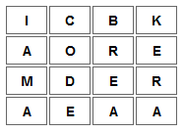
Transposition Ciphers
Transposition Ciphers are based on a simple idea but are more difficult to crack than codes like the Caesar shift. A transposition means that the letters of the code are simply rearranged into a different order.
For example, ICBKAOREMDERAEAA, can be rearranged into rows of length 4 to give:
YOUR TURN
Try and solve:
TIOICCBKTHSRFUORIEIAEFLDENSSMDITEAGT
(make 4 rows of length 9)
WTFRUELEHQRHIOSADUITUEASUQRPSGSAD
(make 3 rows of length 11)
Try this one without instructions:
YRORITOEDENAUAEAGRACBRSQ
Remember to send your solutions to me to receive your next code.
The message is then read from down the columns – I am a codebreaker.
VOCABULARY
Transposition
The act of reversing the order or place of.
In music, playing in a different key from the key intended; moving the pitch of a piece of music upwards or downwards.

Slide 3
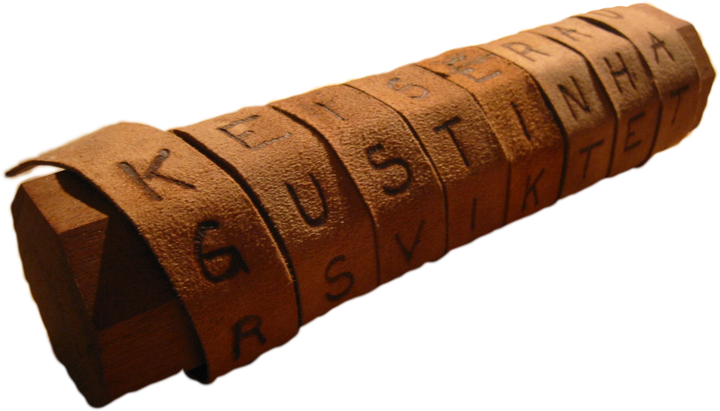
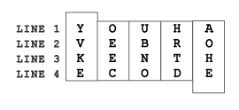
SCYTALE
Another transposition Cipher used by the Romans was called the Scytale. This involved putting a message on a strip of paper that could only be read when wrapped around a rod of a given length.
An example is given below:
A scytale consists of a cylinder with a strip of parchment wound around it on which is written a message.
The recipient uses a rod of the same diameter on which the parchment is wrapped to read the message. It has the advantage of being fast and not prone to mistakes.
The Ancient Greeks, are said to have used this cipher to communicate during military campaigns.

Slide 4
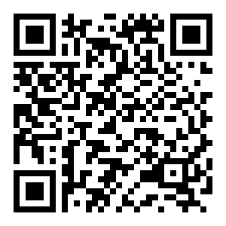
JUST FOR FUN!
TRY ONE YOURSELF!
Have a go at making your own Scytale and try it out on a family member.
You could use a can of pop, toilet roll tube etc as your baton.
Send me a picture if you do!
I am taken from a mine, shut up in a wooden case, from which I am never released, and yet I am used by almost everybody.
If you are a confident codebreaker have a go at these online challenges:
http://ibmathsresources.com/code-challenge/
The solution to the first code gives you the password to access the next puzzle, there are 5 to solve in total in each set.
Let me know how far you get – take a photo and email me!
Follow this QR code to a list of letters which hold the solution to this riddle.
Can you crack the code?

