Slide 1
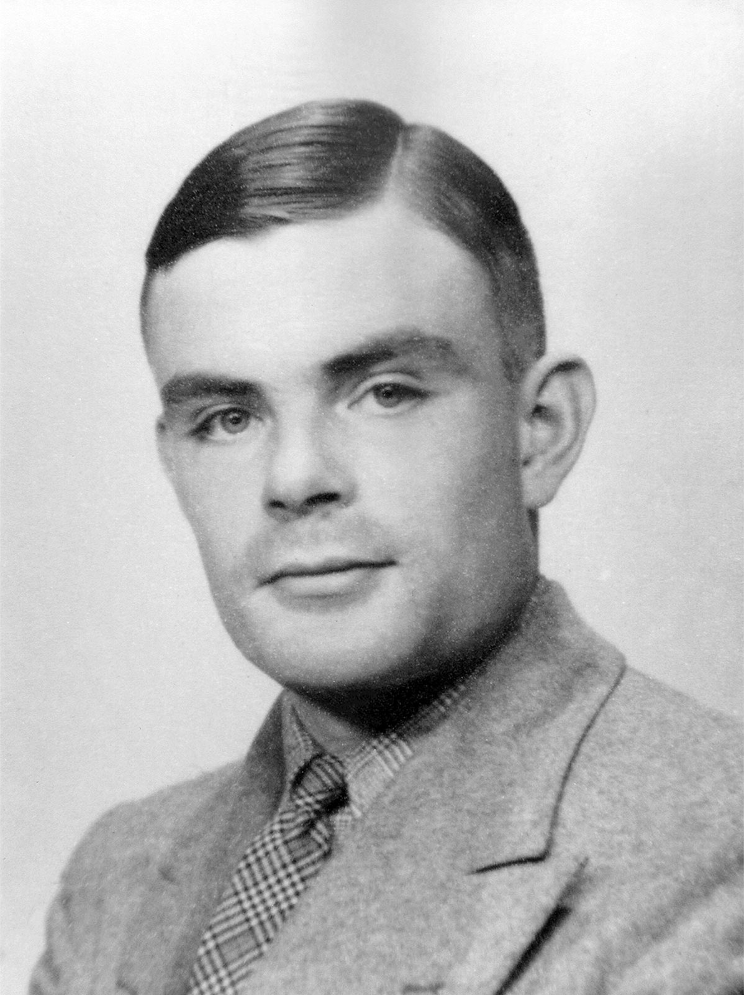
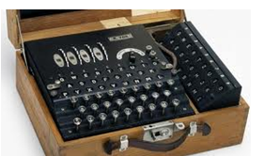
CAN YOU CRACK THE CODE?
There is a long history of mathematicians being used in code making and code breaking - the most famous is probably the Bletchley Park code breakers, where some of the most brilliant mathematicians in the country such as Alan Turing worked in secret to crack the German WWII Enigma code.
The code was so complicated that the Germans were confident that it was unbreakable, however the men and women at Bletchley Park were able to crack it using incredible ingenuity. This meant that the allies were able to intercept and understand German communications – a huge breakthrough in the war.

Slide 2
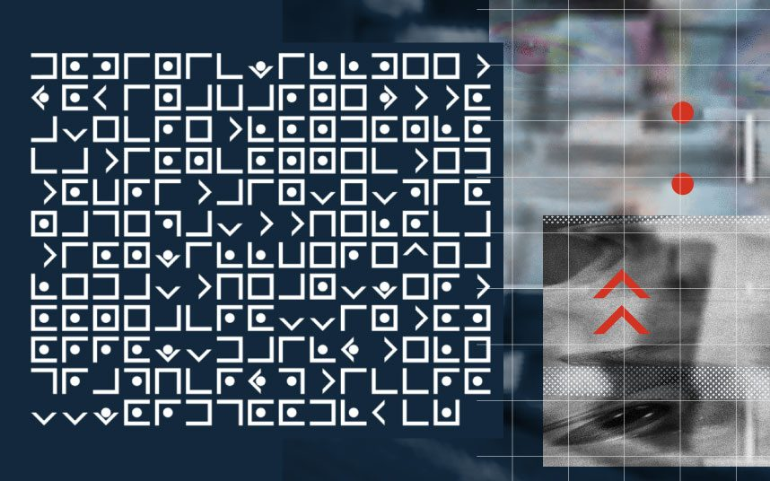
Codes now play an integral part in all our lives - from the ISBN codes on the back of every book you buy, to the algorithm that checks if the credit card you've entered is genuine, from the encrypted data sent via the internet to the content you watch on digital TV.
In the next few weeks, I will introduce you to different types of code.
See if you can crack the codes to decipher the messages.
Send your solution to me, and I’ll send you a new code.
If you are a confident codebreaker have a go at these online challenges:
http://ibmathsresources.com/code-challenge/
The solution to the first code gives you the password to access the next puzzle, there are 5 to solve in total in each set.
Let me know how far you get – take a photo and email me!
This code appeared in The Telegraph newspaper in November last year. The first 20 people to solve it were invited to a secret party!

Slide 3
Caesar Shifts
The Caesar Shift is one of the most simple codes in cryptography. It is a substitution code, which means that each letter is replaced with another one. The code is named after the Roman Emperor Julius Caesar who used this method to send military messages to his army.
To encrypt or decrypt a Caesar shift we first list the alphabet, and then for a Caesar shift of three, we move every letter of the alphabet 3 places:
Caesar shift codes can be easily broken. If you count the frequency of each of the letters in the code, you can then compare these frequencies with how often they appear in English.
Here we would decode A as X, B as Y etc.
So KHOOR translates to HELLO
VOCABULARY
Cryptography, or cryptology, is the practice and study of hiding information. It is sometimes called code, but this is not really a correct name. It is the science used to try to keep information secret and safe.
In a long message the letter which appears the most we would expect to correspond to the letter E.
If that fails, try T or A.

Slide 4
CAESAR SHIFT
Use Caesar shifts to decode these messages:
BRX QHHG D GLIIHUHQW VKLIW IRU WKH QHAW WZR FRGHV
ZLKDOXQRIXQFLKP VLR EXSB ZOXZHBA QEB ZXBPXO PEFCQ ZLAB
DOHA PZ AOL MPMAO AYPHUNBSHY UBTILY
Send your solutions to me to receive the next code.
Feel free to send me a coded message using a Caesar shift. I love cracking codes!!

