Slide 1
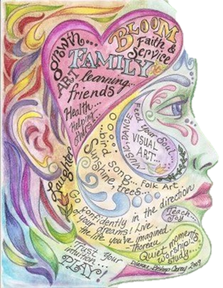
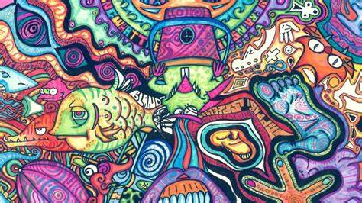
HEBBURN COMPREHENSIVE SCHOOL ART CHALLENGE
TRANSITION YR6 TO YR7

Slide 2
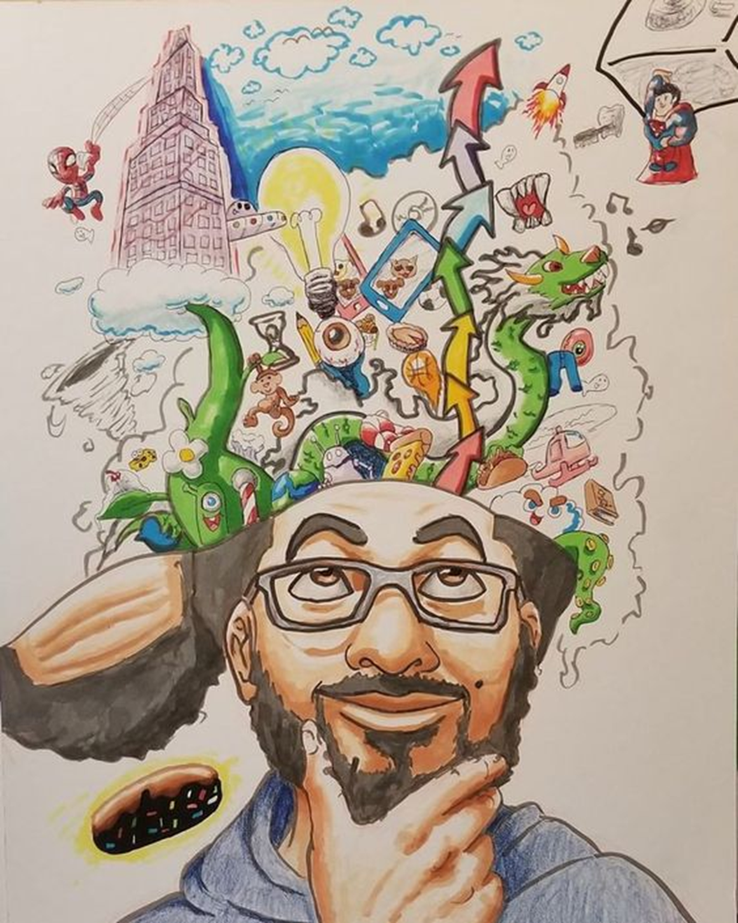
THIS ART CHALLENGE IS FOR FUN BUT ALSO TO EXPRESS WHAT IS GOING ON IN YOUR HEAD AT THE MOMENT.
WE WANT TO KNOW WHAT MAKES YOU TICK. SHARE SOME OF YOUR THOUGHTS AND FEELINGS ABOUT LIFE.
WE WANT YOU TO FILL THE TEMPLATE OF THE HEAD OR DRAW YOUR OWN AND SHARE THINGS WHICH ARE IMPORTANT TO YOU.
THIS MAY BE ABOUT FAMILY, ASPIRATIONS, DREAMS FOR THE FUTURE, HOBBIES, PASSIONS, WORRIES AND HAPPY MEMORIES.
DON’T WORRY ABOUT BEING JUDGED ON YOUR ART, WE WANT YOU TO DOODLE, SKETCH AND USE WHATEVER ART MATERIALS YOU HAVE AT HAND. A PEN IS A GREAT START BUT IF YOU HAVE COLOURS, PAINT AND GLUE WE WOULD LOVE YOU TO USE THEM.
PLEASE LOOK AT THE FOLLOWING ARTISTS TO GET IDEAS THEN DO ONE IMAGE OF YOUR OWN.
GOOD LUCK AND HAVE FUN!

Slide 3
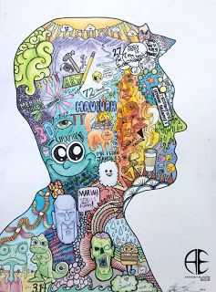
Both these artists are telling us things about them….
IT MAY BE ABOUT THE PLACES THEY HAVE BEEN, HOLIDAYS, FAMILY, WHAT THEY ARE GOOD AT, SPORT, WHAT THEY LIKE TO EAT OR DON’T LIKE TO DO.
THEY HAVE USED WORDS, PICTURES, LOGOS AND COLOURS TO DO THIS.
What could you have in your picture?
Start by making a list and then plan where they will be placed in the head template.

Slide 4
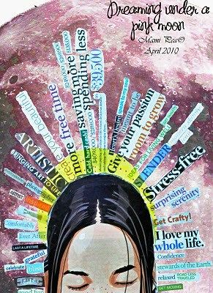
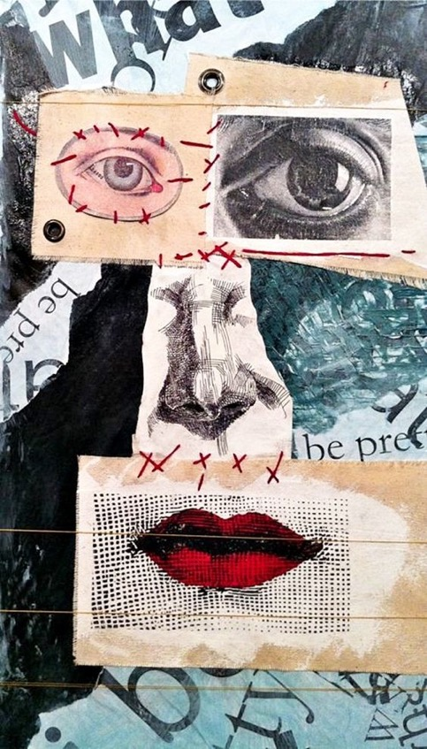
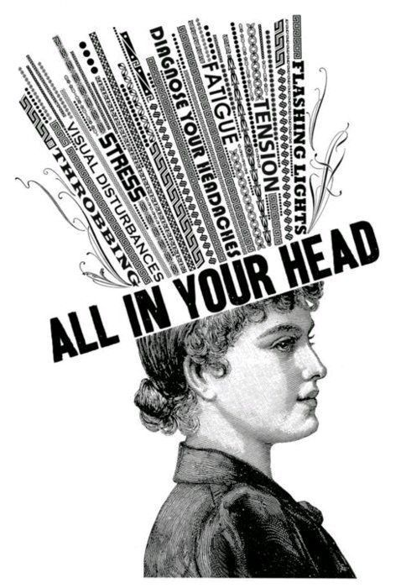
You may want to use collage and glue papers together to create an interesting face.
If you prefer to stick to black and white you can create a dramatic image like this.
You could also use words and messages. Cut out from magazines, newspapers or print words if you have access to a printer and computer. If not, you can write on using different fonts.
You may want to express something about you which is about your personality and your thoughts about moving to secondary school.

Slide 5
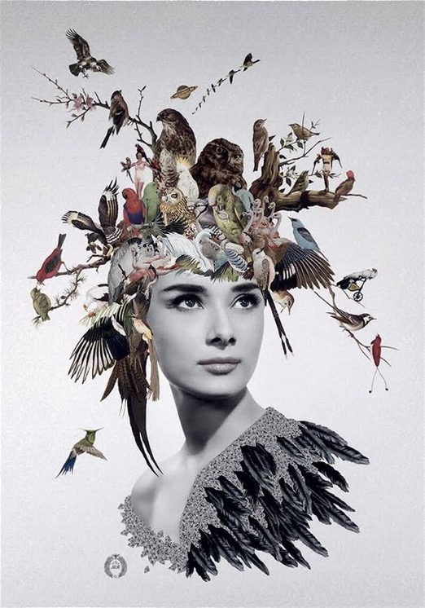
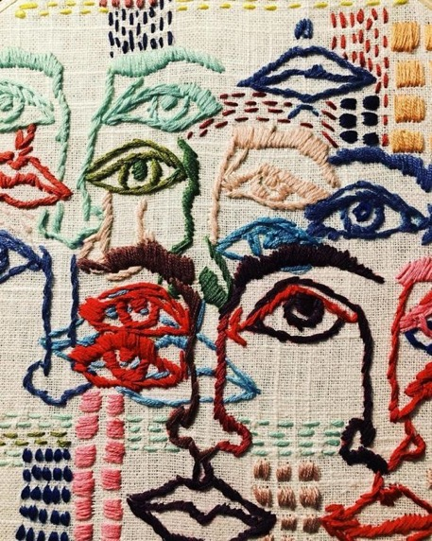
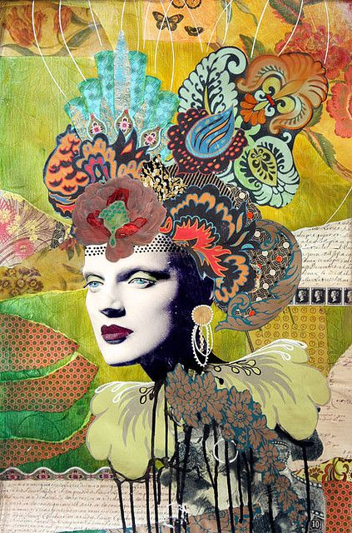
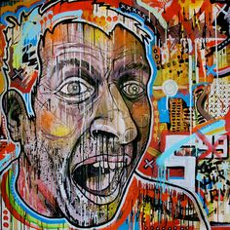
Think about using colour, coloured papers, wallpaper collage and make an image which tells me something about you.
It could be theatrical and fill the whole page with information.
If you can sew or use craft techniques you can use these in your work.
This artist has sewn into material to create these overlapping faces.
If you like expressive text and words like graffiti, use this in your work. You may have a tag or want to use an artists work you follow online. Try to add something about yourself to this.
The image above is decorated with bird life. What theme could you use? If you like fishing then add images of fish and fishing equipment. If you like scootering add scooters. If you love eating add lots of images of your favourite food.

Slide 6
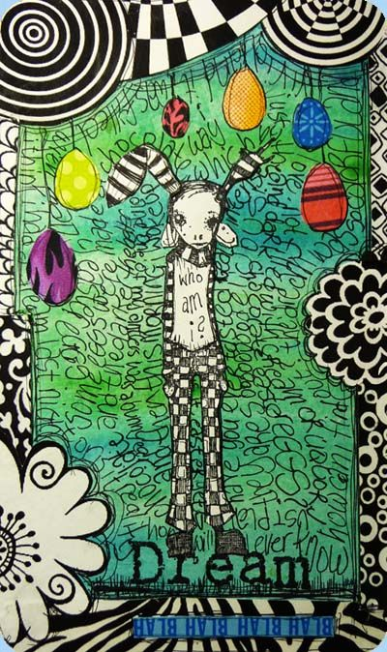
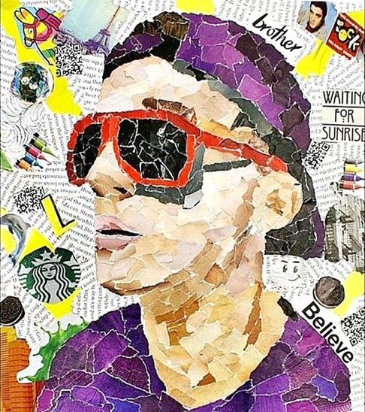
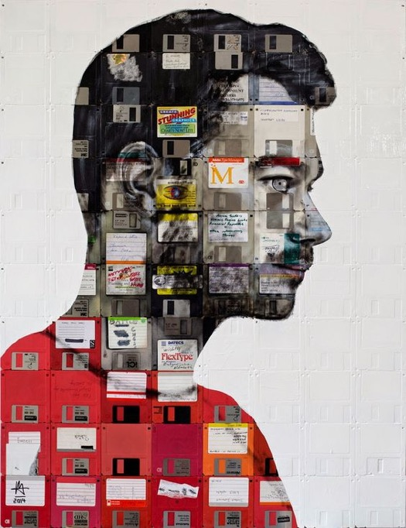
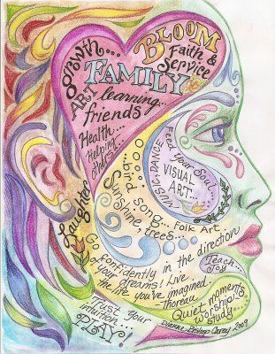
What do you like about this work?
Can you use any ideas from these in your own work?
The image below has used old sim cards to collage with.
The image below is a lovely example of something you could do. This artist has used words and phrases with coloured pencils. You could do this too on the templates provided.
The image above has used collage to create the colours and textures. Rip up free newspapers and magazines from the supermarket for your art work.
You might also find images to add on from packaging and advertisements.
Your work can be an expression of what you feel about things. You may want to use words to songs or poems or make up your own.

Slide 7
TEMPLATES TO USE
Use the templates or draw your own.
Cut out and work into.
Please save all your work and bring into Hebburn Comprehensive school in September. Make sure your name is on it.
We really look forward to meeting and working with you.
Have a safe and restful summer.

Slide 8
Use the template if you want to collage onto the silhouettes.

Slide 9
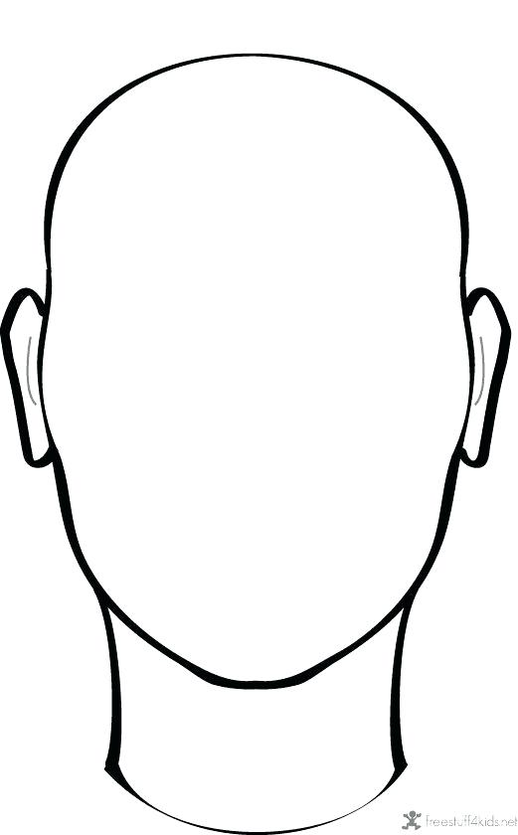
More templates to add your art onto.

Slide 10
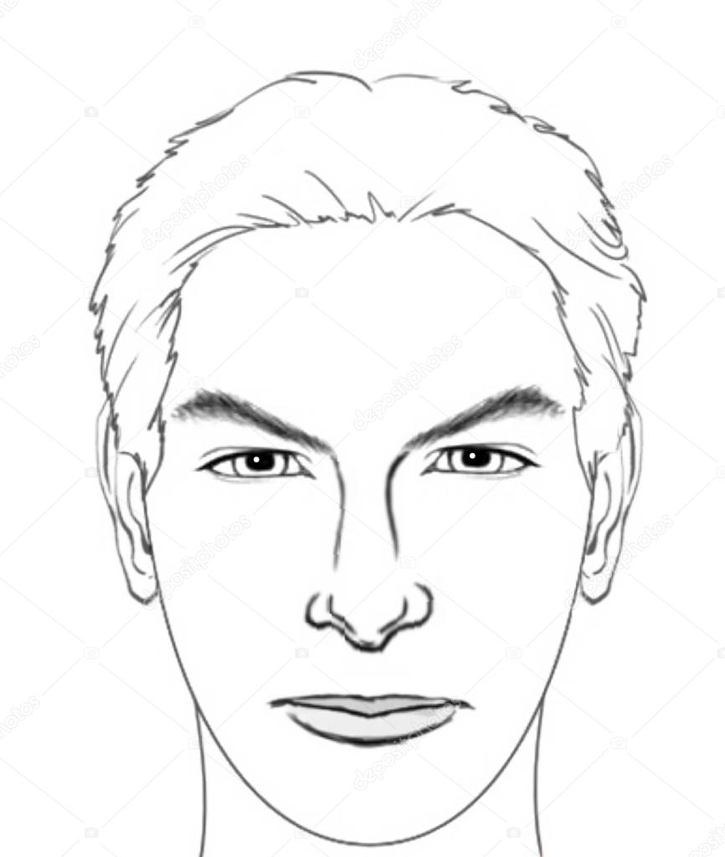
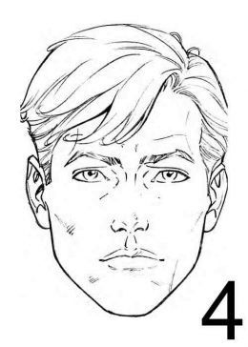

Slide 11
