Slide 1
Writing your CV
T: 020 7587 1842
W: literacytrust.org.uk
Twitter: @Literacy_Trust
Facebook: nationalliteracytrust

Slide 2
Writing your CV
Learning objectives:
I understand what is expected in a CV
I can begin to draft my own CV
I can write a personal statement to make my CV stand out

Slide 3
What is a CV?
CV = curriculum vitae
Latin [noun]: course of life
Most jobs will request a CV as part of the application
A CV acts as an advert for yourself, your experience, education and ambitions
You should update your CV often – even when you’re not looking for a job
Before you send off your CV, it should be tailored to match the job you are applying for

Slide 4
CV quiz
Quick quiz!
Note down your answers to these questions and then mark yourself with the answers on the next slide.
On average, how many applicants are invited to an interview?
Everyone who applied
The 2 they liked best
About 4 – 6 people
How long does a recruiter spend reading a CV?
7 minutes
7 seconds
7 hours
How many people apply for each job advert (roughly)?
8
81
118

Slide 5
CV quiz
Quick quiz!
Tick or correct your answers.
Lots of people apply for every job advert – so that’s a lot of CVs to look at. Making sure your CV is just what a recruiter is looking for will help you throughout your career!
On average, how many applicants are invited to an interview?
Everyone who applied
The 2 they liked best
About 4 – 6 people
How long does a recruiter spend reading a CV?
7 minutes
7 seconds
7 hours
How many people apply for each job advert (roughly)?
8
81
118
Notes:
According to online recruiter ‘The Ladder’, recruiters spend an average of 7 seconds per CV. (https://www.theladders.com/career-advice/you-only-get-6-seconds-of-fame-make-it-count).
Recruiters, Collingwood Search, found that on average, 118 people apply for a given job advert (https://www.collingwoodsearch.co.uk/our-insights/recruiting-retaining-talent/15-interesting-recruitment-facts/)
Although there have been examples of much higher figures: CV Library records statistics on applications and some posts have over 4,000 applicants for one vacancy (https://www.cv-library.co.uk/recruitment-insight/top-jobs-1000-applications-2/)

Slide 6
What should be on my CV?
Task: mind map ideas as to what you should include in a CV
grades
CV
name

Slide 7
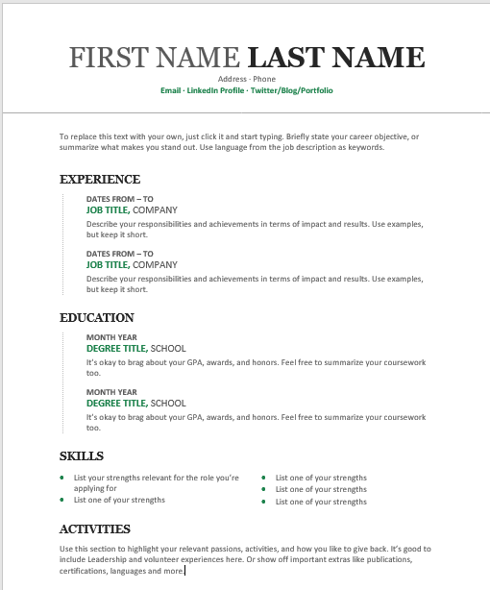
CV example
Add anything you have missed to your mind map.
Tip: This list is in order of importance!
Name - include both your first and surname.
Contact details – include a professional work email address.
Personal statement – use this space to talk about yourself and why you are applying for the position.
Education - chronologically highlight any educational qualifications.
Work experience – chronologically (most recent first) detail any work or volunteering experiences.
Skills – include skills you have developed that are relevant to the job.
hobbies – include this only if it is relevant to the application.
Notes:
Each section appears in the order it should be on a CV.
It might be useful to discuss what students feel is more important – education or qualifications. As a general rule, education/qualifications would be placed higher in a CV until relevant professional experience is gained.
Skills should be soft skills such as ‘communication’ ‘leadership’.
Hobbies can be included if it is relevant to the post. For example applying for teacher training and including voluntary clubs.

Slide 8
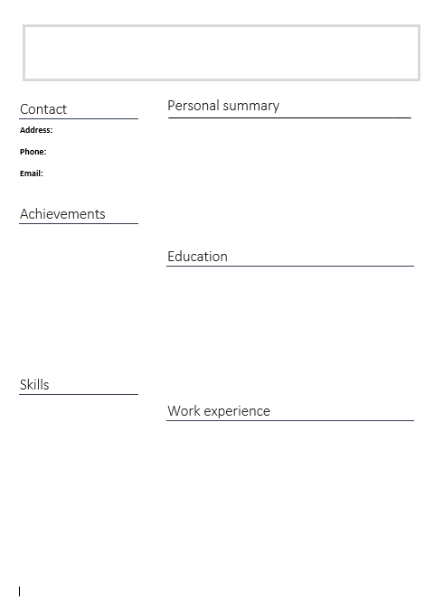
Drafting my CV
Use the template to make notes and draft your own CV.
Top tips:
It should be 1 side of A4 (even if you’re the CEO)
Create a new email if you don’t have a professional one
Be positive
Add all of your qualifications including short courses and certificates
Add skills you have learnt at school or clubs/teams
Showcase projects or responsibilities you are proud of (sports captain, prefect, student ambassador, director in your drama group)
It must be accurate – proofread it every time!
Don’t tell any fibs!
You don’t need to include personal information such as house number, gender, birthday or a photo
As you gain more work experience you may want to move it above qualifications.
Notes:
A CV should be 1 side of A4 – no matter how far into a career someone is. This makes it much easier for digital recruiting processes – A 1-page Word document will fit easily onto a tablet/phone/laptop screen, meaning an employer or recruiter will not miss out on important information on the second page.
List all qualifications including short courses/half GCSEs and extra-curricular qualifications, such as First Aid, Duke of Edinburgh etc.
Encourage students to consider the skills they have developed through out-of-school clubs and groups, or responsibilities, such as parent’s evening helpers, library assistants, reading mentor programmes, prefect/student council etc.
This task can be used for peer/self-assessment to highlight the importance of proofreading a CV
A CV does not need to contain personal information – full name, contact email and telephone number is enough.

Slide 9
Personal statement
A personal statement is a brief overview of you and your skills. It sits just below your name and contact information. This should be short and snappy to really sell yourself and ensure a recruiter reads your CV.
Include
Who you are
Why you are suitable for the role and the value you can add
Your career goals and aims
Rules
No longer than five sentences
Use the buzz words used in the job ad
Make sure it is specific to the job you are applying for

Slide 10
Personal statement
Task: Read these two personal statements. Which one do you think is the best and why?
Example two
Example one
A highly motivated and hardworking individual, who has recently completed their A-Levels, achieving excellent grades in both Maths and Science. Seeking an apprenticeship in the engineering industry to build upon a keen scientific interest and start a career as a maintenance engineer. Eventual career goal is to become a fully-qualified and experienced maintenance or electrical engineer, with the longer-term aspiration of moving into project management.
Dancing has been my passion for a long time, I recently achieved my grade 7 in ballet and have previously gained grade 6 in tap dancing. I enjoy dancing because it helps me get fit and allows me to hang around with my friends. I also like wearing the pretty costumes when we put on a performance. I also enjoy business administration.
Make notes or discuss with your group how you could improve one or both of these personal statements.
Notes:
Neither of these are perfect examples, and a balance needs to be found between the two. Example 1 is much more formal and has focussed on skills and experience, but is not very specific in terms of achievements and goals. Example 2 is more informal, however for students applying for their first role they may wish to showcase their achievements in their hobbies.
Students could rewrite one or both to improve these personal statements.

Slide 11
Writing a personal statement
Task: You’re now going to write your own personal statement.
If you can, ask someone to proofread your personal statement to make sure you aren’t caught out by spelling or grammar mistakes!
Top tips:
No more than five lines
Use buzzwords you see in the job advert
Show off your skills
Show off your ambition
Include the company name and/or job title
Summarise why you think you’ll be great for the job!

Slide 12
Plenary - quiz
Test your CV knowledge:
CV can be translated to:
My job journey
Course of life
Story of my life
How long does a recruiter spend reading a CV?
7 minutes
7 seconds
7 hours
How many pages should a CV be?
1
3
Depends
A personal statement should be:
No more than 5 sentences
No more than 5 words
No more than 5 lines
It’s OK to lie on a CV to get an interview
True
False
Should Rachel use her email: gigglebox07@loveemail.com on a CV?
No – get a more professional account to add to CVs and applications
Yes – if that’s your main email address it’s fine.

Slide 13
Plenary - quiz
Tick or correct your answers.
CV can be translated to:
My job journey
Course of life
Story of my life
How long does a recruiter spend reading a CV?
7 minutes
7 seconds
7 hours
How many pages should a CV be?
1
3
Depends
A personal statement should be:
No more than 5 sentences
No more than 5 words
No more than 5 lines
It’s OK to lie on a CV to get an interview
True
False
Should Rachel use her email: gigglebox07@loveemail.com on a CV?
No – get a more professional account to add to CVs and applications
Yes – if that’s your main email address it’s fine.

